Slide 1
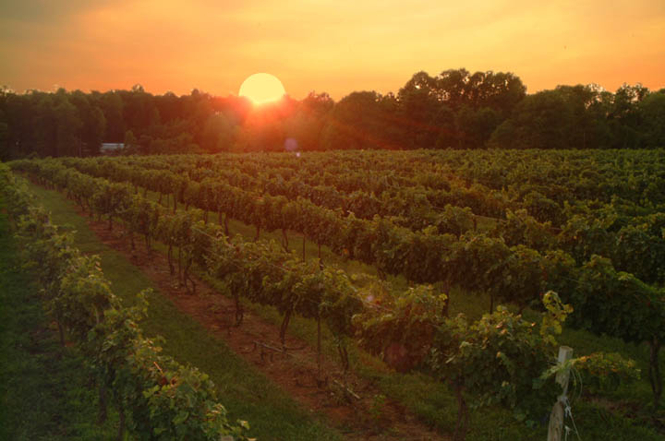
Laborers in the Vineyard
Matthew 20:1-16
Jesus used many commonplace things to teach spiritual lessons
Richie Thetford www.thetfordcountry.com

Slide 2
Householder went out to HIRE Laborers
Offered an incentive to get men to work in his vineyard
Did not try to scare men into his vineyard
Did not try to force men into his vineyard
Wanted volunteers
Agreed to give them wages if they would work in his vineyard
Richie Thetford www.thetfordcountry.com

Slide 3
Householder went out to HIRE Laborers
Jesus wants us in His vineyard
Matthew 11:28-30
Those outside Christ will not find rest
Revelation 22:14
To get into the vineyard of Jesus we must do His commandments
Matthew 7:21
Richie Thetford www.thetfordcountry.com

Slide 4
Householder went out to hire LABORERS
He did not want loafers
John 9:4
Our opportunity for work will soon be gone
1 Corinthians 15:58
Philippians 2:12
Christians must work it out!
James 2:14, 17, 26
Richie Thetford www.thetfordcountry.com

Slide 5
Householder went out to hire Laborers INTO HIS VINEYARD
Makes a difference where the work is done
Must be done in the right vineyard
Must look to the one for whom we work for
Colossians 3:17
The faithful Christian ensures that they are working in the Lord’s vineyard
Richie Thetford www.thetfordcountry.com

Slide 6
The Laborers Went at the FIRST Opportunity
Worked in the vineyard at different hours
They did NOT turn down the invitation
All are encouraged to obey the Master’s call at the very first opportunity
Some refuse to come to Jesus
Some wait until it is eternally too late
Don’t let this opportunity pass you by!
Richie Thetford www.thetfordcountry.com

Slide 7
Laborers in the Vineyard
Remember these four great lessons:
The householder went out to HIRE laborers
The householder went out to hire LABORERS
The householder went out to hire laborers INTO HIS VINEYARD
The laborers went at the FIRST opportunity
Won't you volunteer now to
labor in the vineyard of Christ?
Richie Thetford www.thetfordcountry.com

