Slide 1
Knowing Each Other in HEAVEN
Richie Thetford www.thetfordcountry.com

Slide 2
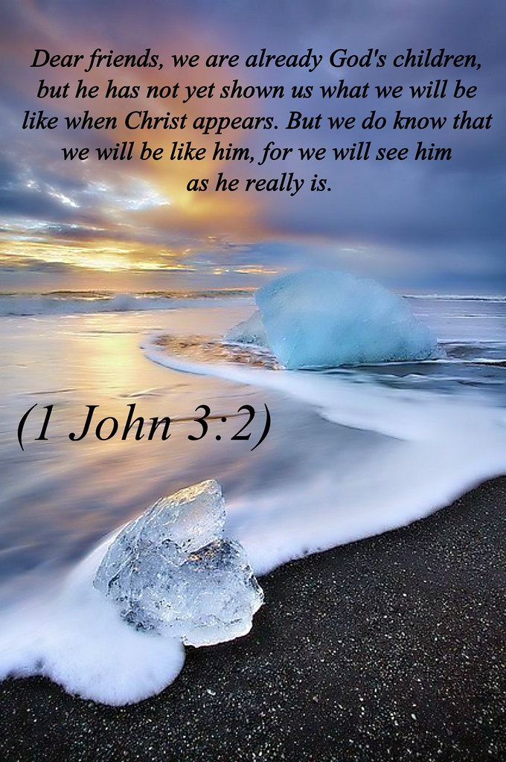
We Will Be Like the Lord
Seeing Him as He is
1 John 3:2
Our bodies will be changed
1 Corinthians 15:50-54
Richie Thetford www.thetfordcountry.com

Slide 3
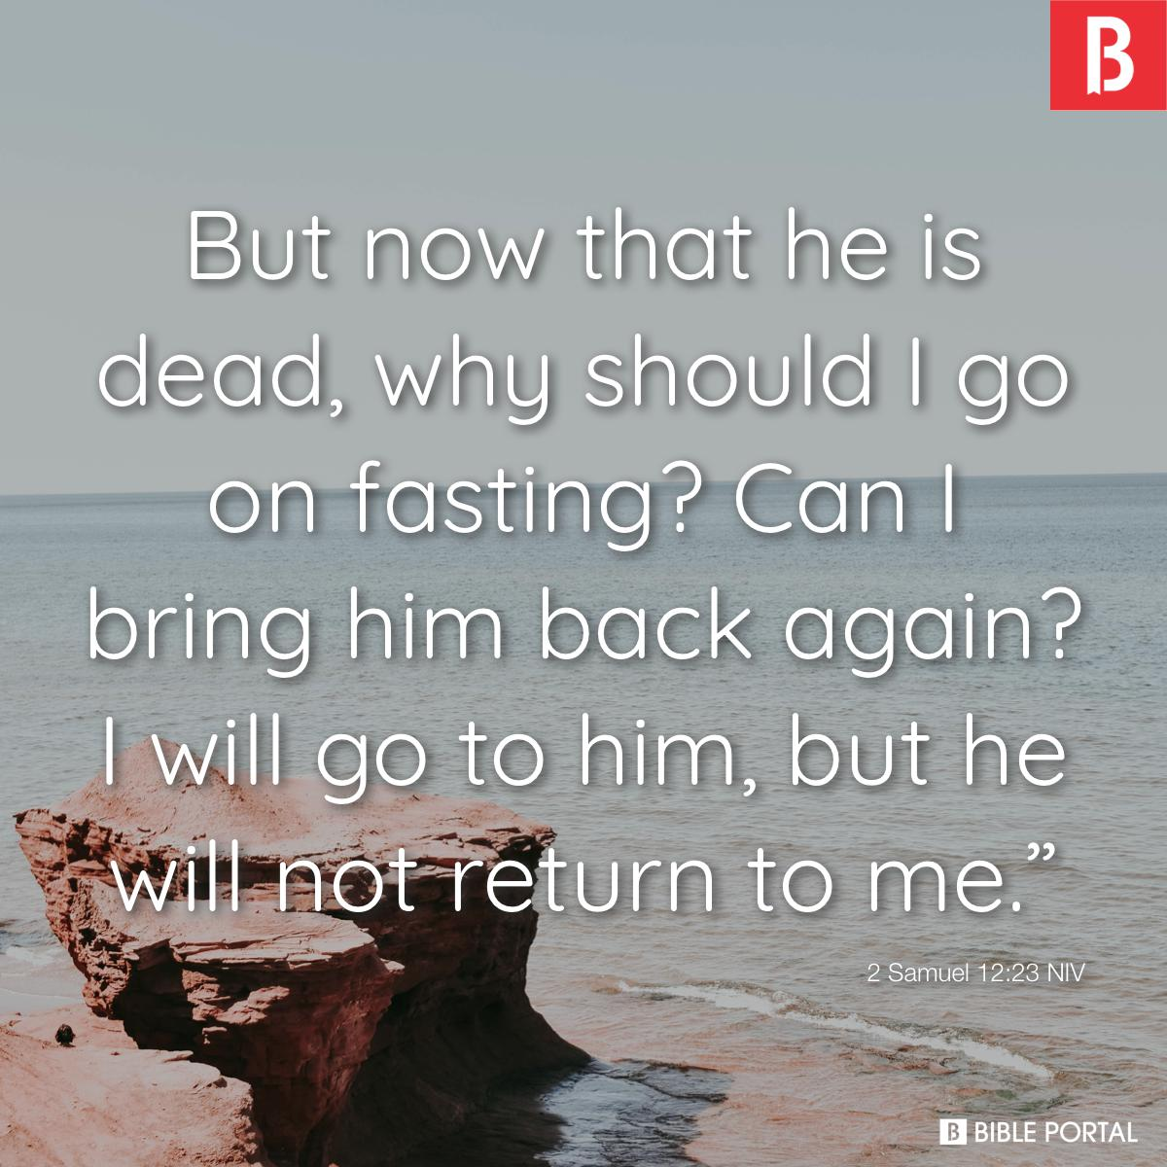
David’s Statement
“I shall go to him”
2 Samuel 12:23
Richie Thetford www.thetfordcountry.com

Slide 4
Description of the Kingdom
Jesus’ description
Matthew 8:11-12
A personal recognition
Blessedness enjoyed
Richie Thetford www.thetfordcountry.com

Slide 5
Recognizing Others
Individuals retain their identity
Luke 16:19-31
Recognized Abraham
Jesus’ teaching about the resurrection
Matthew 22:31-32
Shows identity and personal recognition
Richie Thetford www.thetfordcountry.com

Slide 6
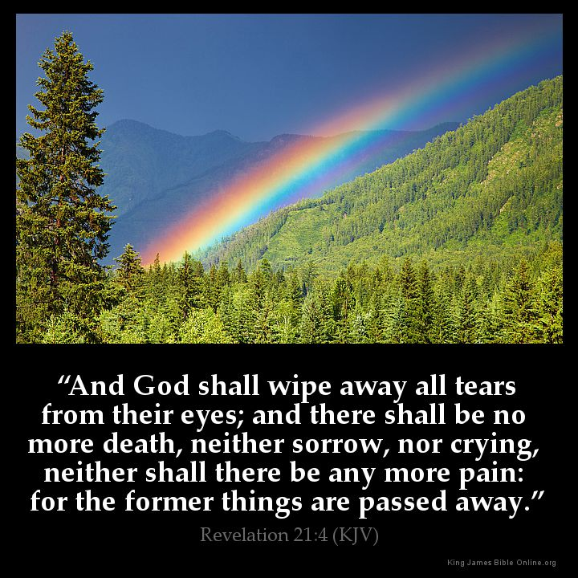
Eternal Happiness
Not dependent on who is present or absent
We do not love those close to us any more than God does
Appreciate God’s plan
Never limit our concept of heavenly joy
Revelation 21:4
Richie Thetford www.thetfordcountry.com

Slide 7
Conclusion
Great comfort in our assurance
1 Thessalonians 4:13-18
The reunion that is affirmed
The joy that will occur at such a time
The comfort that is made possible
Richie Thetford www.thetfordcountry.com

