Slide 1
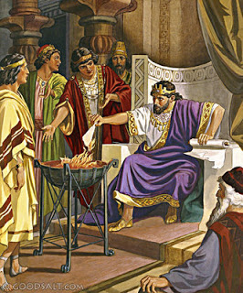
King Jehoiakim
2 Kings 23:36-37
Richard Thetford www.thetfordcountry.com

Slide 2

Characteristics of Jehoiakim’s Reign
Extortion, oppression, dishonesty, injustice
  Jeremiah 22:13-17
  Our responsibility
    James 1:27
Richard Thetford www.thetfordcountry.com

Slide 3
Characteristics of Jehoiakim’s Reign
Threatening and killing prophets
  Jeremiah 26:2-5, 12-15
  Our responsibility
    Galatians 4:16
Richard Thetford www.thetfordcountry.com

Slide 4
Characteristics of Jehoiakim’s Reign
Disregard for God’s Word
  Jeremiah 36:2-6, 21-23, 27-32
  Our responsibility
    John 17:17; Revelation 22:18-19
    Isaiah 40:8; Hebrews 4:12
Richard Thetford www.thetfordcountry.com

Slide 5

Jehoiakim’s End Was Tragic
Jeremiah 22:18-19
Let us NOT suffer the same fate!
2 Thessalonians 1:6-10
Richard Thetford www.thetfordcountry.com

