Slide 1

The Joys of Worship
Psalms 84

Slide 2
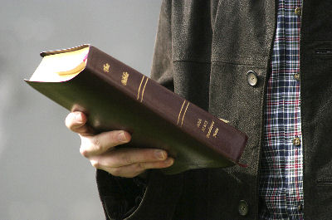
The Joys of Worship
David’s love for God’s house (1-3)
  God’s tabernacles are lovely
    Matthew 18:20
  David longed to worship God
    Psalms 122:1
    Psalms 42:1-2
  Thirst for worship should
  be our attitude
    Matthew 5:6
    Hebrews 10:25

Slide 3

The Joys of Worship
Blessings of God’s Servants (4-7)
  Man of God is blessed
    1 Peter 2:5
    Romans 12:12
    Philippians 4:4-5
  His strength is in the Lord
    Romans 8:28
    2 Timothy 2:19-21

Slide 4
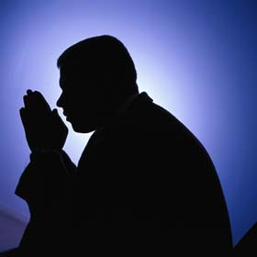
The Joys of Worship
His Prayer of Praise to God (8-11)
  Calls on God to hear his prayer
    Ephesians 3:20
    Philippians 4:6
    1 Thessalonians 5:17-18
  Praises God for being able
  to come before His throne
  God is his protection
    Genesis 15:1; Psalms 115:9
    Ephesians 6:16

Slide 5

The Joys of Worship
We Must Trust God (12)
  Happy is the man who does trust God
    2 Timothy 1:12
    Hebrews 11:6
    1 John 5:4-5

Slide 6
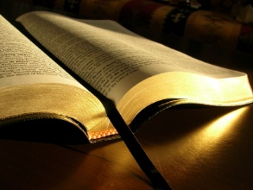
The Joys of Worship
Worship
is a great joy
for the true child of God!

