Slide 1
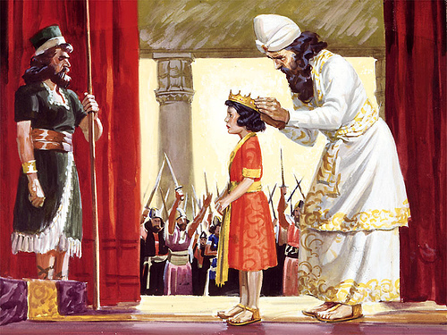
King Josiah
2 Chronicles 34:1-3
Richie Thetford www.thetfordcountry.com

Slide 2
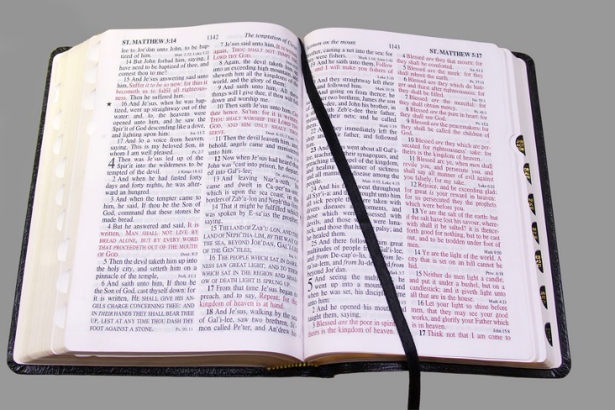
Lessons Learned From Josiah
We do NOT have to act like our family members
Manasseh
2 Kings 21:9-11
Amon
2 Chronicles 33:21-23
Just because our ancestors did not do what was pleasing to God, that we too must follow their paths
Richie Thetford www.thetfordcountry.com

Slide 3
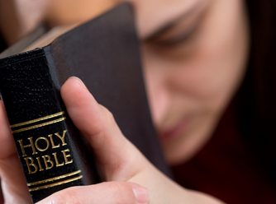
Lessons Learned From Josiah
Young people do a lot in service to God
Josiah became king at age 8
He began seeking the Lord at age 16
2 Chronicles 34:3
Solomon
Ecclesiastes 12:1
Paul
1 Timothy 4:12
Young people can do many things
for the cause of Christ
Richie Thetford www.thetfordcountry.com

Slide 4
Lessons Learned From Josiah
God had confidence in Josiah – even before he was born
God knows all things
1 Kings 13:1-2
Fulfillment came years later
2 Kings 23:15-16
Good if God had that much confidence in us
God knows whether this world will be better because you and I came this way
Richie Thetford www.thetfordcountry.com

Slide 5
Lessons Learned From Josiah
Josiah loved the word of God
Told of his love
2 Kings 23:24
2 Chronicles 34:19
He read the words of God to the people
2 Kings 23:2-3
Josiah was determined to restore true religion
Knew he must put into action God’s plan
2 Chronicles 34:19-21; 35:1-3
Richie Thetford www.thetfordcountry.com

Slide 6
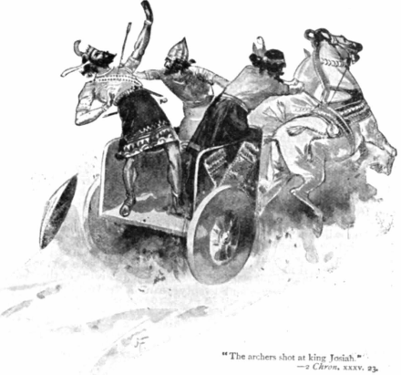
Lessons Learned From Josiah
Sometimes bad things happen to good people
Although a good man – he still made a bad choice
2 Chronicles 35:20-23
Richie Thetford www.thetfordcountry.com

Slide 7
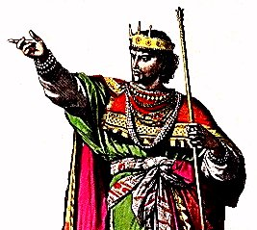
Lessons Learned From Josiah
Our children will not always follow in our footsteps
The sons of Josiah did NOT follow his love of God
Jeremiah 36:28-30
2 Kings 23:31-32; 23:36-37; 24:8-9
Richie Thetford www.thetfordcountry.com

Slide 8
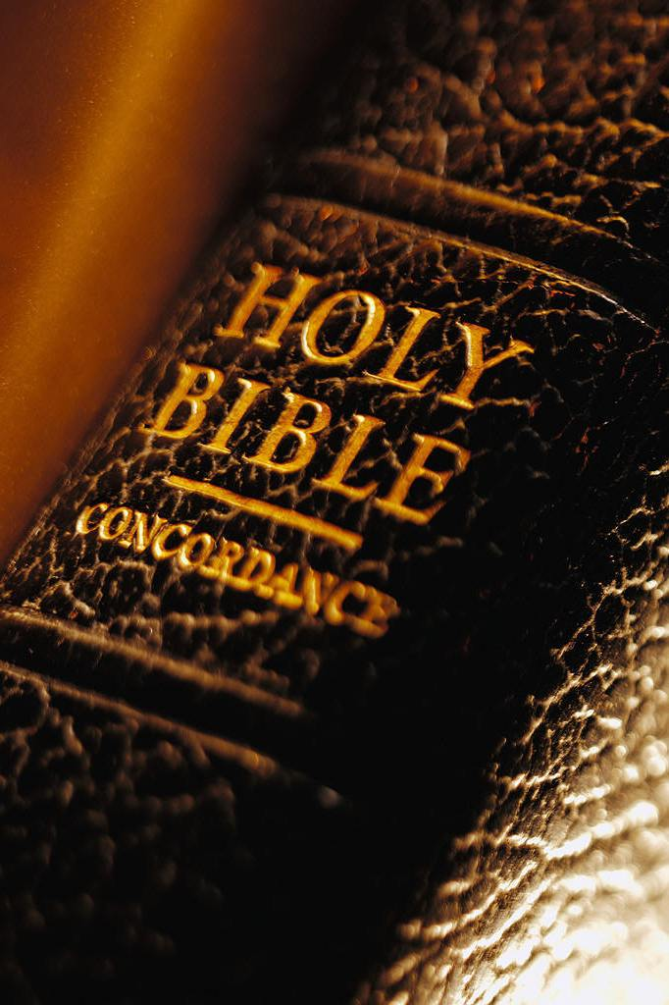
Truths Learned
Must realize that no life is lived correctly without God
Must seek God while we are young
Must make a difference for good in the world
Must stand opposed to religious error
Must restore the truth of God’s Holy Word
Restoration is an on-going process – can end rapidly
Our children might not appreciate where we stood
Must please God in all aspects of our life
We should be bothered when error is running rampant
Richie Thetford www.thetfordcountry.com

