Slide 1
joshua
Joshua 1:1-9
Richie Thetford www.thetfordcountry.com

Slide 2

Joshua – god’s chosen leader
Sincere trust in God
Proved himself to others
  Deuteronomy 31:1-8, 23
Faithful
  Numbers 32:6-13
Richie Thetford www.thetfordcountry.com

Slide 3
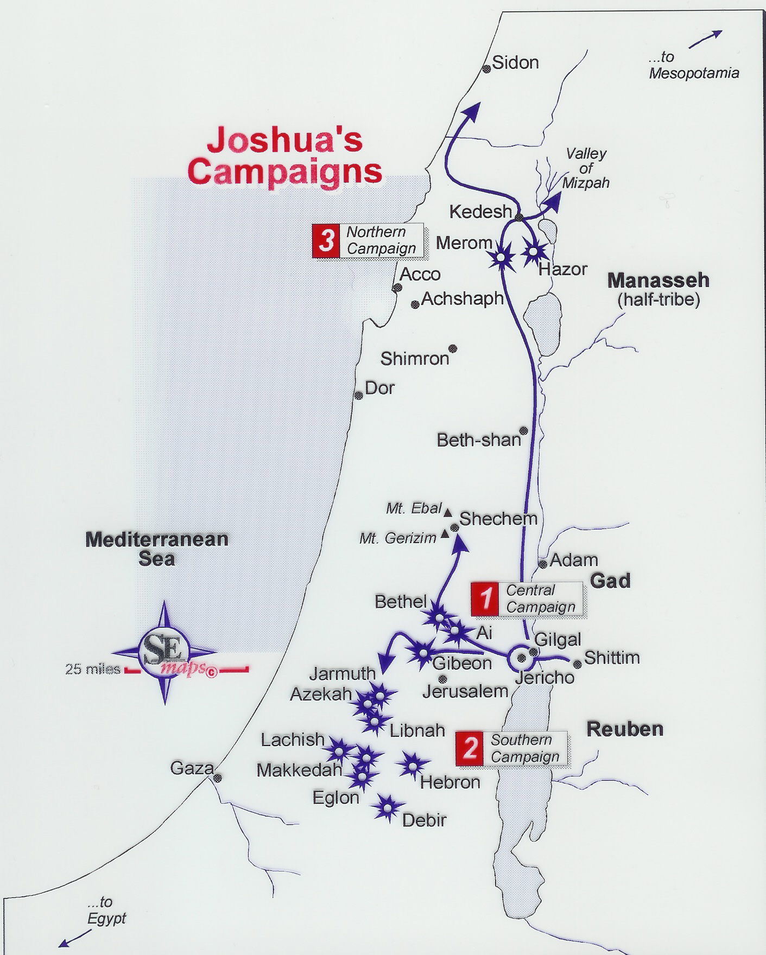
God
was leading
the way!
Richie Thetford www.thetfordcountry.com

Slide 4

Joshua – god’s chosen leader
Had a reverence for God
  Numbers 14:1-9
Servant of God
  Joshua 24:14-15
Richie Thetford www.thetfordcountry.com

Slide 5
Joshua
Lessons Learned From
When God needs a leader – He chooses one who has proven to be dependable
God’s promises are always conditional
The book of the law of God was primary
“But as for me and my house, we will serve the LORD”
Richie Thetford www.thetfordcountry.com

