Slide 1
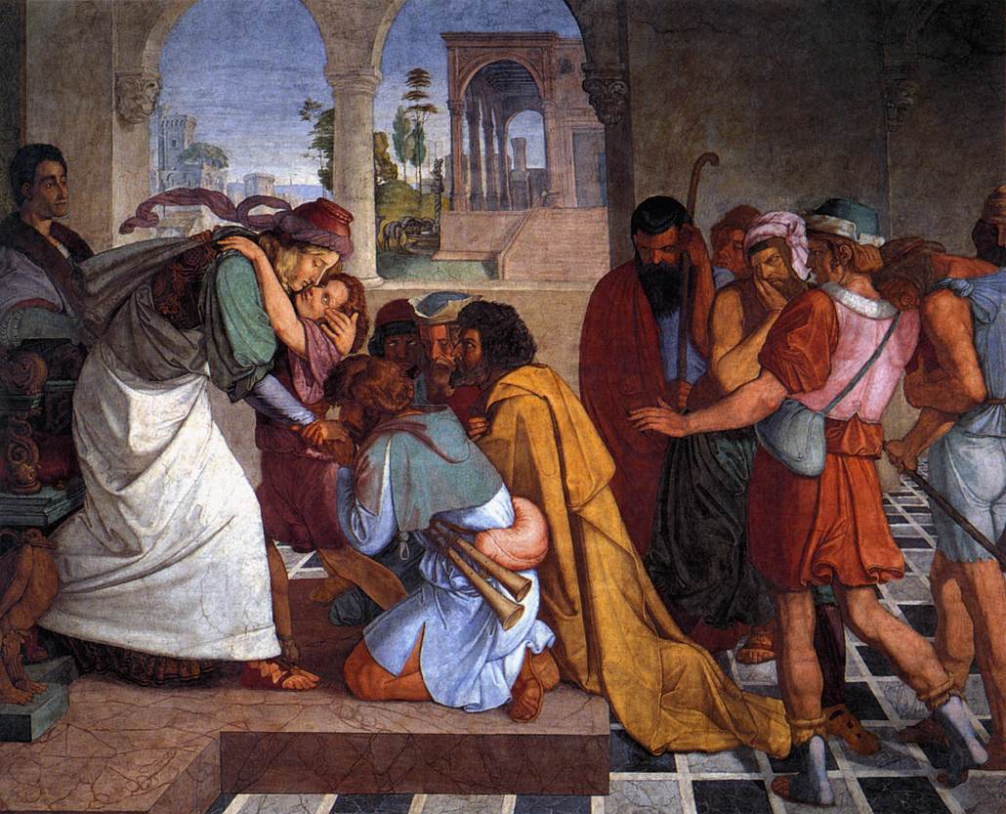
JOSEPH: God’s Successful Servant
Genesis 39:1-2
He was one of the most admirable characters in the Old Testament

Slide 2
Joseph’s Characteristics
Physical attractiveness
Genesis 39:6
Unblemished character, integrity
Firm trust in God
Leadership ability
Genesis 39:4, 6, 22-23; 41:40-41
Wisdom
Genesis 41:39

Slide 3
Joseph’s Characteristics
Ability to make the best of unpleasant circumstances
Ability to “forgive and forget”
Active concern for his relatives
Humility
Genesis 40:8; 41:16, 51-52

Slide 4
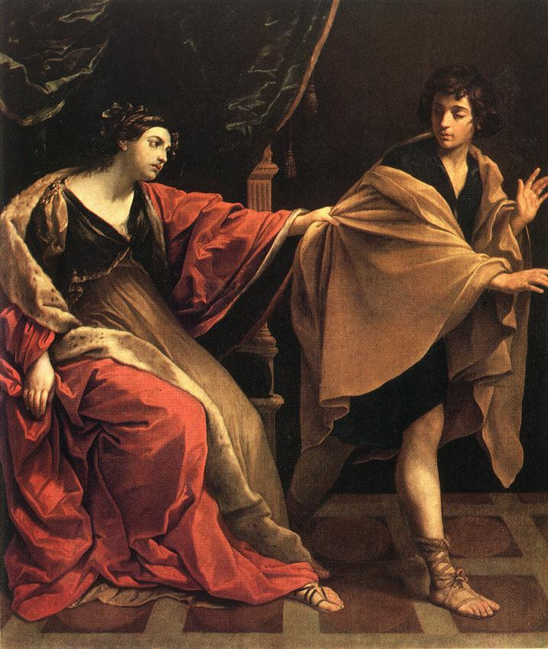
Joseph’s Character
Temptation to commit fornication
He refused!
Genesis 39:8-9
Joseph chose to submit to His God

Slide 5
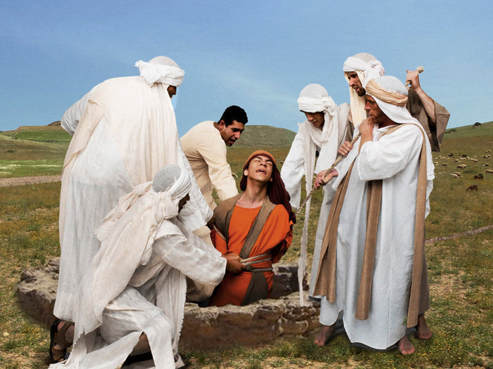
Joseph’s Character
His treatment of his brothers
Refused to seek revenge!
Genesis 50:19-21
Relied on the principle that revenge belongs to God
Romans 12:18-21

Slide 6
Joseph’s Character
He guided his conduct on the basis of sound standards of conduct and acted on principle, rather than impulse

Slide 7
Application to Christian Life
Acquire good guiding principles
Proverbs 3:5 Trust in the LORD with all your heart, And lean not on your own understanding;
1 Corinthians 6:20 For you were bought at a price; therefore glorify God in your body and in your spirit, which are God's.
1 Corinthians 15:33 Do not be deceived: “Evil company corrupts good habits.”

Slide 8
Application to Christian Life
Acquire good guiding principles
Proverbs 10:19 In the multitude of words sin is not lacking, But he who restrains his lips is wise.
Proverbs 22:1 A good name is to be chosen rather than great riches, Loving favor rather than silver and gold.
Proverbs 5:15 Drink water from your own cistern, And running water from your own well.

Slide 9
Application to Christian Life
Acquire good guiding principles
Proverbs 5:18 Let your fountain be blessed, And rejoice with the wife of your youth.
Hebrews 13:4 Marriage is honorable among all, and the bed undefiled; but fornicators and adulterers God will judge.
Matthew 6:21 For where your treasure is, there your heart will be also.

Slide 10
Application to Christian Life
Acquire good guiding principles
Matthew 6:33 But seek first the kingdom of God and His righteousness, and all these things shall be added to you.
2 Corinthians 9:6 But this I say: He who sows sparingly will also reap sparingly, and he who sows bountifully will also reap bountifully.
Romans 8:31 ……If God is for us, who can be against us?

Slide 11
Application to Christian Life
We need to remember our principles
Revelation 2:4-5
We need to apply our principles
Galatians 2:11-14
Joseph remained steadfastly true to his principles
He did not allow himself to be “sidetracked” by the impulse of the moment

