Slide 1
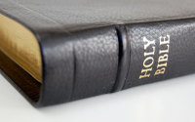
Jesus
“Closed the Book”
Luke 4:20
Richie Thetford www.thetfordcountry.com

Slide 2
Isaiah Prophesied:
Appointed to preach the gospel
Sent to heal the brokenhearted
Sent to preach deliverance to captives
Sent to recover the sight to the blind
Sent to set at liberty those being oppressed
To proclaim the acceptable year of the Lord
Richie Thetford www.thetfordcountry.com

Slide 3
Jesus
“Closed the Book”
All eyes were fixed upon Him!
“Today this scripture is fulfilled”
Richie Thetford www.thetfordcountry.com

Slide 4
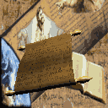
Jesus Fulfilled Prophecy
Isaiah left it incomplete
  Did not know when it would happen
Christ fulfilled it
  He “closed the book”
On Old Testament Prophecy!
Richie Thetford www.thetfordcountry.com

Slide 5
Jesus Completed the
Old Testament
Final chapters were fulfilled when:
  Jesus died, was buried, resurrected
  His church was established
Jesus “closed the book” on the
Old Testament
  Romans 7:1-6
  Hebrews 9:15-17
Richie Thetford www.thetfordcountry.com

Slide 6
Jesus Completed the
Old Testament
“having wiped out the handwriting
of requirements that was against us,
which was contrary to us. And He
has taken it out of the way,
having nailed it to the cross.”
Colossians 2:14
Richie Thetford www.thetfordcountry.com

Slide 7
Jesus Completed the
New Testament
God revealed that His Son would come
  Hebrews 1:1-2
    Christ was God’s final word to man
Christ “closed the book” on the
New Testament
  Fulfilled all prophecy
  Giving us ONE more
Richie Thetford www.thetfordcountry.com

Slide 8
The Future
Kingdom will be delivered up
  1 Corinthians 15:24
Many chapters written in world history
  Christ will write the final chapter
    Acts 1:9-11
Each of us has a story of life
  Christ will “close the book” on our life
    Revelation 14:13; 3:7
Richie Thetford www.thetfordcountry.com

Slide 9
The Future
What will Jesus write in our
book of life?
  Revelation 3:5; Matthew 10:32
We will all stand before the judgment seat of God
  The question is:
    Will our name be written in the book?
    Revelation 20:12,15
Richie Thetford www.thetfordcountry.com

Slide 10
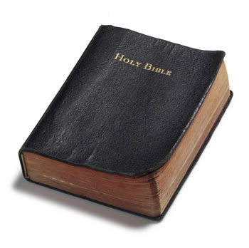
Jesus will
“Close the Book”
All will know for certain
where eternity will be spent!
Richie Thetford www.thetfordcountry.com

