Slide 1
JESUS, A True Friend
John 15:9-17
“The better part of one’s life consists of his friendships”
-- Abraham Lincoln
“Your friend is the man who knows all about you, and still likes you”
-- Elbert Hubard
Richie Thetford www.thetfordcountry.com

Slide 2
JESUS Was a Friend to All While on Earth
A friend to children
Matthew 19:13-15; Matthew 18:1-4
A friend to the poor
Matthew 11:1-5; 2 Corinthians 8:9
A friend to the sick
Matthew 14:13-14
A friend to all races
Matthew 28:19; Acts 15:8-9
Richie Thetford www.thetfordcountry.com

Slide 3
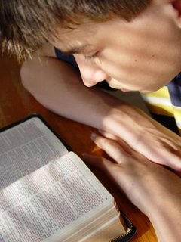
JESUS Is a Friend to Sinners
Laid down His life
Romans 5:6-8; John 1:29; 1 Peter 1:18-19
Good news – forgiveness!
Acts 2:38; Romans 1:16; Acts 13:38
All are sinners
Romans 3:23; 3:9-12; Isaiah 64:6
He is touched by our weakness
Hebrews 4:15
Richie Thetford www.thetfordcountry.com

Slide 4
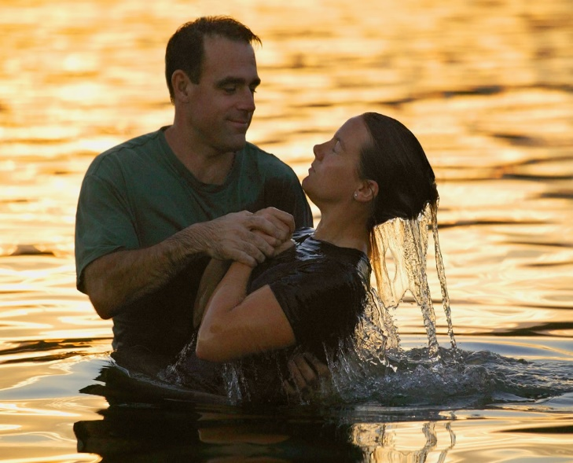
JESUS Calls Us to Be His Friends
Showed His friendship
John 15:13
Calls all to be His friends
Matthew 11:28-30; Mark 16:15; Matthew 18:18-19
How do we become His friend?
John 15:14; Matthew 7:21-23
Believe (John 8:24); Repent (Luke 13:3-5); Confess (Matt 10:32); Baptized (Acts 22:16)
Richie Thetford www.thetfordcountry.com

Slide 5
CONCLUSION
Jesus was a “people person”
Jesus loved the sinner – hated the sin!
People treated as those of great worth
Sees what we can become – when we turn from sin and become His friend
“I never met a person I didn’t like.” -- Will Rogers
Jesus urges you to come, accept His friendship, and be His friend
Richie Thetford www.thetfordcountry.com

