Slide 1

Is there evidence of Christ in you?
Matthew 13:3-9
If we were to be put on trial for being a Christian – would there be enough evidence to convict us?
“…that your progress may be evident to all.”
1 Timothy 4:12-16
Richie Thetford www.thetfordcountry.com

Slide 2
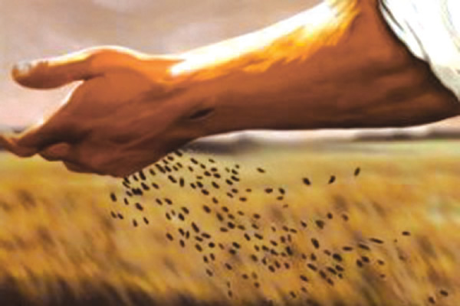
Explanation of the parable
The Sower
Jesus
The Seed
Word of God
The Soil
Four soils
Richie Thetford www.thetfordcountry.com

Slide 3
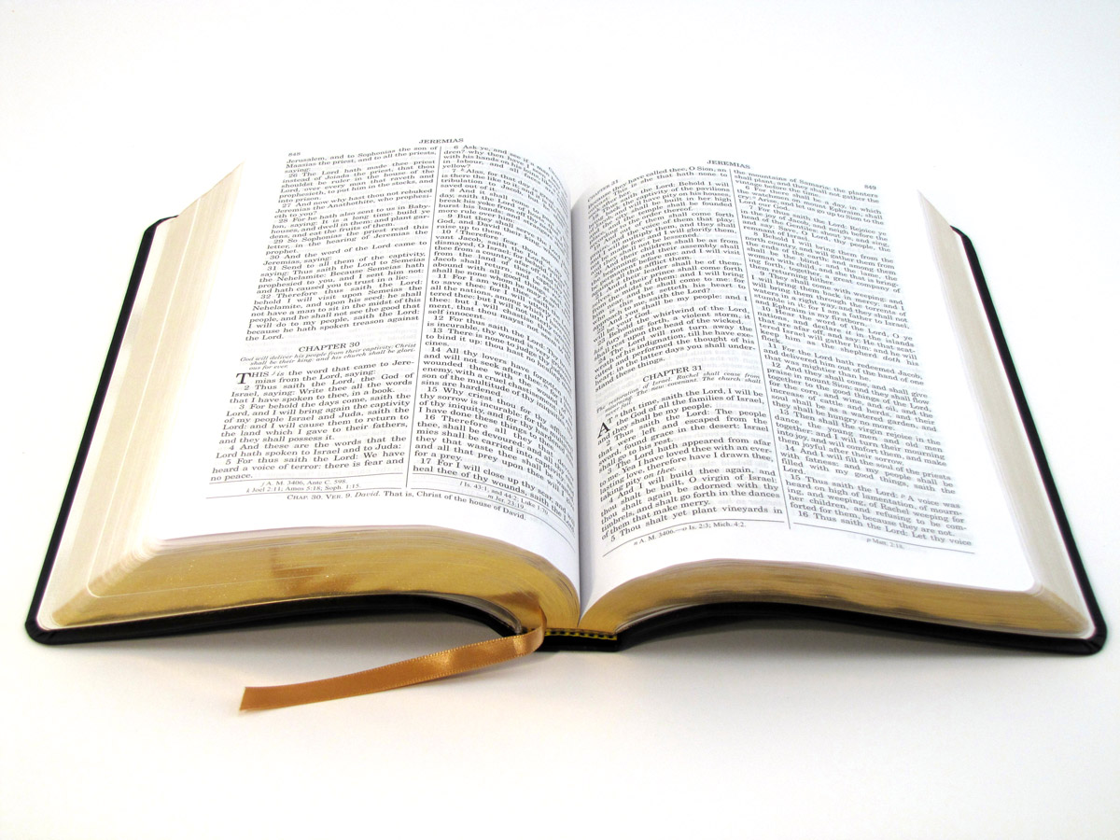
The Wayside Soil
Matthew 13:15
2 Corinthians 4:3-4
Stony Soil
Matthew 13:20-21
Is There Evidence of Christ In You?
Richie Thetford www.thetfordcountry.com

Slide 4
The Thorny Soil
Matthew 13:22
Luke 8:14
Is There Evidence of Christ In You?
Richie Thetford www.thetfordcountry.com

Slide 5
The “three” Thorns – Unfruitful
Being unprepared - Luke 21:34-36
Detracting our minds – Luke 12:29-32
Deceitfulness of riches – 1 Timothy 6:9-10
Pleasures of life – Galatians 5:17
Sowing to the flesh – Galatians 6:7-9
Is There Evidence of Christ In You?
Richie Thetford www.thetfordcountry.com

Slide 6
The Good Soil
Matthew 13:23
Romans 6:22
Romans 12:1-2
Is There Evidence of Christ In You?
Richie Thetford www.thetfordcountry.com

Slide 7
APPLICATION of the parable
The Wayside?
Heard – but not a Christian
May be hardening your heart
You are susceptible to Satan’s deception in some form, not accepting God’s Word
Richie Thetford www.thetfordcountry.com

Slide 8
APPLICATION of the parable
The Stony?
Responded at one time, but now are not grounded in faith
You will likely fall away when persecution and temptation comes your way
Richie Thetford www.thetfordcountry.com

Slide 9
APPLICATION of the parable
The Thorny?
Responded at one time, but now becoming preoccupied with the cares, riches, and pleasures of life
You will not be able to bear fruit!
John 15:1-6
Richie Thetford www.thetfordcountry.com

Slide 10
APPLICATION of the parable
The Good?
Responded to the gospel and are bearing fruit
A good heart
Understanding
Patience
The Word has been able to produce its intended effect in your life!
Richie Thetford www.thetfordcountry.com

Slide 11
“He who has ears to hear, let him hear!”
Matthew 13:9
Only the “GOOD SOIL” will be among the FEW
Is There Evidence of CHRIST In You?
Richie Thetford www.thetfordcountry.com

