Slide 1

Is Doctrine Really Important?

Slide 2
John 12:44-50 Then Jesus cried out and said, "He who believes in Me, believes not in Me but in Him who sent Me. (45) And he who sees Me sees Him who sent Me. (46) I have come as a light into the world, that whoever believes in Me should not abide in darkness. (47) And if anyone hears My words and does not believe, I do not judge him; for I did not come to judge the world but to save the world. (48) He who rejects Me, and does not receive My words, has that which judges him— the word that I have spoken will judge him in the last day. (49) For I have not spoken on My own authority; but the Father who sent Me gave Me a command, what I should say and what I should speak. (50) And I know that His command is everlasting life. Therefore, whatever I speak, just as the Father has told Me, so I speak."

Slide 3
Hebrews 1:1-4 God, who at various times and in various ways spoke in time past to the fathers by the prophets, (2) has in these last days spoken to us by His Son, whom He has appointed heir of all things, through whom also He made the worlds; (3) who being the brightness of His glory and the express image of His person, and upholding all things by the word of His power, when He had by Himself purged our sins, sat down at the right hand of the Majesty on high, (4) having become so much better than the angels, as He has by inheritance obtained a more excellent name than they.

Slide 4

Hebrews 2:1-3 Therefore we must give the more earnest heed to the things we have heard, lest we drift away. (2) For if the word spoken through angels proved steadfast, and every transgression and disobedience received a just reward, (3) how shall we escape if we neglect so great a salvation, which at the first began to be spoken by the Lord, and was confirmed to us by those who heard Him,

Slide 5
Introduction
Why do we not have joint activities with other religious groups?
Is Doctrine really important?
  1 John 2:19
Approximately 45,000 plus so-called “Christian” denominations
  John 18:37-38

Slide 6

FOUR VALUABLE TRUTHS:
  There is absolute truth and
  we can know it
  God requires that man learn
  His truth
  God’s truth must mold man’s
  character and conduct
  God instructs His people to be
  unwavering in His doctrine

Slide 7

There Is Absolute Truth and We Can Know It
Jesus declared that we can know truth
  John 8:32
Jesus declared His
words were truth
  John 17:17
The word of truth must be applied before sanctification can occur

Slide 8
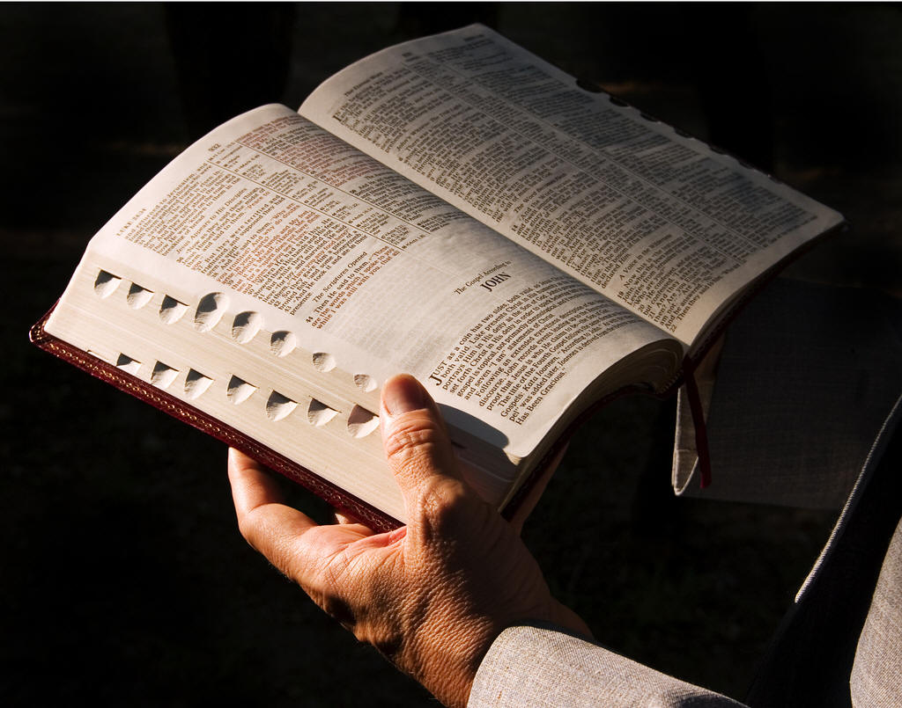
There Is Absolute Truth and We Can Know It
Jesus affirmed His words are
from God
  John 8:45; John 12:49
  1 Peter 4:11; John 16:13-15
Truth is of God – revealed to man
  Psalms 119:160
  Romans 1:18, 25
  Jeremiah 5:3

Slide 9
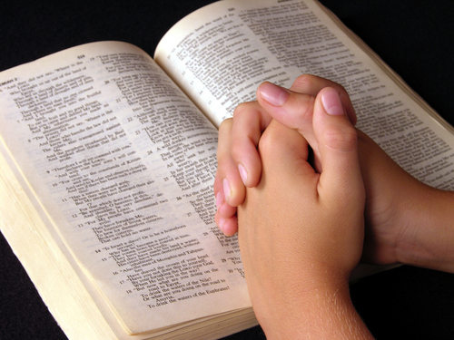
God Requires That Man
Learn His Truth
Knowing the truth is essential
to salvation
  1 Timothy 2:3-4
  Ephesians 2:8-9
  Galatians 3:26
  Hebrews 11:6
  Romans 10:14, 17
  Romans 6:17-18

Slide 10

God Requires That Man
Learn His Truth
Knowing the truth is essential
to maturing faith
  Hebrews 5:12-14
  Hebrews 6:1
  1 Peter 2:2
  Ephesians 4:11-12

Slide 11
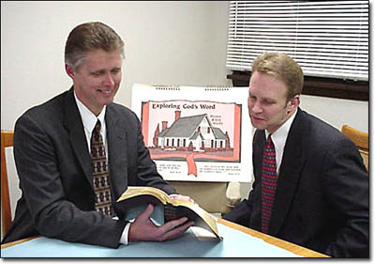
God Requires That Man
Learn His Truth
Those who follow Christ must be willing to learn
  Matthew 11:29-30
  2 Timothy 2:15

Slide 12
God’s Truth Must Mold Man’s Character and Conduct
The word is only of value if we live it
  James 1:21-24
  James 2:14-26
Doctrine limits what
we can do, say
or believe
  1 Corinthians 4:6
“Why do you call me Lord, Lord and do not do what I say.”
Luke 6:46

Slide 13
God’s Truth Must Mold Man’s Character and Conduct
Doctrine limits who we can fellowship
  Romans 16:17
  1 Timothy 6:3
  2 John 7-11
Paul to Timothy:
  2 Timothy 4:1-4

Slide 14

God Instructs That His People
Be Unwavering in Doctrine
The Doctrine is complete
  2 Peter 1:3
  Hebrews 2:3-4
  Mark 16:20
The Doctrine must
be defended
  Titus 1:9
  Jude 3

Slide 15
MUST STUDY THE DOCTRINES
OF THE BIBLE BECAUSE:
  Needed to be set free from Satan
  God requires that man learn
  His truth
  God’s truth must mold man’s
  character and conduct
  God instructs His people to be
  unwavering in His doctrine

Slide 16

Obedience to God’s truth results in eternal salvation
  John 8:32; Romans 10:17
Knowledge of the Word of God is essential to keep us from slipping away
  Hebrews 2:1

