Slide 1

Is Baptism Necessary for Salvation?
Matthew 28:18-20
Richie Thetford www.thetfordcountry.com
Notes:
This template can be used as a starter file for presenting training materials in a group setting.
Sections
Right-click on a slide to add sections. Sections can help to organize your slides or facilitate collaboration between multiple authors.
Notes
Use the Notes section for delivery notes or to provide additional details for the audience. View these notes in Presentation View during your presentation.
Keep in mind the font size (important for accessibility, visibility, videotaping, and online production)
Coordinated colors
Pay particular attention to the graphs, charts, and text boxes.
Consider that attendees will print in black and white or grayscale. Run a test print to make sure your colors work when printed in pure black and white and grayscale.
Graphics, tables, and graphs
Keep it simple: If possible, use consistent, non-distracting styles and colors.
Label all graphs and tables.

Slide 2
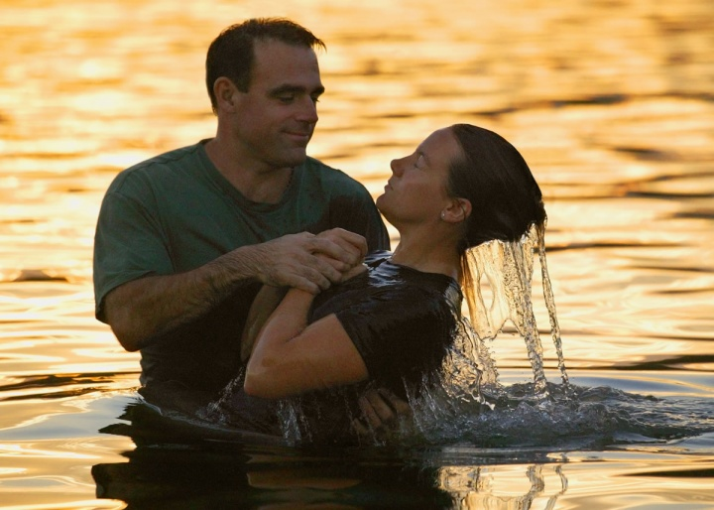
Baptism
is an Immersion in Water
John 1:26
John 3:23
Matthew 3:13, 16
Acts 8:36-39
Richie Thetford www.thetfordcountry.com
Notes:
Use a section header for each of the topics, so there is a clear transition to the audience.

Slide 3

Baptism
is for the remission of sins
Acts 2:38
Romans 6:17-18
Acts 16:30
Luke 24:47
Acts 22:16
Richie Thetford www.thetfordcountry.com
Notes:
Use a section header for each of the topics, so there is a clear transition to the audience.

Slide 4

Baptism
is a burial
Romans 6:3-4
James 1:14-15
Colossians 2:12-13
Richie Thetford www.thetfordcountry.com
Notes:
Use a section header for each of the topics, so there is a clear transition to the audience.

Slide 5

Baptism
is a birth
John 3:5, 7
Luke 8:11
1 Peter 1:23
1 Peter 2:2
Galatians 3:26-27
James 2:5
Richie Thetford www.thetfordcountry.com
Notes:
Use a section header for each of the topics, so there is a clear transition to the audience.

Slide 6

Baptism
is a washing
Acts 22:16
Revelation 1:5-6
1 Peter 2:5, 9
Ephesians 5:23-32
Romans 7:4
Acts 2:47
Richie Thetford www.thetfordcountry.com
Notes:
Use a section header for each of the topics, so there is a clear transition to the audience.

Slide 7

Baptism
now saves us
1 Peter 3:20-21
Luke 17:26-27
Richie Thetford www.thetfordcountry.com
Notes:
Use a section header for each of the topics, so there is a clear transition to the audience.

Slide 8
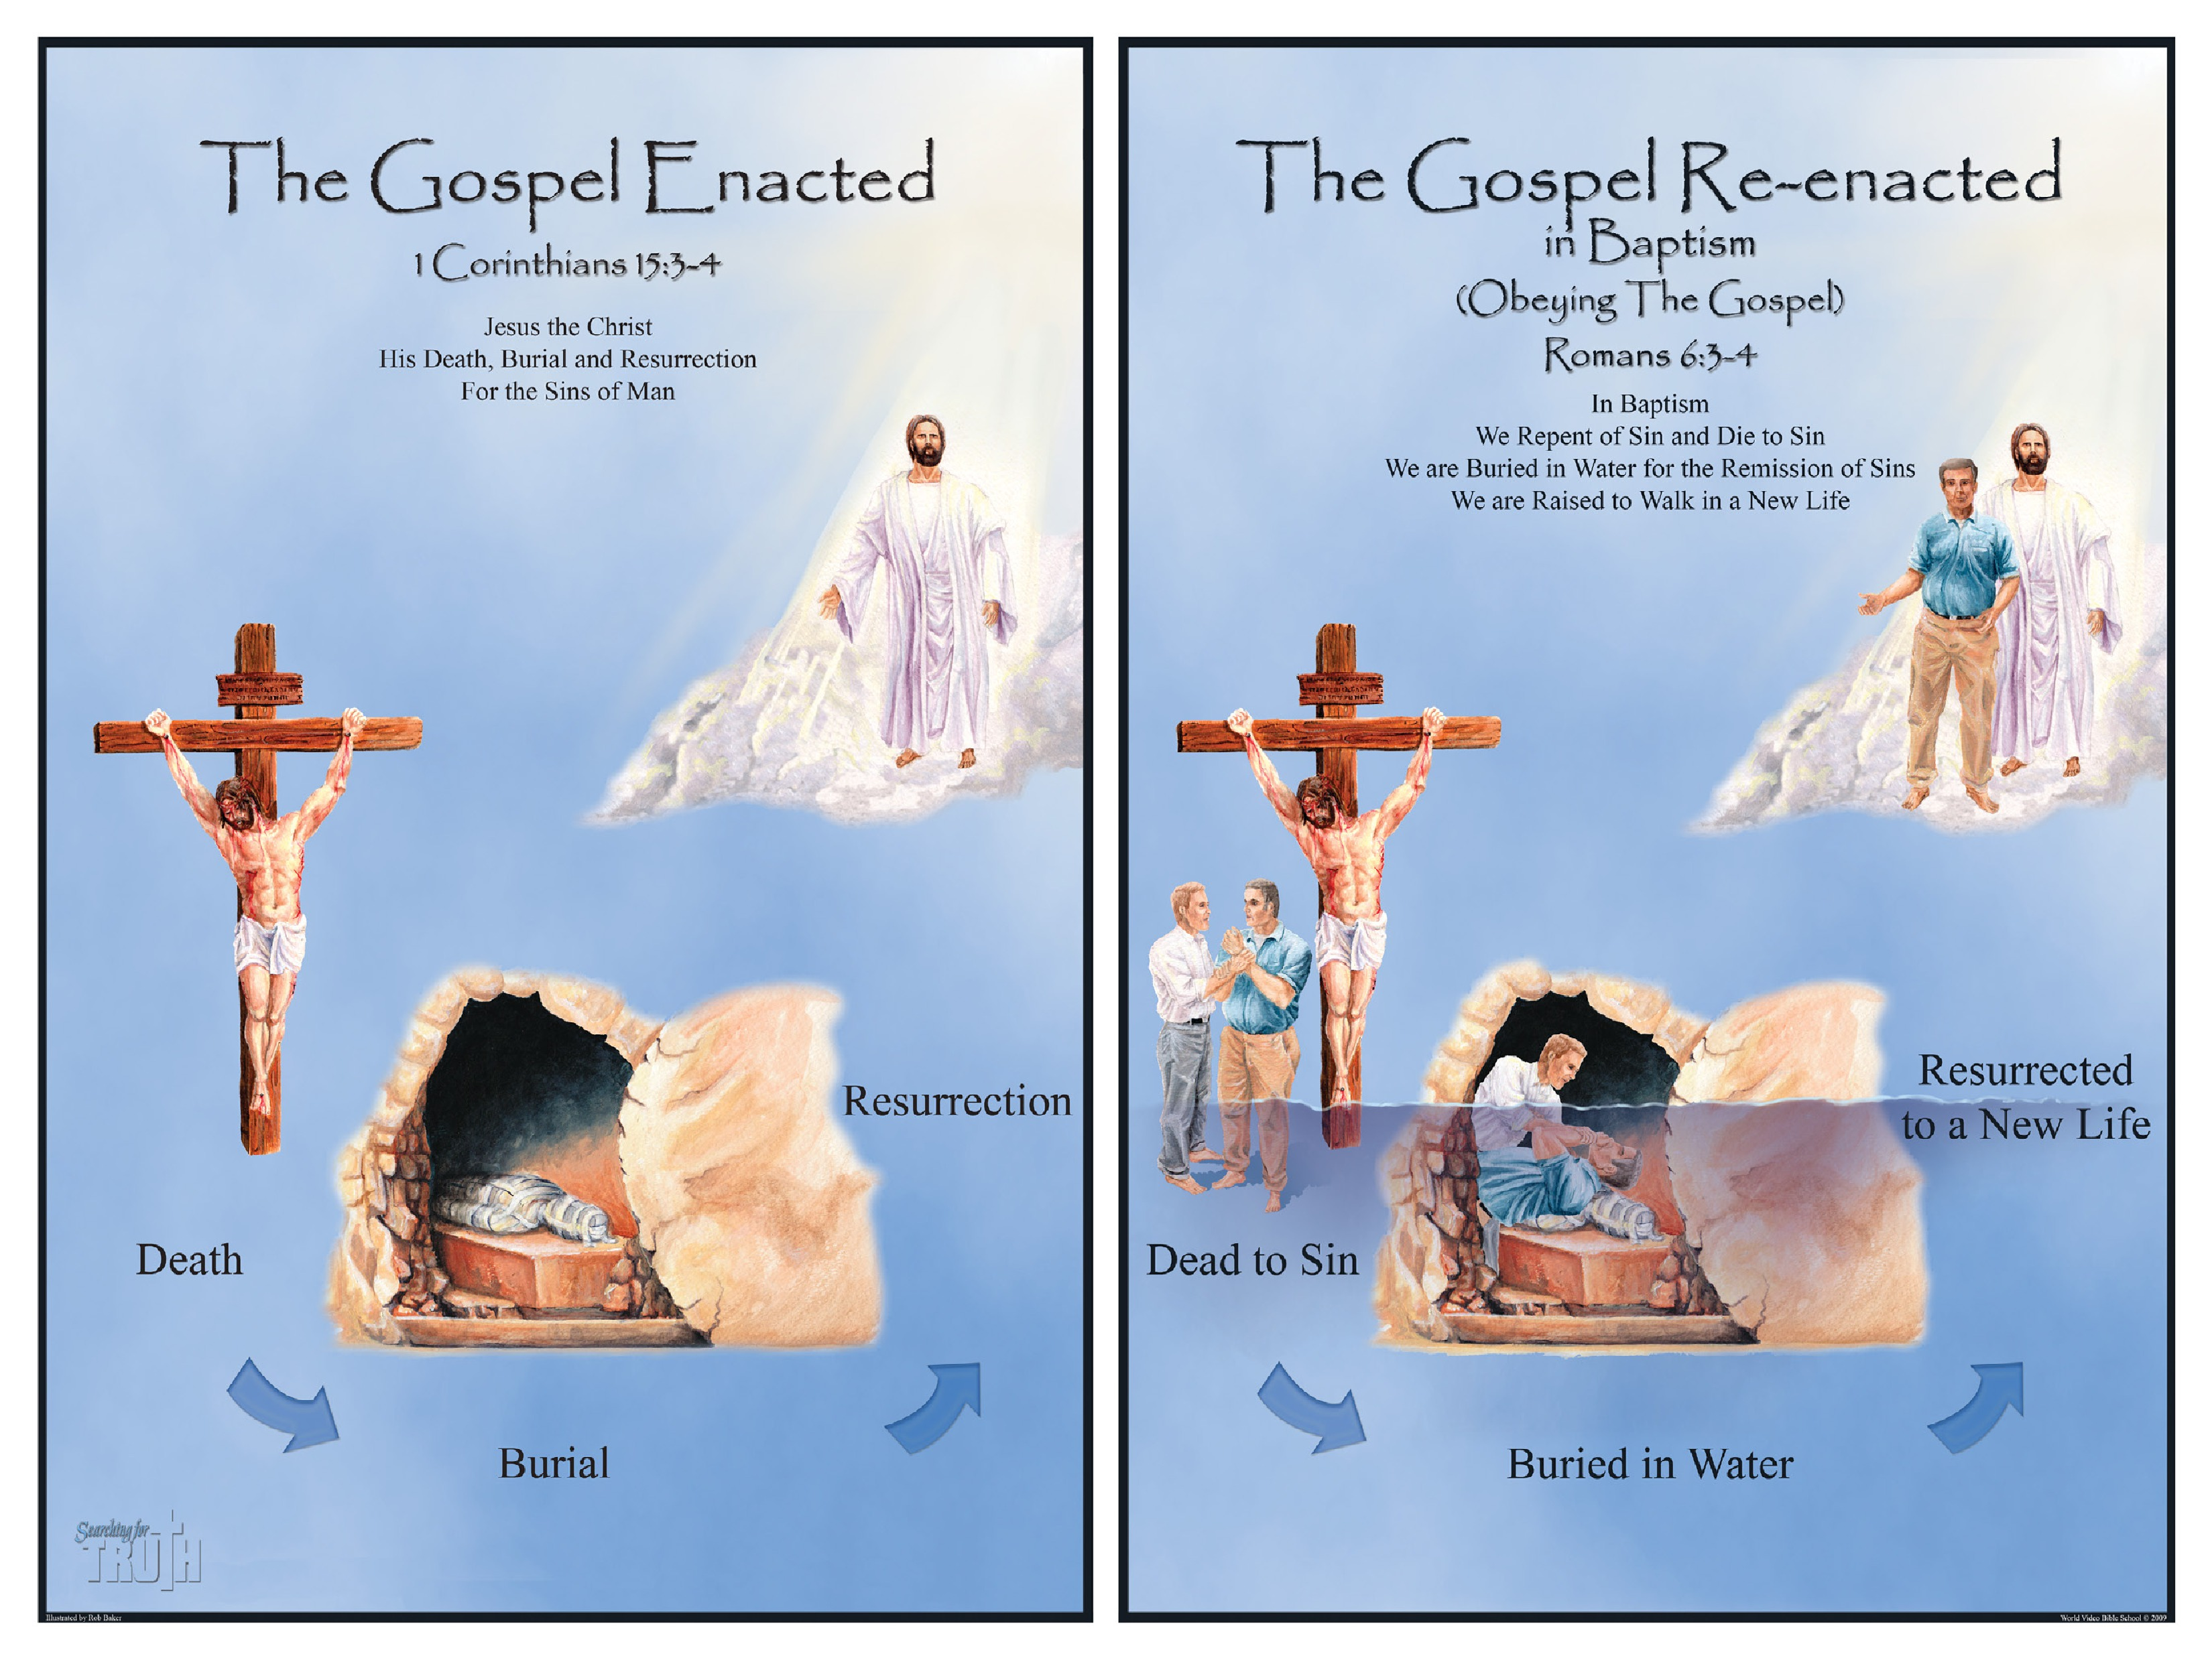
Richie Thetford www.thetfordcountry.com
Notes:
Use a section header for each of the topics, so there is a clear transition to the audience.

Slide 9

Conclusion
Mark 16:16
Acts 2:38
Acts 22:16
“For He says: IN AN ACCEPTABLE TIME I HAVE HEARD YOU,
AND IN THE DAY OF SALVATION I HAVE HELPED YOU. Behold, now is the accepted time; behold, now is the day of salvation.” 2 Corinthians 6:2
Richie Thetford www.thetfordcountry.com
Notes:
Use a section header for each of the topics, so there is a clear transition to the audience.

