Slide 1
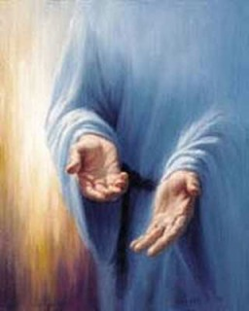
The Invitation of Christ
Jesus offers man the greatest invitation of all!
Matthew 11:28-30
Colossians 3:1-4
Richard Thetford www.thetfordcountry.com

Slide 2
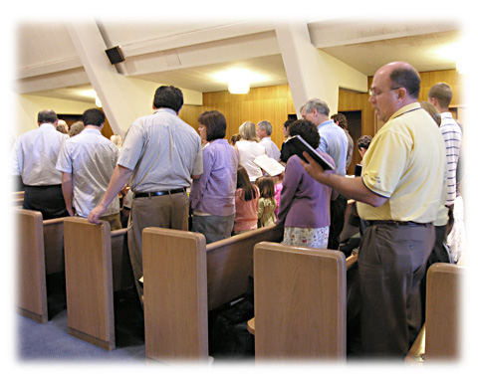
The Abundant Life
Christ came to give us the abundant life
John 10:10; 1 John 5:12; John 14:15
Once we “put on Christ” we can enjoy the benefits of the abundant life
Galatians 3:27
Ephesians 1:13-14
Beauty of Serving Contentment of Labor Joy of Hope
Richard Thetford www.thetfordcountry.com

Slide 3
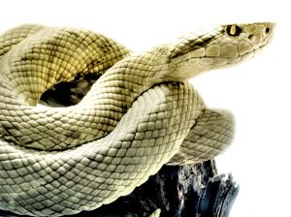
Freedom from Sin
Sin is lawlessness
1 John 3:4
The reality of sin
Romans 3:23
Divine punishment for all who abide in sin
Romans 6:23
Conscience should be pricked due to sin
1 John 3:18-21; Hebrews 9:14
Richard Thetford www.thetfordcountry.com

Slide 4
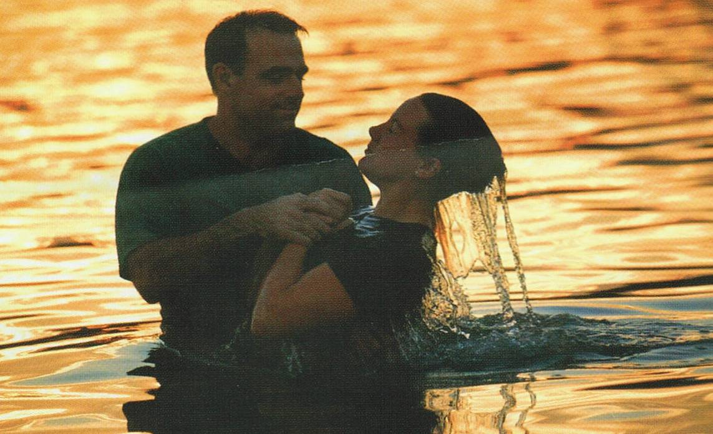
Freedom from Sin
Dead to sin, alive in Christ
Ephesians 2:1-5
How are we made alive in Christ?
Mark 16:16 Acts 2:38 Acts 22:16 Romans 6:18
Christ’s invitation offers us freedom from the burden of sin!
Richard Thetford www.thetfordcountry.com

Slide 5
Eternal Life
He died for us and returned to Heaven to prepare a place
John 14:1-3
Must remain faithful to enter in
Revelation 22:14
Heaven is a prepared place for a prepared people
“Come to Me, all you who labor and are heavy laden, and I will give you rest.” Matthew 11:28
Richard Thetford www.thetfordcountry.com

Slide 6
The Benefits of Christ’s Invitation
HEAVEN is just an INVITATION away!
Abundant Life Freedom from Sin Eternal Life
Won’t you accept His invitation?
Richard Thetford www.thetfordcountry.com

