Slide 1
The Importance of the BIBLE
What do we really know about the Bible?
Richie Thetford www.thetfordcountry.com

Slide 2
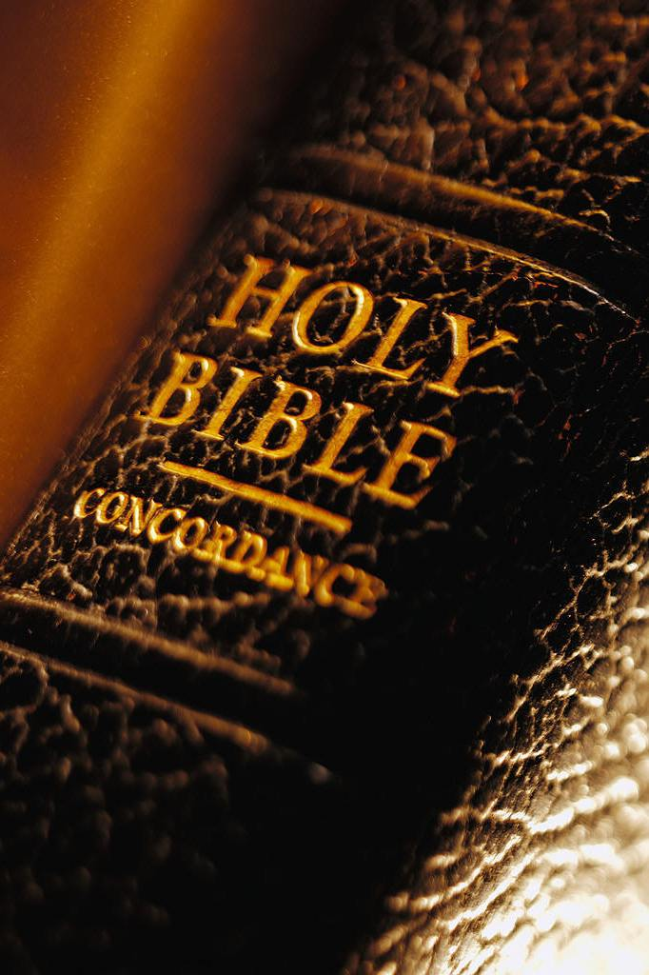
Why Does Man Need the Bible?
Gives the best insight of our past
Gives the best light for the present
2 Thessalonians 2:15
Gives the best light for the future
Matthew 25:31-46
Richie Thetford www.thetfordcountry.com

Slide 3
The Timeliness of the Bible
Never be out of date
Everything is in the Bible that we need to know
Revelation 22:18-19
2 John 9-11
Has always met man’s needs
Romans 1:16-17
Richie Thetford www.thetfordcountry.com

Slide 4
The Bible Blesses Man
Teaches man about God
Completely furnishes us to every good work
2 Timothy 3:16-17
Blessings in Christ
Ephesians 1:3
Richie Thetford www.thetfordcountry.com

Slide 5
We Will Be Judged by the Bible
Christ’s Words will judge us
John 12:48
We learn what will happen to those who refuse to obey
2 Thessalonians 1:7-9
Richie Thetford www.thetfordcountry.com

Slide 6
Conclusion
Man needs the Bible
Jesus invites us to come to Him
Matthew 11:28-30
John 14:1-3
Richie Thetford www.thetfordcountry.com

Slide 7
Conclusion
We prepare by reading, knowing, understanding, and practicing the will of God
Richie Thetford www.thetfordcountry.com

