Slide 1

Impartiality
Romans 2:11
Richie Thetford www.thetfordcountry.com

Slide 2

He Has Declared All Under Sin
Man sins
  Romans 3:23
God’s most faithful servant sins
Richie Thetford www.thetfordcountry.com

Slide 3
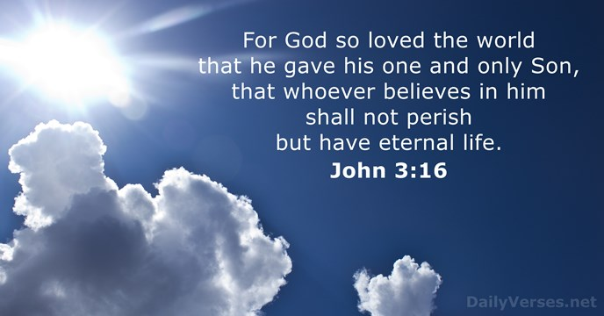
A Common Savior
Jesus died for all
  John 3:16
  1 Timothy 2:6
Great commission
  Matthew 28:18-20
Jesus scatters seed
  Matthew 13:1-9
Richie Thetford www.thetfordcountry.com

Slide 4

Same Invitation
Weary and heavy laden
  Matthew 11:28-30
All who will come
  Revelation 22:17
The obedient will not be rejected
  John 6:37
Richie Thetford www.thetfordcountry.com

Slide 5
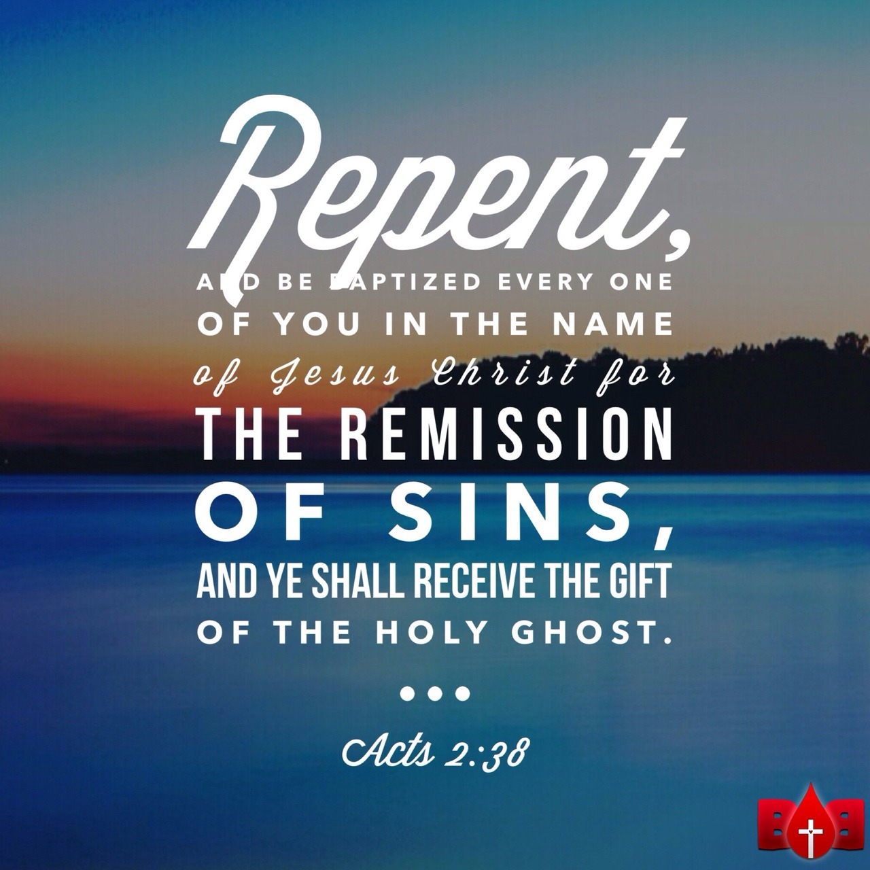
Same Conditions of Pardon
God has one plan for all
  Acts 2:38
  Acts 17:30
  Romans 10:12-13
Richie Thetford www.thetfordcountry.com

Slide 6
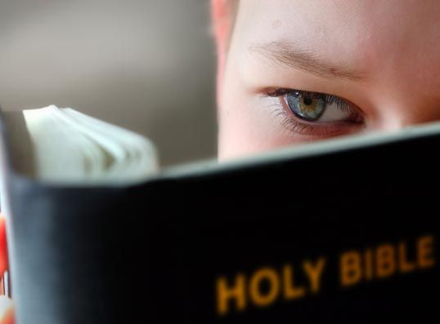
One Standard of Conduct
Confidence in God’s Word
  Only has one standard
Richie Thetford www.thetfordcountry.com

Slide 7
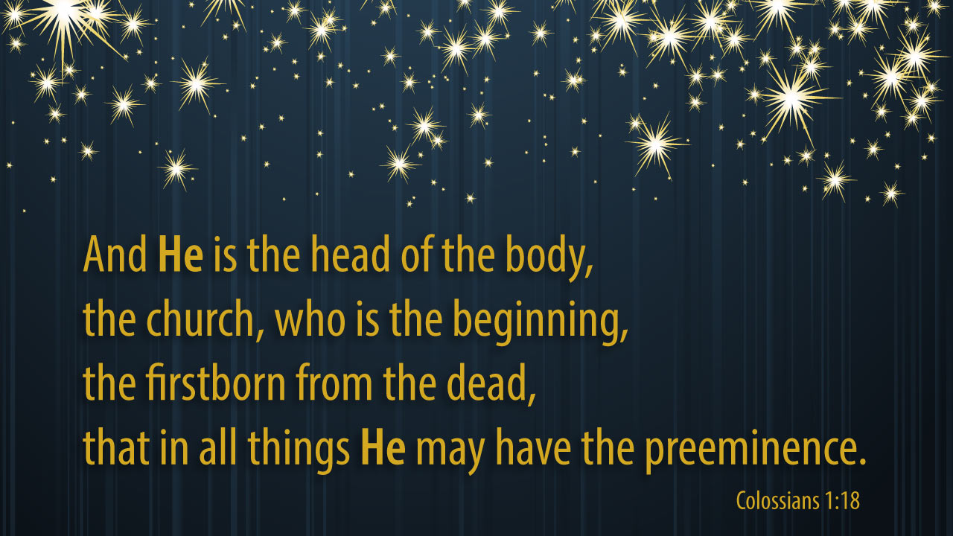
A Common Church
Did not build “many” churches
  Matthew 16:16-18
  Colossians 1:18
  Ephesians 4:4
All distinctions are erased
  Galatians 3:26-28
Richie Thetford www.thetfordcountry.com

Slide 8
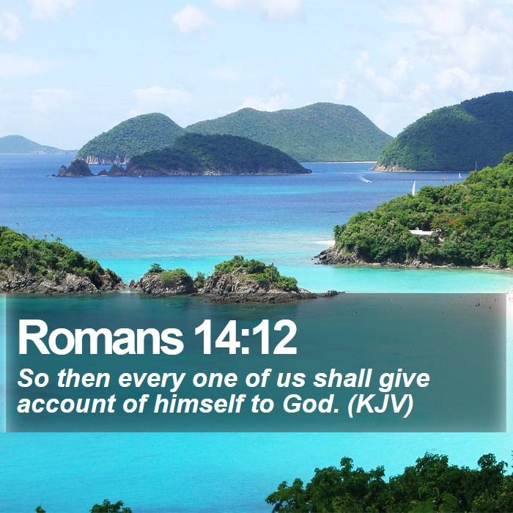
The Manner of Judging
God judges as individuals
  1 Peter 1:17
  Romans 14:12
Judged according to deeds
  2 Corinthians 5:10
  Revelation 20:12
Richie Thetford www.thetfordcountry.com

Slide 9
Impartiality
God is no respecter of persons – He is a respecter of character
Acts 10:34-35
Romans 2:11
Richie Thetford www.thetfordcountry.com

