Slide 1
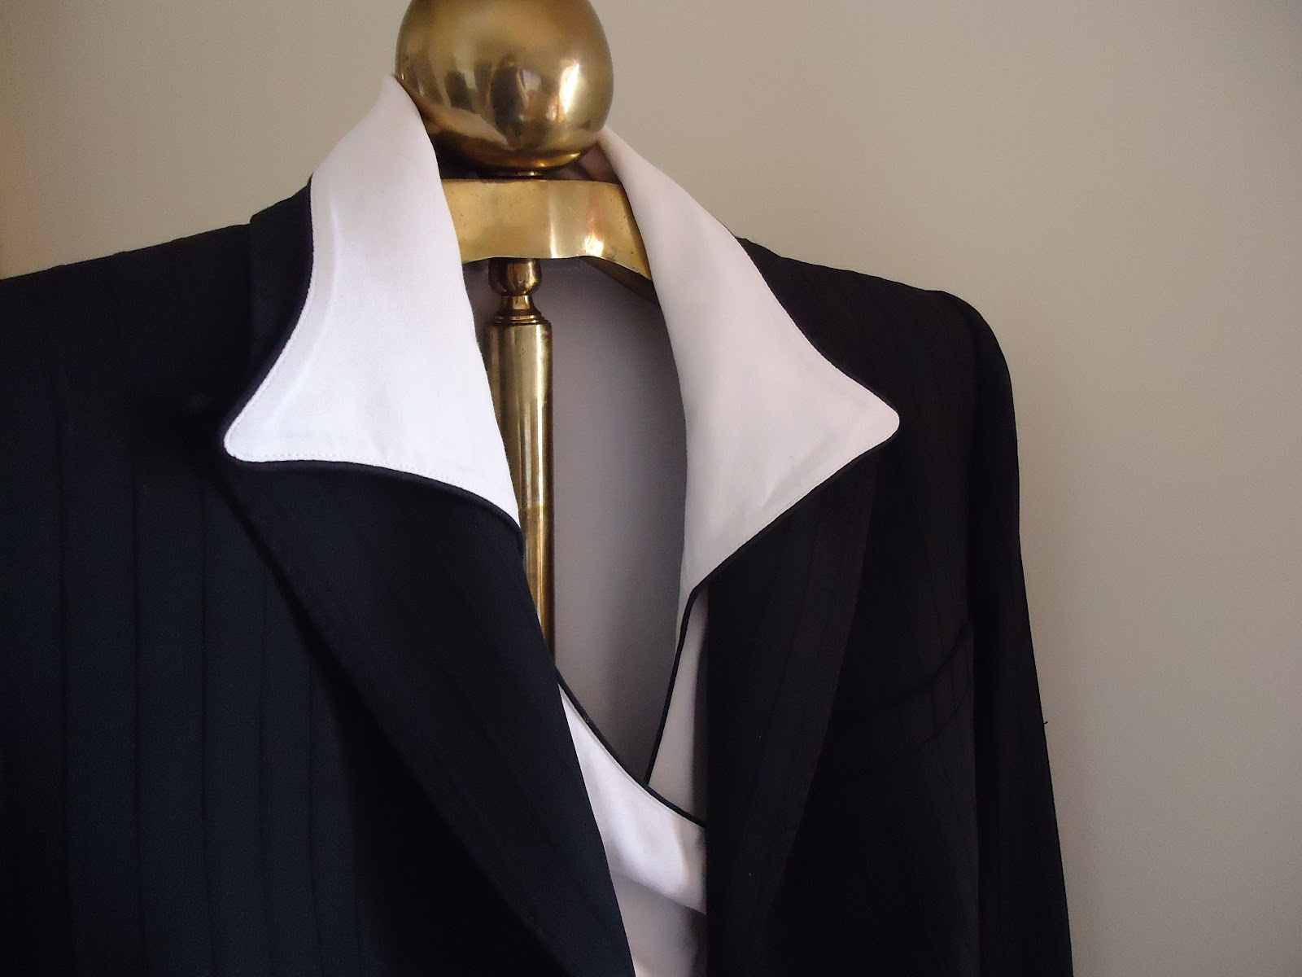
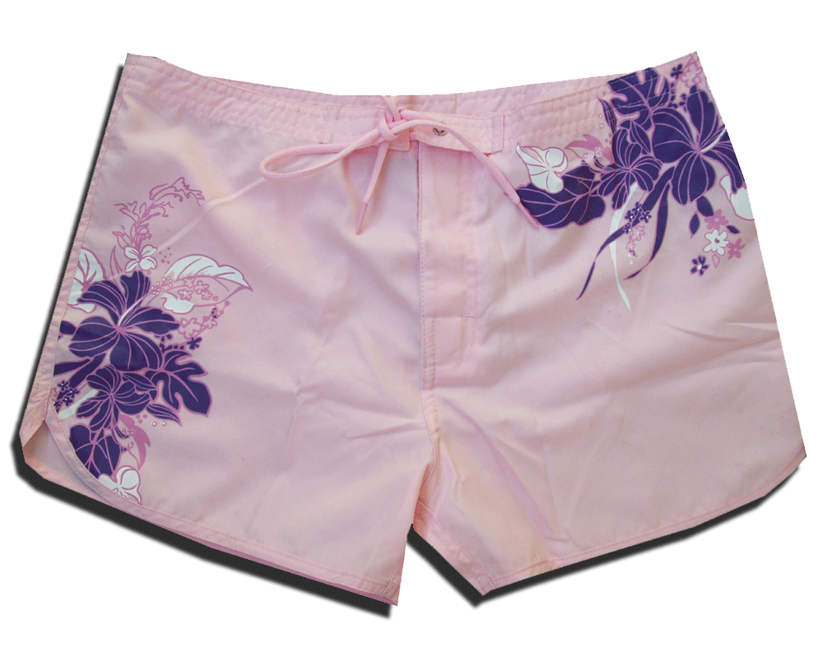
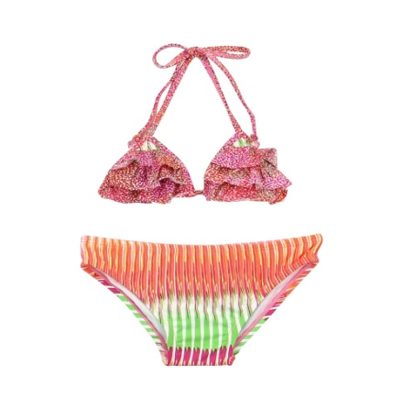
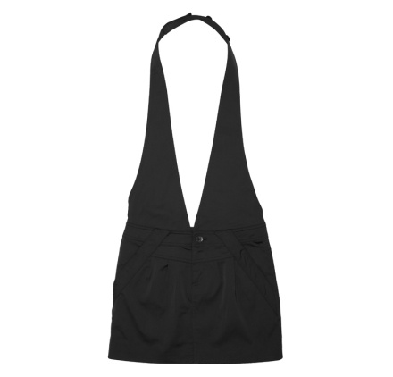
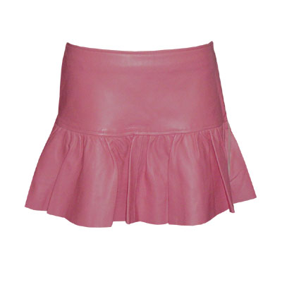
Immodesty – Biblical Principles
“And whatever you do in word or deed, do all in the name of the Lord Jesus, giving thanks to God the Father through Him.” Colossians 3:17
Richard Thetford www.thetfordcountry.com

Slide 2

Definition of Words
Immodest
  Having an immoderate estimate of one’s self; having a forward nature; having a disregard for decencies of behavior or dress
    1 Timothy 2:9
Lascivious
  Lewd, wanton, inciting to lust
    Galatians 5:19
Richard Thetford www.thetfordcountry.com

Slide 3

Definition of Words
Obscene
  Offensive, suggesting impure ideas.
  On “purity,” the opposite quality
    Philippians 4:8; 1 John 3:3
Unbecoming
  Beneath the standard implied by
  one’s character or position
    1 Timothy 2:10; Romans 1:28
Richard Thetford www.thetfordcountry.com

Slide 4

Definition of Words
Indecent
  Not conformed to recognized standards of propriety; to be fitting, suitable, acceptable
    Romans 12:17; 2 Corinthians 8:21
Richard Thetford www.thetfordcountry.com

Slide 5

Understanding Bible Principles
Shameful to expose one’s nakedness
  Clothing needed to cover nakedness
    Genesis 3:7, 10-11, 21
  Shameful to expose or draw attention to the private parts of the body
    Isaiah 47:1-3
    1 Corinthians 12:23-24
Richard Thetford www.thetfordcountry.com

Slide 6

Understanding Bible Principles
Shameful to expose one’s nakedness
  One can be “naked” in the Biblical sense, without being totally nude
    Job 22:6
    James 2:15-16
Richard Thetford www.thetfordcountry.com

Slide 7
Understanding Bible Principles
Lasciviousness destroys others as well as one’s self
  Galatians 5:19-21
    “Lasciviousness” (Lewdness – NKJV); lustfulness, sensuality; that which promotes lewd emotions and lustful desires
    Ephesians 4:19
    1 Peter 4:3
    Romans 13:14
Richard Thetford www.thetfordcountry.com

Slide 8
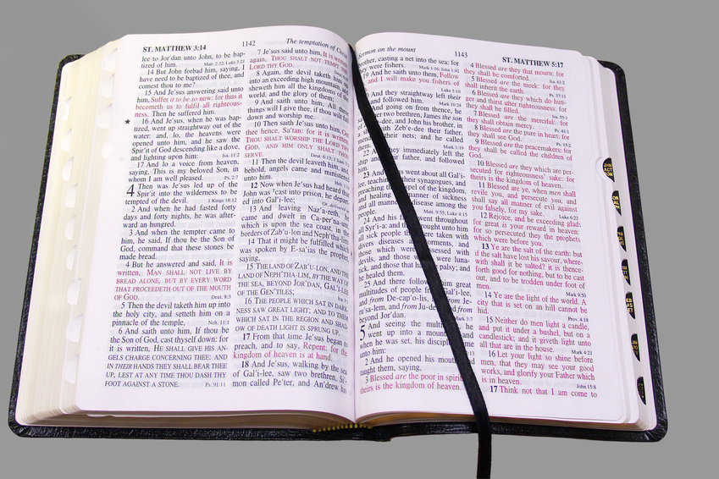
Understanding Bible Principles
Lasciviousness destroys others as well as one’s self
  Matthew 5:27-30
    Two-fold responsibility – Man and Woman
    2 Samuel 11:1-5
Richard Thetford www.thetfordcountry.com

Slide 9

Understanding Bible Principles
Christian’s clothing must be consistent with godliness
  Proverbs 7:6-27
    Woman’s attire fit her lustful intent
Richard Thetford www.thetfordcountry.com

Slide 10
Understanding Bible Principles
Christian’s clothing must be consistent with godliness
  1 Timothy 2:9-10
    “Adorn” – to put in order; to arrange; ornament
    “In modest apparel” – in seemly guise
    “Propriety” – modesty; reverence; respect
      Hebrews 12:28
      Involves a sense of shame
Richard Thetford www.thetfordcountry.com

Slide 11
Understanding Bible Principles
Christian’s clothing must be consistent with godliness
  1 Timothy 2:9-10
    “Moderation” – soundness of mind; self-control
    “Not with braided hair or gold or pearls or costly clothing”
      Not that outward adornment is wrong, but that, in comparison to the adorning of the inner person by good works, it is of lower priority.
Richard Thetford www.thetfordcountry.com

Slide 12
Understanding Bible Principles
Christian’s clothing must be consistent with godliness
  1 Timothy 2:9-10
    “Proper” – fitting, seemly, suitable, becoming
      Ephesians 5:3
    “Professing godliness” – laying a claim to being reverent
Richard Thetford www.thetfordcountry.com

Slide 13
Understanding Bible Principles
Christian’s clothing must be consistent with godliness
  1 Peter 3:3-4
    “Hidden person of the heart” – hidden, inner, concealed
    “Incorruptible” – imperishable, unfading, lasting, ageless
    “Gentle” – meek, mild
    “Quiet” – tranquil, serene, calm, peaceful
Richard Thetford www.thetfordcountry.com

Slide 14

Conclusion
Character and conduct are interrelated
  Apparel is both a thermometer and thermostat to character
  Modesty and immodesty are primarily characteristics of the person, and only secondarily of clothing
    Ephesians 5:17
    Hebrews 5:14
Richard Thetford www.thetfordcountry.com

Slide 15

Conclusion
Character and conduct are interrelated
  Consistent godliness rejects immodesty in all three forms
    Character
    Conduct
    Dress
  Outer appearance should reflect inward purity, modesty, fidelity, and chastity
Richard Thetford www.thetfordcountry.com

Slide 16

Conclusion
In our character, the Christian must progressively be “transformed”
  Romans 12:1-2
  Colossians 3:1-2
Changes in character will
often result in changes in
wardrobe
  Ephesians 4:20-24
Richard Thetford www.thetfordcountry.com

