Slide 1
Immodesty – Adjusting Our Thinking
“in like manner also, that the women adorn themselves in modest apparel, with propriety and moderation, not with braided hair or gold or pearls or costly clothing, but, which is proper for women professing godliness, with good works.”
1 Timothy 2:9-10
Richard Thetford www.thetfordcountry.com

Slide 2
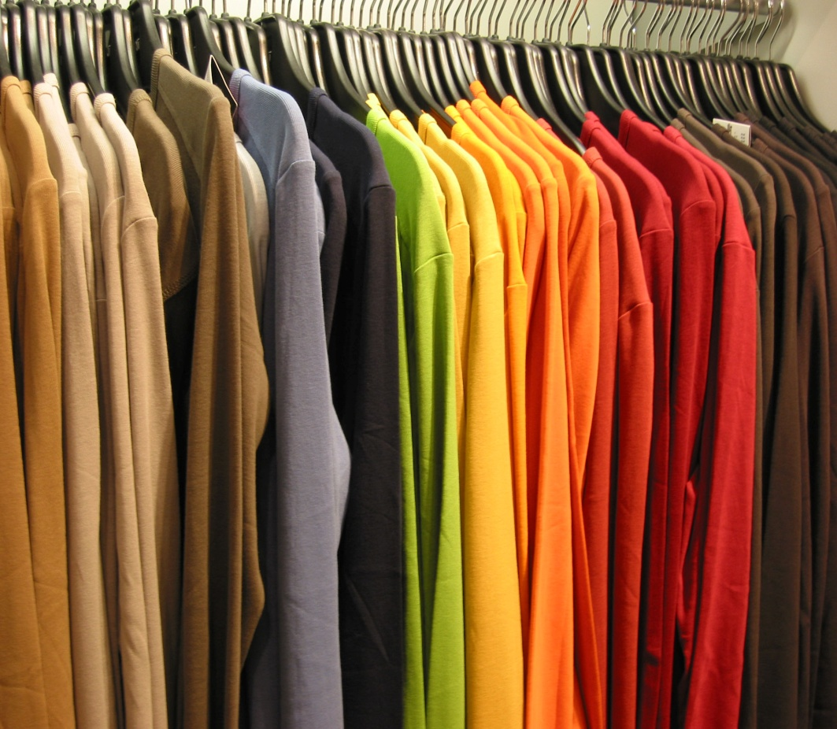
Basic Ideas About Clothing
Proper uses of clothing
  To cover nakedness
    Genesis 3:7-11, 21
  To protect from
  the elements
    2 Timothy 4:13, 21
  To adorn
    1 Timothy 2:9
Richard Thetford www.thetfordcountry.com

Slide 3
Basic Ideas About Clothing
Kinds of immodest apparel
  Perverse
    Deuteronomy 22:5
  Revealing
    Isaiah 47:1-3
  Suggestive
    Romans 13:14
    Galatians 5:19
Modern swimsuit:
Reveals too much
Often too tight
Allows for no
undergarments
Draws attention
to private parts
Richard Thetford www.thetfordcountry.com

Slide 4
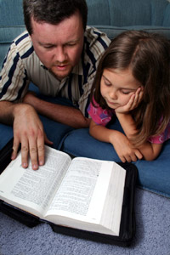
Basic Ideas About Clothing
Kinds of immodest apparel
  Defiant
    Romans 12:10
    Romans 15:2
    Philippians 2:3-4
  Unbecoming
    1 Timothy 2:10
Richard Thetford www.thetfordcountry.com

Slide 5
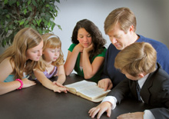
Specific Problem Areas
We may have a tendency to rationalize our conduct
  May find some way to make an exception for the activities we want to engage in – even when they come in conflict with Bible principles
Only qualified obedience
pleases the Lord
  James 2:10-11
Richard Thetford www.thetfordcountry.com

Slide 6
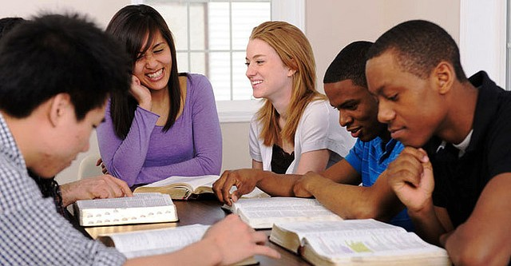
Specific Problem Areas
Areas where we may be inconsistent in the application of our convictions:
  Double standards
    Singles and married
    Youth and adults
    Male and female
  Warped sense of modesty
    Undergarments versus revealing garments
    Dressing versus watching
Richard Thetford www.thetfordcountry.com

Slide 7
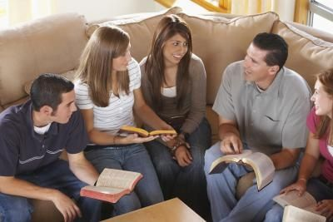
Specific Problem Areas
Areas where we may be inconsistent in the application of our convictions:
  Special situations
    Family
    Strangers
    Close friends and
    fellow Christians
Richard Thetford www.thetfordcountry.com

Slide 8
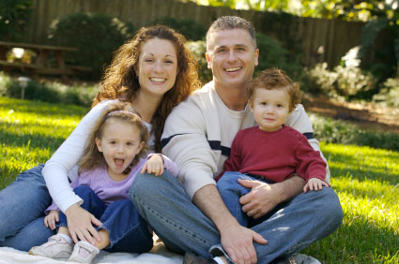
Specific Problem Areas
Areas where we may be inconsistent in the application of our convictions:
  Relaxation and recreation
    Special social events
    Comfort
    Swimming, water skiing, water sports
    Sports
Richard Thetford www.thetfordcountry.com

Slide 9
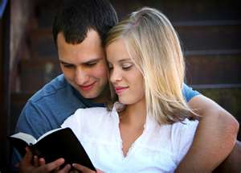
Conclusion
Don’t put ourselves in the position of those “who call evil good, and good evil”
  Isaiah 5:20
God is concerned about the
way we dress ourselves
  Colossians 3:17
May we reverently dress ourselves
consistently as those
“professing godliness”
Richard Thetford www.thetfordcountry.com

