Slide 1
Immodesty
Following the example of
Man or God?
Philippians 2:12-16
Richie Thetford www.thetfordcountry.com

Slide 2

Immodesty
Jesus and Paul:
  Matthew 5:16
  Romans 2:24
We are living in a loose
and lascivious age
  Jeremiah 6:16-17
These words occur in every generation
A Rebellious Attitude
Richie Thetford www.thetfordcountry.com

Slide 3

Immodesty
The Bible is God’s inspired Word
All Scripture is given by inspiration of God, and is profitable for doctrine, for reproof, for correction, for instruction in righteousness
2 Timothy 3:16
The Bible is our guide throughout life
Richie Thetford www.thetfordcountry.com

Slide 4
Old Testament Principles
Old Testament is not our authority
  We look to it for examples and principles
    God has given to man over hundreds of years
For whatever things were written before were written for our learning, that we through the patience and comfort of the Scriptures might have hope.
Romans 15:4
Now all these things happened to them as examples, and they were written for our admonition, upon whom the ends of the ages have come.
1 Corinthians 10:11
Richie Thetford www.thetfordcountry.com

Slide 5
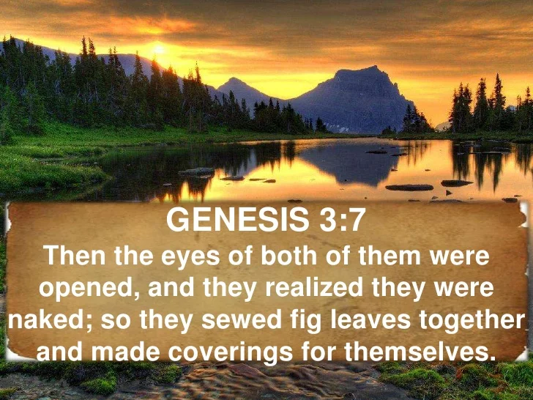
Old Testament Principles
Scriptures pertaining to the modesty issue
  Genesis 3:7
    Aprons/coverings
    Considered naked
  Genesis 3:8-11
    Knew they were naked
    Not stripped
      James 2:15-16
Richie Thetford www.thetfordcountry.com

Slide 6
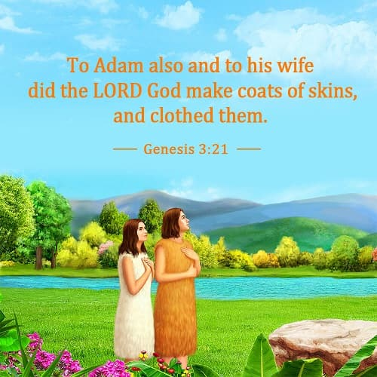
Old Testament Principles
Scriptures pertaining to the modesty issue
  Genesis 3:21
    God dressed them
  Exodus 28:42
    “from the loins to the thighs”
    Covering the thigh to the knee
    Priests were instructed – so are we
      1 Peter 2:5
Richie Thetford www.thetfordcountry.com

Slide 7
Old Testament Principles
Scriptures pertaining to the modesty issue
  Isaiah 47:1-3
    Figurative discussing the destruction of Babylon
    by the Persians
    Their “thigh” was uncovered
    As a result, their nakedness was revealed
Genesis 2:24: Jesus went back to the Old
One man for one woman
2 Peter 2: Peter went back to the Old
Sodom and Gomorrah and the flood of Noah
Richie Thetford www.thetfordcountry.com

Slide 8
New Testament Principles
“in like manner also, that the women adorn themselves in modest apparel, with propriety and moderation, not with braided hair or gold or pearls or costly clothing, but, which is proper for women professing godliness, with good works.” (1 Timothy 2:9-10)
Modest: well arranged, seemly
Shamefacedness (propriety NKJV): having a sense of shame
Sobriety (moderation NKJV): soundness of mind and judgment; curbing one’s desires and impulses,
self-controlled, temperate
Richie Thetford www.thetfordcountry.com

Slide 9
New Testament Principles
We cannot have a double standard!
After seeing and hearing God’s standard, seeing God clothing
Adam and Eve, telling the priests what to do to be modest,
we learn this important fact:
Exposing the Thigh is Nakedness!
Can Christians be pleasing to God who say:
“wear whatever you want”
“if it feels good, do it”
Richie Thetford www.thetfordcountry.com

Slide 10
What Does Our Dress Say to People?
American Institute of Public Opinion Poll:
“Do you approve of women wearing shorts on the street? In public eating places? At the office?”
Place | M/W | Yes | No | Undecided
Street | Men | 24 | 69 | 7
 | Women | 14 | 83 | 3
Eating | Men | 14 | 80 | 6
 | Women | 6 | 92 | 2
Office | Men | 8 | 87 | 5
 | Women | 3 | 96 | 1
Richie Thetford www.thetfordcountry.com

Slide 11

What Does Our Dress Say to People?
Brushy Mountain State Penitentiary’s Visitation Handbook (Rule 5):
“All visitors shall dress in an appropriate manner ..…halter tops, tank tops, sun dresses, shorts, and other revealing attire shall not be acceptable on persons over the age of 10” (Greg Gwin, The Beacon)
Richie Thetford www.thetfordcountry.com

Slide 12
What Does Our Dress Say to People?
The Ohio Department of Rehabilitation and Correction’s list of rules governing those who visit inmates of their institutions:
No see-through or tight-fitting clothing
No shorts (shorts will be permitted for children under age 12)
No skirts or dresses higher than the middle of the knee
No clothing with gang/club insignia or obscene gestures or language
No tank tops, tube tops or muscle shirts and no bare midriffs
Shoes and shirts must be worn at all times
Any other attire found to be potentially disruptive or offensive (Larry Devore, Bible Matters)
Richie Thetford www.thetfordcountry.com

Slide 13

Principles That Should Guide Christians
Philippians 2:15
Romans 12:1-2
Ephesians 5:11
Matthew 5:16
1 Thessalonians 5:21-22
1 Peter 2:11-12
Luke 17:1-2
2 Peter 3:14
Richie Thetford www.thetfordcountry.com

Slide 14
Conclusion
Would you walk arm in arm with
Jesus everywhere you go and with
everything you put on each day?
“But put on the Lord Jesus Christ, and make no provision for the flesh, to fulfill its lusts.”
Romans 13:14
Richie Thetford www.thetfordcountry.com

