Slide 1
The Image of Christ
Romans 8:29
2 Corinthians 3:18
Richie Thetford www.thetfordcountry.com

Slide 2
Christ is the Image of God
Image of His substance
Hebrews 1:3
Image of God
2 Corinthians 4:4
Photograph of God
1 John 4:9
John 12:21
2 Corinthians 4:4
Richie Thetford www.thetfordcountry.com

Slide 3
Christians Are to Become Like Christ
Strive to be like Him
John 3:2
Should be our destiny and glory
Romans 8:29
To become like God
2 Peter 1:4
Richie Thetford www.thetfordcountry.com

Slide 4
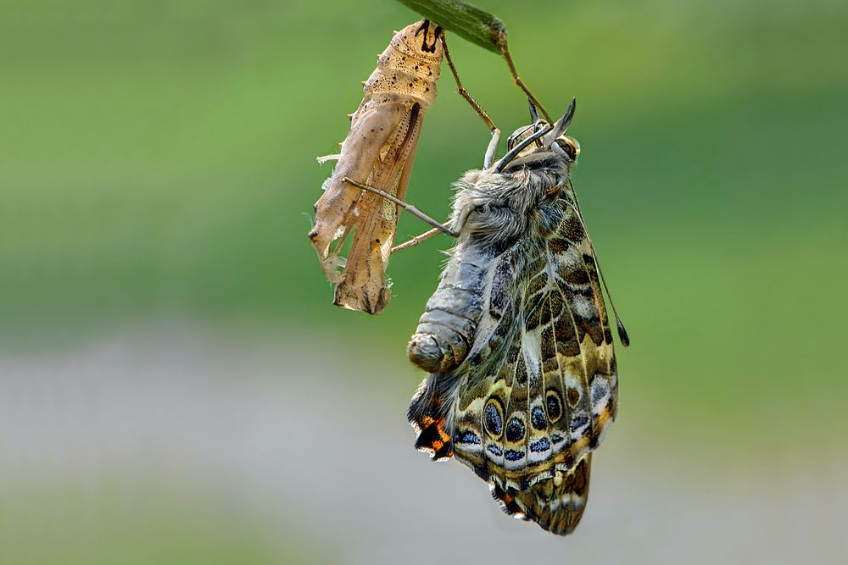
Process of Transformation
“Metamorphose” – to change the form
To transfigure
Matthew 17:2
Into Christ’s image
2 Corinthians 3:18
Romans 12:1-2
Richie Thetford www.thetfordcountry.com

Slide 5
Process of Conformation
Make like in form; to harmonize
Conform to His image
Romans 8:29
Should be an inward conformity
Richie Thetford www.thetfordcountry.com

Slide 6
Task of a Christian
Become like Jesus
We are:
Removed further from the world
Conforming to Christ – going on simultaneously
Strive to keep Christ firmly implanted at the forefront of our mind and in our thought process
Richie Thetford www.thetfordcountry.com

