Slide 1

If We Love
Proper Actions
Will Follow
Richie Thetford www.thetfordcountry.com

Slide 2
“Watch, stand fast in the faith, be brave, be strong. Let all that you do be done with love.”
1 Corinthians 16:13-14
Richie Thetford www.thetfordcountry.com

Slide 3
Introduction
Love the Lord and truth – Obedience follows
  Acts 2:38, 41
More dedicated members – if there is love
  2 Corinthians 8:3-5
Definition of Love?
  Attitude of mind which leads one to do good
  for one who is the object of the love
1 John 3:18
Richie Thetford www.thetfordcountry.com

Slide 4

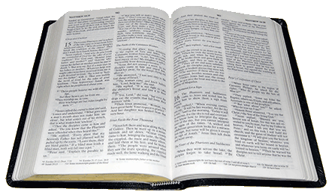
Description of the love
Taught in God’s Word
1 Corinthians 13:1-13
Love suffers long and is kind (v4)
  Matthew 23:37
  Galatians 6:2
Love does not envy (v4)
  Genesis 4:3-5, 8
Love does not parade itself; is not puffed up (v4)
  James 4:10
  Romans 12:3
Richie Thetford www.thetfordcountry.com

Slide 5
Description of the love
Taught in God’s Word
Love does not behave rudely (v5)
  1 Peter 3:8-9
  2 Timothy 2:24-25
Love does not seek its own (v5)
  1 Corinthians 10:24
  Matthew 20:28
Richie Thetford www.thetfordcountry.com

Slide 6
Description of the love
Taught in God’s Word
Love is not provoked (v5)
  Romans 12:18
  Luke 23:34
Love thinks no evil (v5)
  Philippians 4:8
  Hebrews 8:12
Richie Thetford www.thetfordcountry.com

Slide 7
Description of the love
Taught in God’s Word
Love does not rejoice in iniquity (v6)
  Takes no pleasure in the sins of others
Love rejoices in the truth (v6)
  2 John 4
  3 John 4
Richie Thetford www.thetfordcountry.com

Slide 8
Description of the love
Taught in God’s Word
Love bears all things (v7)
  Galatians 6:1
Love believes all things (v7)
  1 Timothy 6:3-4
Richie Thetford www.thetfordcountry.com

Slide 9
Description of the love
Taught in God’s Word
Love hopes and endures all things (v7)
  Confident, firm – patient
Love never fails (v8)
  Hebrews 13:5; 10:24
  Some have wrong object of love
    2 Timothy 3:2-4
  Proper object should be love of truth
    2 Thessalonians 2:10; 1 Peter 1:22
Richie Thetford www.thetfordcountry.com

Slide 10
Conclusion
Holy Spirit in His Word works to provide sound doctrine
Be alert, firm, mature and loving!
Could it be that LOVE will prompt someone
to serve God now?
“Behold, I stand at the door and knock. If anyone hears My voice and opens the door, I will come in to him and dine with him, and he with Me. To him who overcomes I will grant to sit with Me on My throne, as I also overcame and sat down with My Father on His throne. He who has an ear, let him hear what the Spirit says to the churches.” Revelation 3:20-22
Richie Thetford www.thetfordcountry.com

