Slide 1
I’m Just One!

Slide 2
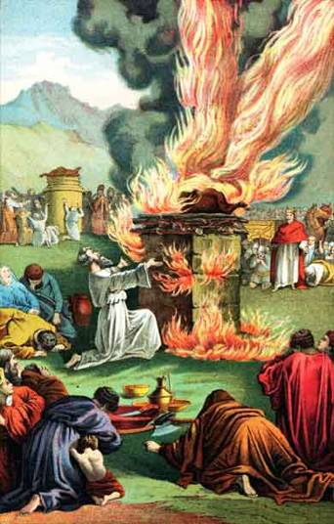
I’m Just One
Elijah
Withstood 450 prophets of Baal
1 Kings 19:11-14
Reassured that there were others
Romans 11:3-4

Slide 3
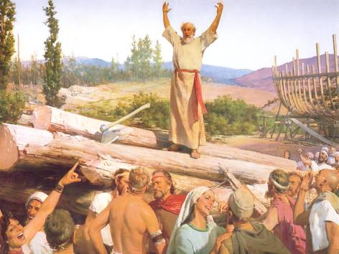
I’m Just One
Righteous man
God was angry with the human race
Listened to God
Genesis 7:1-5
Noah

Slide 4
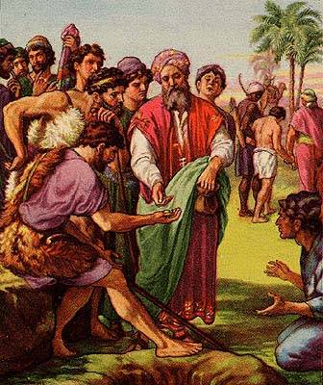
I’m Just One
Overcame being sold as a slave
Rose to high office in Egypt
Helped family in midst of a famine
Genesis 37:4, 25-30; 39:1-3; 47:13
Joseph

Slide 5
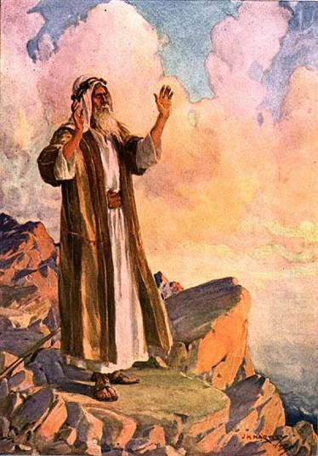
I’m Just One
Moses
Stood up to Pharaoh (Exodus)
Delivered the Israelites from bondage
Knew God was with him

Slide 6
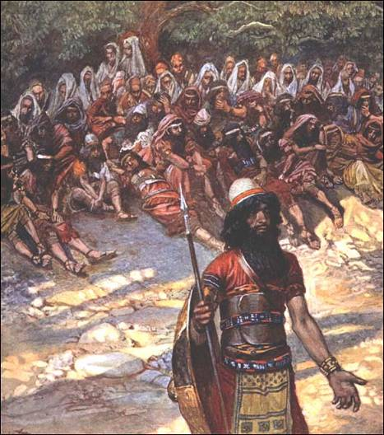
I’m Just One
Gideon
Went into battle with only 300 men
Judges 7:1-7, 12

Slide 7
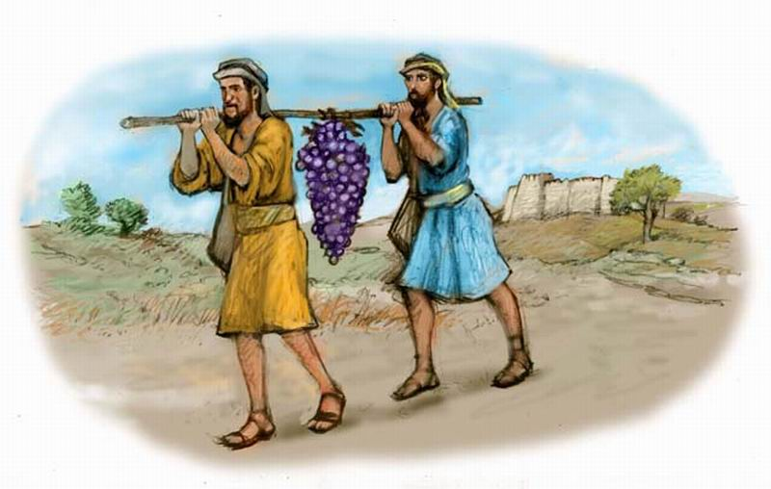
I’m Just One
Came back with a good report
Trusted in God to deliver them
Numbers 14:6-10
Joshua
& Caleb

Slide 8
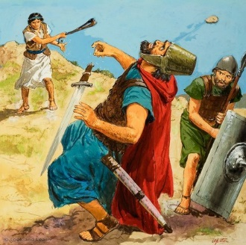
I’m Just One
David
Defeated the Philistine giant
Encouraged the army of Israel to fight!
1 Samuel 17:50-52

Slide 9
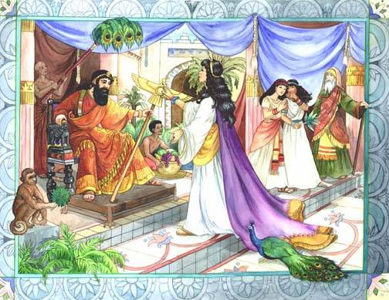
I’m Just One
Saved the Jews from Haman’s plot to have them killed
Esther 4:7-14
God used Esther for His purpose
Esther

Slide 10
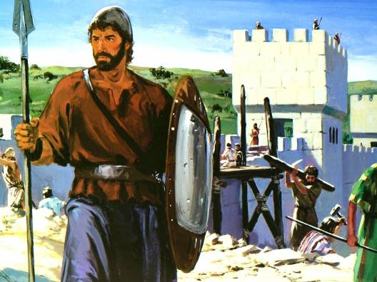
I’m Just One
Nehemiah
Motivated and led the people to rebuild the walls
Against persecution!
Nehemiah 2:11-20

Slide 11
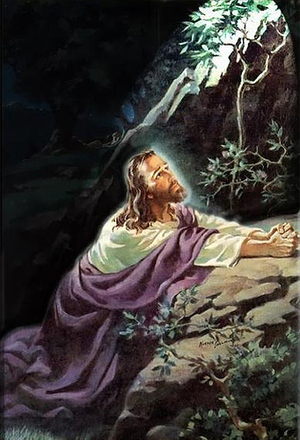
I’m Just One
JESUS
Our ultimate example!
Suffered and died alone for you and me
He did it because He loved us!
Matthew 27:27-50
“We love Him because He first loved us.” 1 John 4:19

Slide 12
I’m Just One!
ONE person – can make a big difference! Are you up to the challenge?
“Therefore, my beloved brethren, be steadfast, immovable, always abounding in the work of the Lord, knowing that your labor is not in vain in the Lord.”
1 Corinthians 15:58

