Slide 1

I Know Whom I Have Believed
2 Timothy 1:12
Richie Thetford www.thetfordcountry.com

Slide 2

I Know Whom I Have Believed
The meaning of real faith
  Hebrews 11:1
  Matthew 9:1-8
We need to have a faith
in God that is both
real and active
Richie Thetford www.thetfordcountry.com

Slide 3

I Know Whom I Have Believed
Three Notable Examples of Trust in God
  Noah
    Hebrews 11:7
  Abraham
    Hebrews 11:8-10, 17-19
    Genesis 15:6
    Galatians 3:6-9
  Moses
    Hebrews 11:23-29
Richie Thetford www.thetfordcountry.com

Slide 4
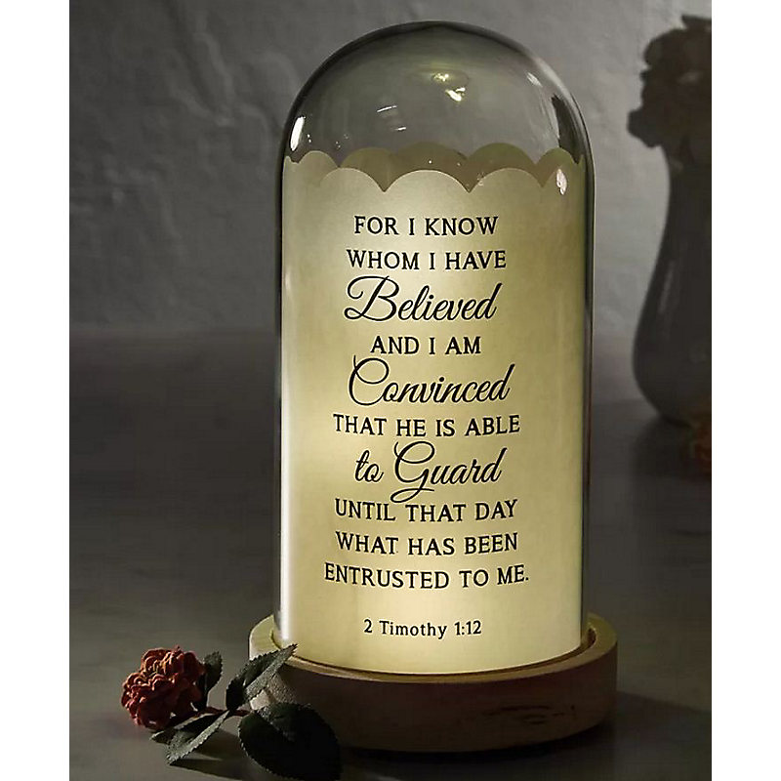
I Know Whom I Have Believed
The Need to Commit
Ourselves to God
  Romans 1:25
  2 Timothy 1:12
  1 Peter 4:19
  1 Peter 5:7
Richie Thetford www.thetfordcountry.com

Slide 5

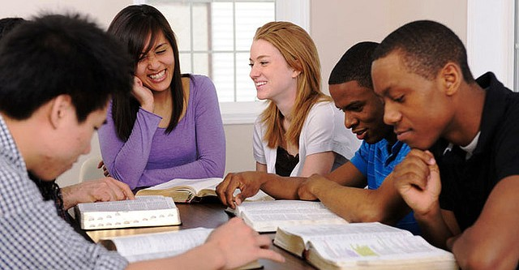
I Know Whom I Have Believed
Conclusion
  Romans 8:31-32
  Job 13:15
  Daniel 3:16-18
  Romans 1:5
Do we know whom
we have believed?
Richie Thetford www.thetfordcountry.com

