Slide 1
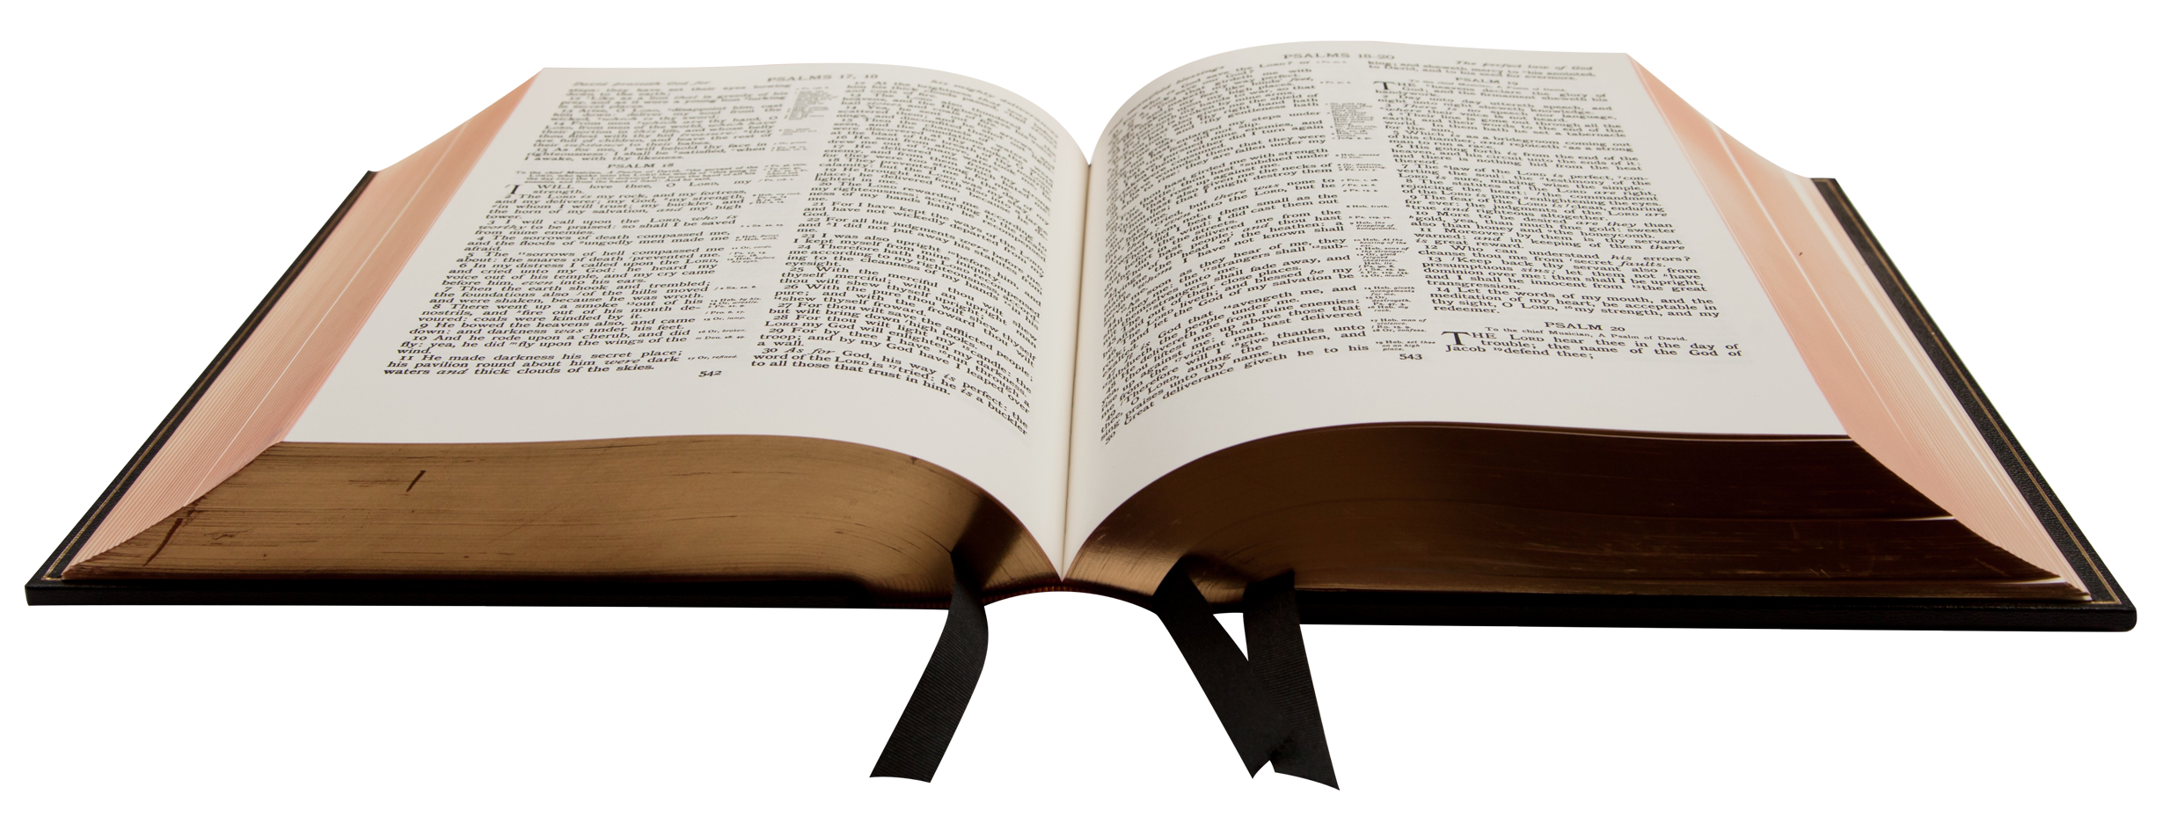
“I Did Not Cease to Warn Everyone”
Acts 20:31
Richie Thetford www.thetfordcountry.com

Slide 2

Ezekiel – The Watchman
Ezekiel the priest of God
  Ezekiel 3:17-21
  Ezekiel 2:7
A warning serves two purposes
  Makes one aware of sin
  Makes one free from the blood
  of the individual warned
Richie Thetford www.thetfordcountry.com

Slide 3

Paul’s Admonitions
Various Admonitions
  1 Thessalonians 2:4
  Galatians 1:10
  2 Corinthians 5:11; 4:1-2
  Acts 20:26-27, 31
  1 Timothy 4:6
  Titus 2:15; 2 Timothy 4:2-4
Richie Thetford www.thetfordcountry.com

Slide 4

The Love of the Truth
Jesus
  Matthew 5:6
Paul’s Assertion
  Galatians 4:16
  2 Thessalonians 2:10-12
Richie Thetford www.thetfordcountry.com

Slide 5
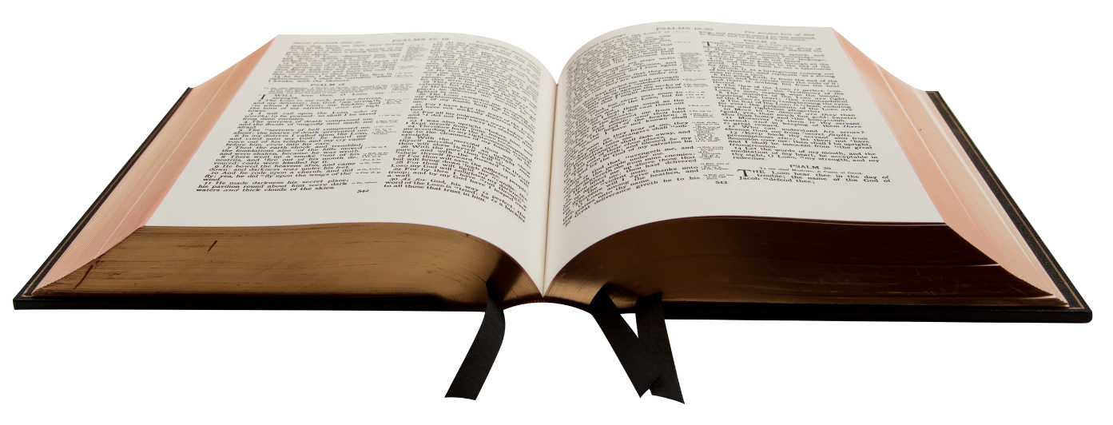
Conclusion
Solomon’s wise words
  Proverbs 1:7
“And let us consider one another in order to stir up love and good works”
Hebrews 10:24
“I ceased not to warn everyone night and day with tears”
Richie Thetford www.thetfordcountry.com

