Slide 1
hypocrisy
The practice of professing beliefs, feelings, or virtues that one does not hold or possess; falseness. An act or instance of such falseness. Play acting, to take on another’s part.
Richie Thetford www.thetfordcountry.com

Slide 2
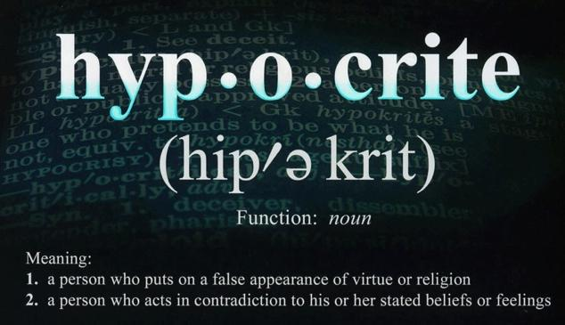


hypocrisy
Richie Thetford www.thetfordcountry.com

Slide 3
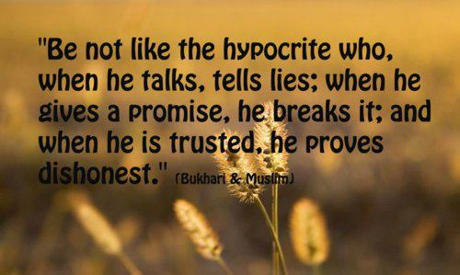
Some key verses
Job 13:16
Job 17:8
Job 20:5
Job 27:8
Matthew 7:4-5
Luke 13:14-15
Richie Thetford www.thetfordcountry.com

Slide 4

Who is a hypocrite?
Matthew 6:2
Matthew 15:7-8
Matthew 22:18
Matthew 23:14
Richie Thetford www.thetfordcountry.com

Slide 5
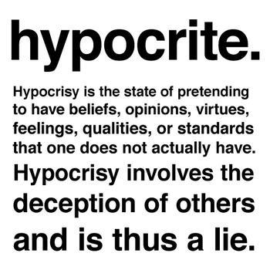
Some well known hypocrites
Judas Iscariot
  Mark 14:44-45
The Pharisees
  Matthew 23
Ananias and Sapphira
  Acts 5
Peter
  Galatians 2
Richie Thetford www.thetfordcountry.com

Slide 6
A hypocrite and a christian
HYPOCRITE | CHRISTIAN
Pretends | Genuine
Play-Acting | Sincere
Selfish | Unselfish
Wants the praise of men | Desires praise of God
No conviction | Great conviction
Tries to deceive man | Tries to serve man
Tries to deceive God | Strives to serve God
Richie Thetford www.thetfordcountry.com

Slide 7

Hypocrites try to fool god
Jeroboam sent his wife to try to fool the prophet of God
  1 Kings 14:1-6
Cannot deceive God!
Richie Thetford www.thetfordcountry.com

Slide 8
HypocriTE
– DON’T BE!
Strive diligently to serve God fully
HYPOCRITES
WILL NOT ENTER HEAVEN
Richie Thetford www.thetfordcountry.com

