Slide 1
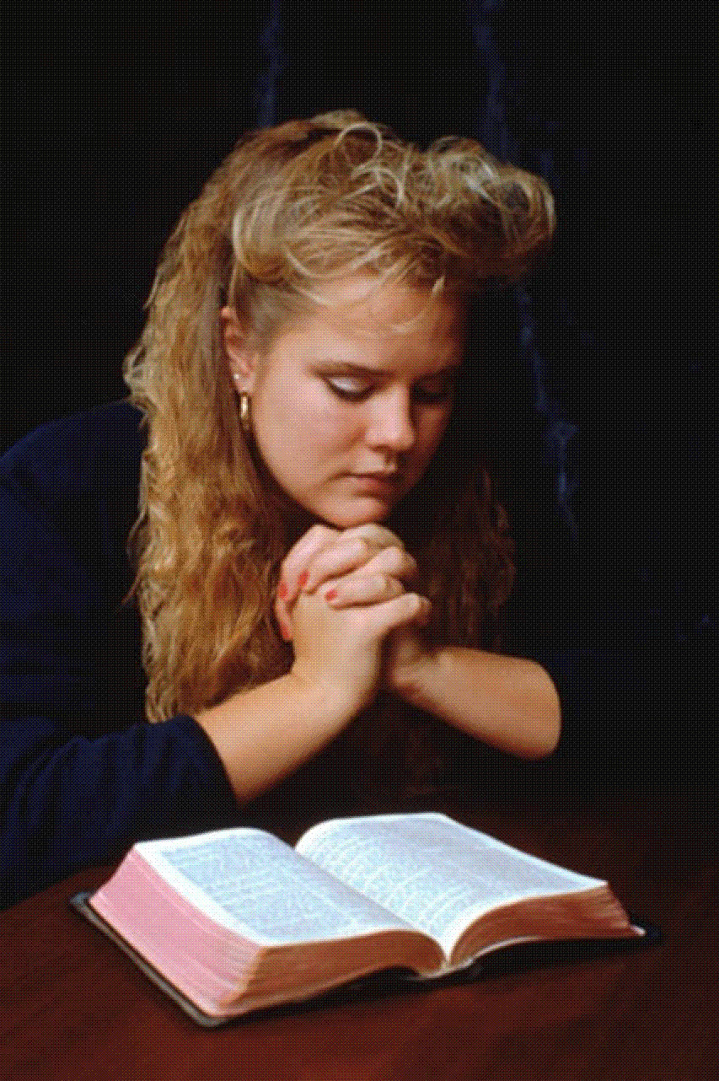
How Committed Are We?
Christians
must be
Totally
Committed
to Christ
Commitment means:
“an agreement or pledge to do something in the future….the state of being obligated”
Richie Thetford www.thetfordcountry.com

Slide 2

The Commitment of Discipleship
Jesus taught men to count the cost of discipleship
“Now it happened as they journeyed on the road, that someone said to Him, "Lord, I will follow You wherever You go." And Jesus said to him, "Foxes have holes and birds of the air have nests, but the Son of Man has nowhere to lay His head.“ Then He said to another, "Follow Me." But he said, "Lord, let me first go and bury my father.“ Jesus said to him, "Let the dead bury their own dead, but you go and preach the kingdom of God.“ And another also said, "Lord, I will follow You, but let me first go and bid them farewell who are at my house.“ But Jesus said to him, "No one, having put his hand to the plow,
and looking back, is fit for the kingdom of God.”
Luke 9:57-62
Richie Thetford www.thetfordcountry.com

Slide 3
The Commitment of Discipleship
The cost of discipleship
  Requires self-denial
  The kingdom MUST take precedence!
“If anyone comes to Me and does not hate his father and mother, wife and children, brothers and sisters, yes, and his own life also, he cannot be My disciple”
Luke 14:26
  Christ must be elevated above family and self
    Matthew 16:24
Christ is our great example
  Philippians 2:1-12
Richie Thetford www.thetfordcountry.com

Slide 4
Paul’s Example of Commitment
He endured much as a Christian
  2 Corinthians 11:23-28; 4:8-10
A soldier understands his commitment
  2 Timothy 2:3-4
He taught others the necessity of living for Christ above all else!
  Galatians 2:20; 2 Corinthians 5:9, 15
He stayed committed when facing death
  2 Timothy 4:6-8
Richie Thetford www.thetfordcountry.com

Slide 5
The Devil’s Effort to Destroy
Our Commitment to Christ
Some may be deterred by:
  False teachers
    2 Peter 2:1-2
  Various temptations
    Luke 8:14
Some become involved in things not sinful
    Matthew 6:33
    Colossians 3:2
    Philippians 2:21; 3:18-19
Richie Thetford www.thetfordcountry.com

Slide 6

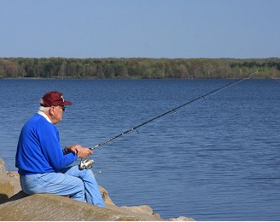
Churches Suffer From
Lack of Commitment
Lack of attendance
Little or no Bible study
  2 Timothy 2:15
“Functions” become more important than our worship
  School, business, recreation
Richie Thetford www.thetfordcountry.com

Slide 7
The Cost of
NOT being Committed
Costly to the Lord’s church
  Worship services will be lifeless
Poor attendance
  Differences between service times
Few conversions
  No personal work going on in our life
Children will be lost
  Must lead by example
The local church will die – not a priority!
Richie Thetford www.thetfordcountry.com

Slide 8
Conclusion
Seek and knock
"Ask, and it will be given to you; seek, and you will find; knock,
and it will be opened to you.” (Matthew 7:7)
“a committed Christian is not a sleeping Christian”
Remember:
“And thus we see that in the beginning all appear alike, but when the heat is on, some come forth and give their all while others fail and are discarded”
"No one, having put his hand to the plow, and looking back,
is fit for the kingdom of God.”
Richie Thetford www.thetfordcountry.com

