Slide 1

How Can I Know God Exists?
“because what may be known of God is manifest in them, for God has shown it to them. For since the creation of the world His invisible attributes are clearly seen, being understood by the things that are made, even His eternal power and Godhead, so that they are without excuse,”
Romans 1:19-20
Richie Thetford www.thetfordcountry.com

Slide 2

God's Evidence
Seen in the Stars
  Psalms 19:1-2
Seen in Man’s Capacity to Reason
  Hebrews 3:4
Seen in the Bible
  2 Timothy 3:16
Richie Thetford www.thetfordcountry.com

Slide 3

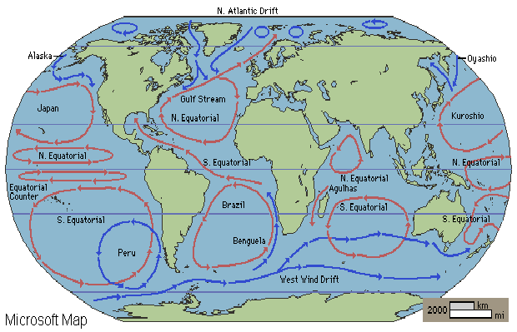
Bible's
Evidence
“Paths of the Sea”
Psalms 8:8
(written 1,000 B.C.)
Modern Man,
In 1855 A.D., discovers this scientific fact about 3,000 years after God wrote it in the Bible!
Richie Thetford www.thetfordcountry.com

Slide 4

Bible's
Evidence
“Springs of the Sea”
Job 38:16
(written 2,000 B.C.)
Genesis 7:11; 8:2
(1450 B.C.) “fountains of deep”
Proverbs 8:28
(1,000 B.C.) “springs of deep”
Modern Man,
beginning in 1930 A.D., discovered fresh water springs in the ocean. God wrote it in the Bible 4,000 years earlier!
Richie Thetford www.thetfordcountry.com

Slide 5

Bible's
Evidence
“Recesses of the Deep”
Job 38:16b
(written 2,000 B.C.)
Until the 19th Century man had believed the ocean floors were flat,
sandy beds like our deserts. In the Bible God revealed what man
did not discover for another 4,000 years!
Richie Thetford www.thetfordcountry.com

Slide 6
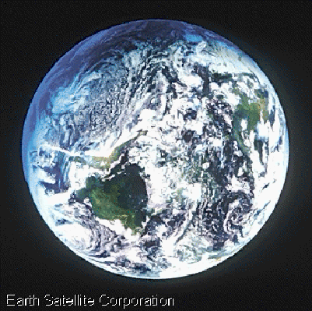
Bible's
Evidence
“Circle of the Earth”
Isaiah 40:22
(written about 700 B.C.)
Modern Man,
in 1492 A.D. discovers this scientific fact about 2,200 years
after God wrote it in the Bible!
Richie Thetford www.thetfordcountry.com

Slide 7
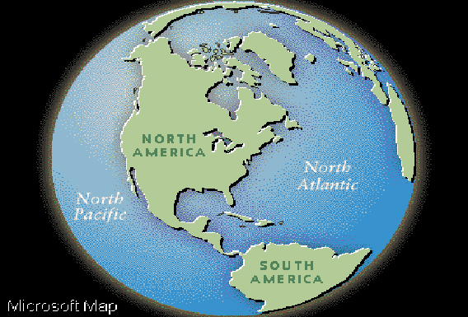
Bible's
Evidence
“Waters – Gathered into One Place”
Genesis 1:9-10
(written 1,450 B.C.)
Modern Man,
in 1520 A.D. discovers this scientific fact about 3,000 years
after God wrote it in the Bible!
Richie Thetford www.thetfordcountry.com

Slide 8
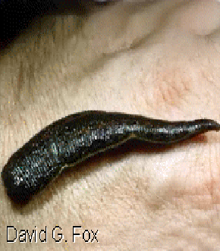
Bible's
Evidence
“Life of the Flesh is in the Blood”
Leviticus 17:11
(written 1,450 B.C.)
Modern Man,
in the 19th Century, was still practicing Blood Letting some 3,300 years after God wrote this scripture in the Bible!
Richie Thetford www.thetfordcountry.com

Slide 9
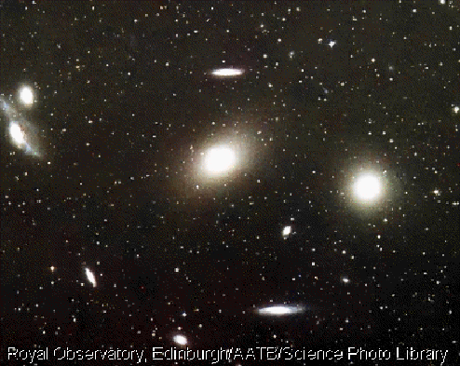
Bible's
Evidence
“Stars Sang”
Job 38:7
(written 2,000 B.C.)
Modern Man,
in 1942 A.D. discovered the scientific fact that stars emit sound.
God wrote it in the Bible 4,000 years earlier!
Richie Thetford www.thetfordcountry.com

Slide 10
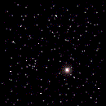

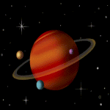
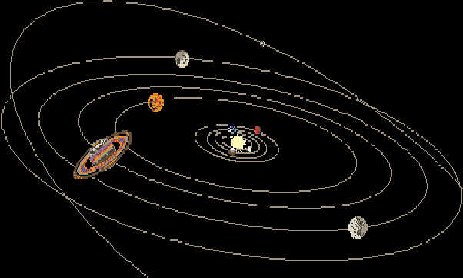
Bible's
Evidence
“Earth Revolves Daily”
Job 38:12-14
(written 2,000 B.C.)
“…it is changed like
clay under the seal.”
Modern Man,
in 1851 A.D. finally proved as a scientific fact what
God had written in the Bible 4,000 years earlier!
Richie Thetford www.thetfordcountry.com

Slide 11
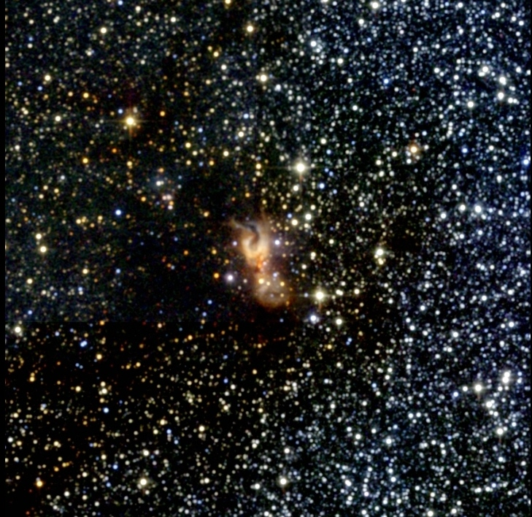
Bible's
Evidence
“Host of Heaven Cannot be Numbered”
Jeremiah 33:22
(written 600 B.C.)
Hebrews 11:12
(written 68 A.D.)
“stars…innumerable”
Man thought the stars could be numbered until 1608 A.D. when the first telescope was invented. Man then realized what
God had written 2,200 years earlier in the Bible!
Richie Thetford www.thetfordcountry.com

Slide 12
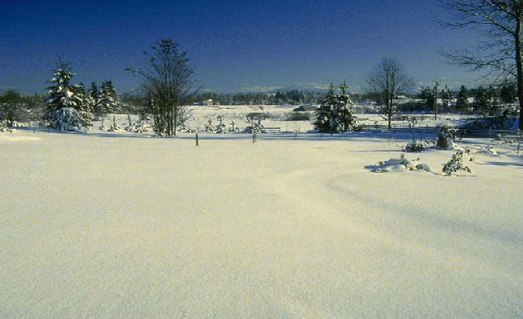
Bible's
Evidence
“Treasures of the Snow”
Job 38:22
(written 2,000 B.C.)
Modern Man,
in the 1920’s, discovered that snow is a valuable fertilizer.
God wrote it in the Bible 4,000 yrs earlier!
Richie Thetford www.thetfordcountry.com

Slide 13
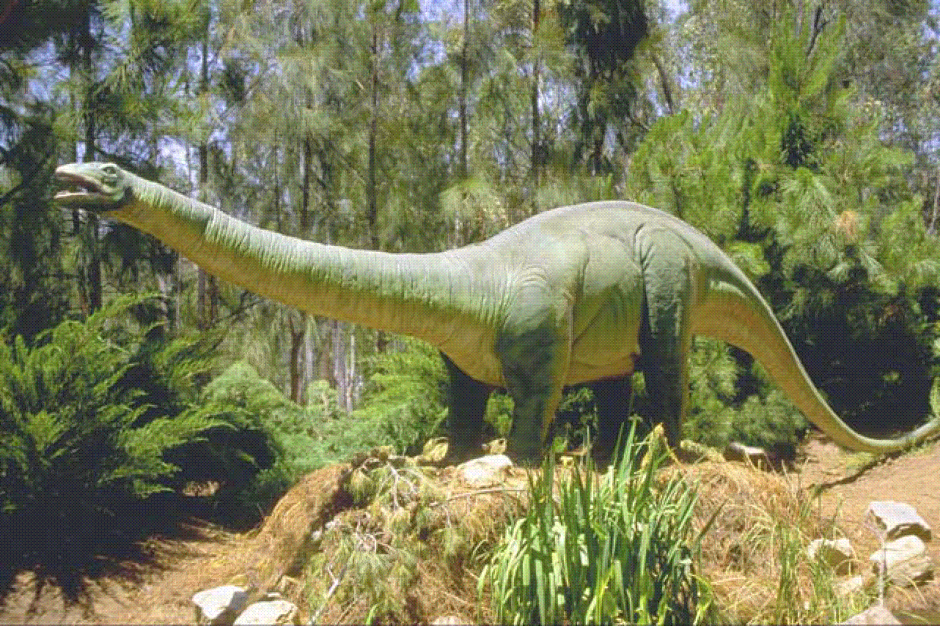
Bible's
Evidence
“Dinosaurs in the Bible”
Job 40:15-24
(written 2,000 B.C.)
Richie Thetford www.thetfordcountry.com

Slide 14
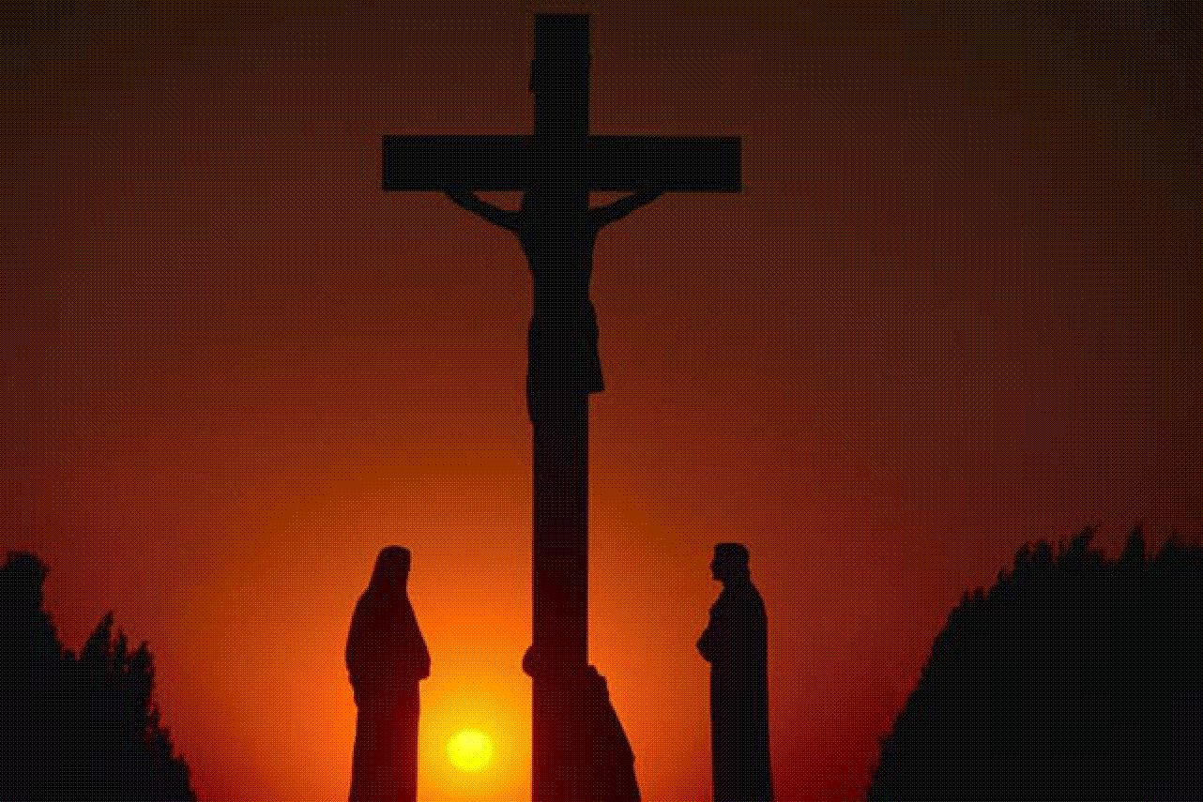
Bible's
Evidence
“Prophecies of the Messiah”
At least 332
Old Testament
Prophecies of Christ
Birthplace
Micah 5:2
Lineage
Isaiah 7:14 (born of a virgin)
Genesis 12:3 (of Abraham)
Genesis 49:10 (tribe of Judah)
Psalms 2:6-7 (Son of God)
Richie Thetford www.thetfordcountry.com

Slide 15
Bible's
Evidence
“Prophecies of the Messiah”
At least 16 prophecies fulfilled in one 24 hour period surrounding Jesus’ death (many were fulfilled by his enemies who would not knowingly fulfill one scripture)
Zechariah 9:9 (description of triumphal entry
Zechariah 11:12-13 (betrayal, 30 pieces of silver)
Zechariah 13:7 (disciples to forsake Him)
Isaiah 53:7 (silent before accusers)
Psalms 22:16 (hands and feet to be pierced)
Psalms 34:20 (no broken bones)
Psalms 16:10 (body did not see corruption)
Joel 2:28f (Pentecost foretold)
Richie Thetford www.thetfordcountry.com

Slide 16
“The fool has said in his heart, there is no God”
Psalms 14:1
Richie Thetford www.thetfordcountry.com

