Slide 1

The
House of God
“For the time has come for judgment to begin at the house of God; and if it begins with us first, what will be the end of those who do not obey the gospel of God?”
1 Peter 4:17
This scripture teaches that the church
(those called out) are referred to as the
“house of God”

Slide 2
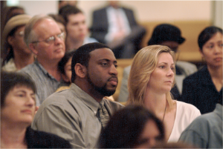
The Church is the
Family of God
“but if I am delayed, I write so that you may know how you ought to conduct yourself in the house of God, which is the church of the living God, the pillar and ground of the truth.”
1 Timothy 3:15
House means family
  Acts 16:31; 10:1-2
Christ is over the house
  Hebrews 3:6; Colossians 1:18
Those in the church are in the house of God
  Ephesians 2:19

Slide 3
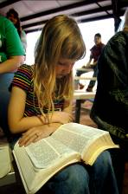
God is the Father
All Christians are children
  Matthew 23:9
The right to call ourselves children
shows a degree of affection
“Behold what manner of love the Father has bestowed on us, that we should be called children of God! Therefore the world does not know us, because it did not know Him. Beloved, now we are children of God; and it has not yet been revealed what we shall be, but we know that when He is revealed, we shall be like Him, for we shall see Him as He is. And everyone who has this hope in Him purifies himself, just as He is pure.” 1 John 3:1-3

Slide 4
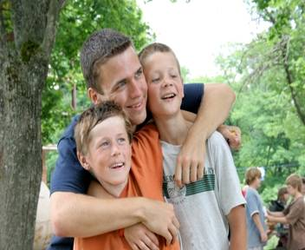
Obligations
As children, we have obligations in God’s house
To do righteousness
  1 John 3:10
To love our brethren
  1 Peter 2:17; John 13:34-35
To give God all the glory
“to Him be glory in the church by Christ Jesus to all generations, forever and ever. Amen.” Ephesians 3:21

Slide 5

Blessings
We are heirs of God
  Heirs according to the promise of Abraham
  Galatians 3:15-18, 26-29
  Joint heirs with Christ,
  if we’re His children
  Romans 8:17
Heir – “one who inherits or is entitled to inherit another’s property or title upon the other’s death.”

Slide 6
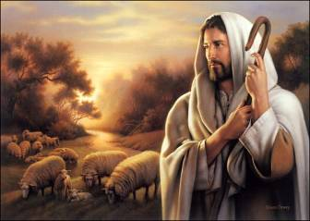
Blessings
We have God’s correction and chastening
  God’s children are chastened by the Word of God
  Hebrews 12:5-11
  Children of God follow Him
  John 10:27
  Children in God’s house
  understand that all must
  be done by the authority
  of Jesus
  Colossians 3:17

Slide 7

Blessings
God’s children can approach Him because they listen to Him
  Jesus teaches how the Father
  is to be approached
  Matthew 6:8-15
  Know that God will answer them
  Matthew 7:7-11
  Those who refuse to listen and
  obey the Father, will not be heard
  Proverbs 1:24-33

Slide 8
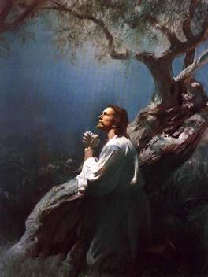
Blessings
God’s children can find a way
of escape from sins
  God will not permit temptation
  greater than His children
  can bear
  1 Corinthians 10:13
  Jesus escaped temptations
  and is our great example
  1 Peter 2:21

Slide 9
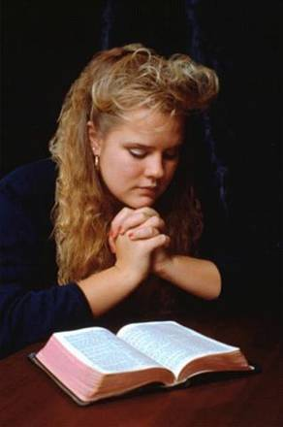
How Can One Become a Member of the
House of God?
Hear the gospel message
  Romans 10:17; Hebrews 11:6
Believe the message of God
  Romans 10:10; John 8:24
Repent of your sins,
turning to serve God
  Acts 17:30; Luke 13:3

Slide 10
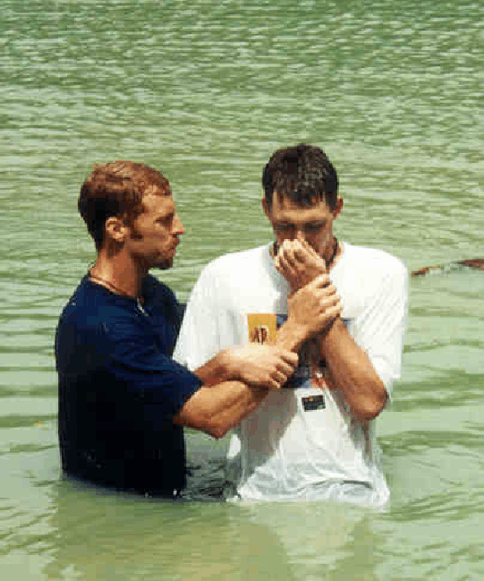
How Can One Become a Member of the
House of God?
Confess Jesus as the Son of God
  Romans 10:10; Acts 8:37
Be baptized for the
forgiveness of your sins
  Acts 2:38; Mark 16:16;
  1 Peter 3:21
Live faithful to God
  Revelation 2:10

Slide 11
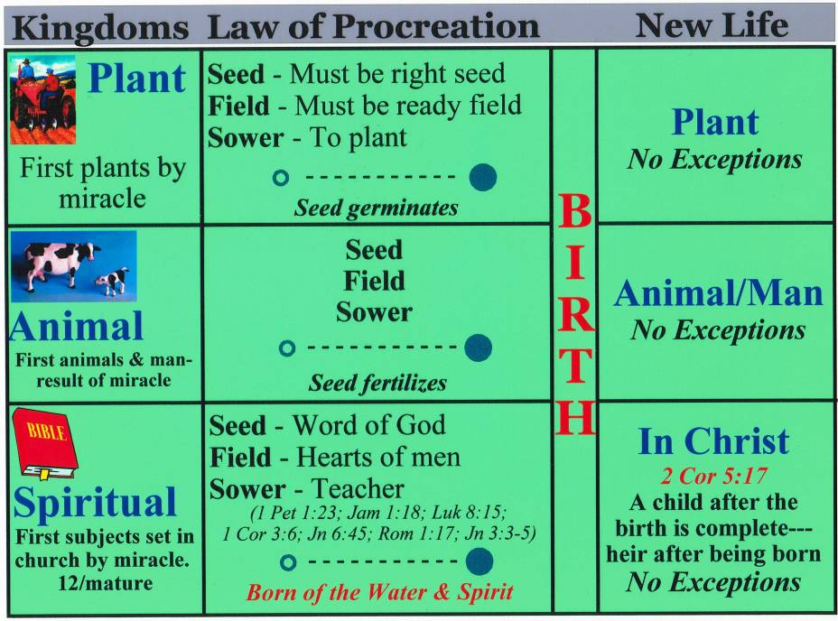

Slide 12

CONCLUSION
One cannot be a child of God and NOT be in God’s family, the church
Those in the house of God love one another
  We refer to one another as brother and sister
There is no closer relationship
than that of the family of God
Be determined to remain faithful

