Slide 1
The Hand of God Working In Our Life!
“Blessed be the God and Father of our Lord Jesus Christ, who has blessed us with every spiritual blessing in the heavenly places in Christ” Ephesians 1:3
Richard Thetford www.thetfordcountry.com

Slide 2
The Hand of God Working In Our Life!
Providence
Old Testament
Joseph (Genesis 39:21)
Esther (Esther 4:14)
Cyrus (Isaiah 44:28)
Today
Civil Rulers (1 Timothy 2:1-2)
His Children (Matthew 6:33)
We can be assured that God will provide for our needs if we faithfully serve Him and do our part
Richard Thetford www.thetfordcountry.com

Slide 3
The Hand of God Working In Our Life!
God Works In Us
“The power that works in us”
Ephesians 3:14-21
Some make this a mystical experience; or direct action of the Holy Spirit in the Christian’s life.
V.14-15 – Grants you to be strengthened
V.16 – Spirit works on the inner man
V.17 – Christ dwelling in our heart by faith
V.17-19 – Benefits
V.20 – The power works in us (power of God working in our lives)
1 John 5:4; Colossians 1:9-11
Richard Thetford www.thetfordcountry.com

Slide 4
The Hand of God Working In Our Life!
God Works In Us
Man and God are at work to accomplish God’s will in man’s life!
“Therefore, my beloved, as you have always obeyed, not as in my presence only, but now much more in my absence, work out your own salvation with fear and trembling; for it is God who works in you both to will and to do for His good pleasure.” Philippians 2:12-13
Richard Thetford www.thetfordcountry.com

Slide 5
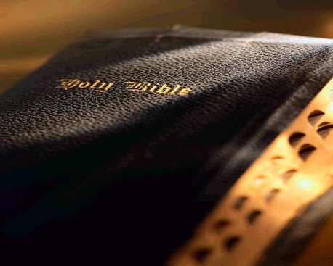
The Hand of God Working In Our Life!
How Does God Work In Our Life?
Through the Gospel
Acts 2:37, 39; 16:13-15
Through Human Agents
Ephesians 4:11-13; 1 Corinthians 3:9
Through Prayer
John 14:13-14; 15:7
Richard Thetford www.thetfordcountry.com

Slide 6
The Hand of God Working In Our Life!
Can Men Do God’s Work in Their Lives?
WE MUST!
John 6:27-29
Faith is a work that we MUST do
Through our obedience God’s works are accomplished in our life
“Therefore, my beloved, as you have always obeyed, not as in my presence only, but now much more in my absence, work out your own salvation with fear and trembling; for it is God who works in you both to will and to do for His good pleasure.” Philippians 2:12-13
Richard Thetford www.thetfordcountry.com

Slide 7
The Hand of God Working In Our Life!
What Have We Learned?
* Trust in God (Matthew 6:30-32)
* Pray to God (Matthew 7:7-11; James 5:13-18)
* Live faithfully for God
We should work as if everything depends upon us, and pray as if everything depends upon God
Richard Thetford www.thetfordcountry.com

