Slide 1
The Hall of Faith
Hebrews 11

Slide 2

What is Faith?

Slide 3

What is Faith?
By faith we believe God created all
  Hebrews 11:2-3

Slide 4

God’s Hall of Faith
Abel
  Hebrews 11:4
Enoch
  Hebrews 11:5
Noah
  Hebrews 11:7
Abraham
  Hebrews 11:8-10, 17-19

Slide 5
God’s Hall of Faith
Sarah
  Hebrews 11:11
Isaac
  Hebrews 11:20
Jacob
  Hebrews 11:21
Joseph
  Hebrews 11:22

Slide 6
God’s Hall of Faith
Moses
  Hebrews 11:23-29
Joshua
  Hebrews 11:30
Rahab
  Hebrews 11:31
Gideon, Barak, Samson, Others
  Hebrews 11:32-38

Slide 7
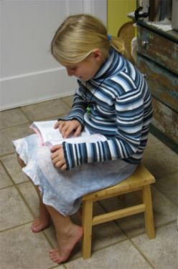
Jesus, the Perfecter of Faith
Did not receive what was promised
  Acts 1:4; 2:39
  Galatians 3:14
  Hebrews 11:13-16, 39-40
Jesus is our great example
  Hebrews 12:2-3
  Revelation 1:8
  Our complete model of faith

Slide 8

Must Have Faith in God’s Word
This is necessary
  1 John 5:1-5
Must obey His commands
  Romans 4:16-21
  John 12:48
  Acts 17:30
  Acts 2:38
  Hebrews 10:25
  Philippians 2:12

Slide 9
Must Have Faith in God’s Word
To have faith in His promises
  Sins forgiven
    Acts 2:38
  Work not in vain
    1 Corinthians 15:58
  Needs will be supplied
    Matthew 6:33
  Of the resurrection when Jesus returns
    John 5:28-29

Slide 10

Conclusion
Must use our faith to keep it alive!
  Romans 15:4
  No greater reward can be received than to have their name written in the book of life!

