Slide 1
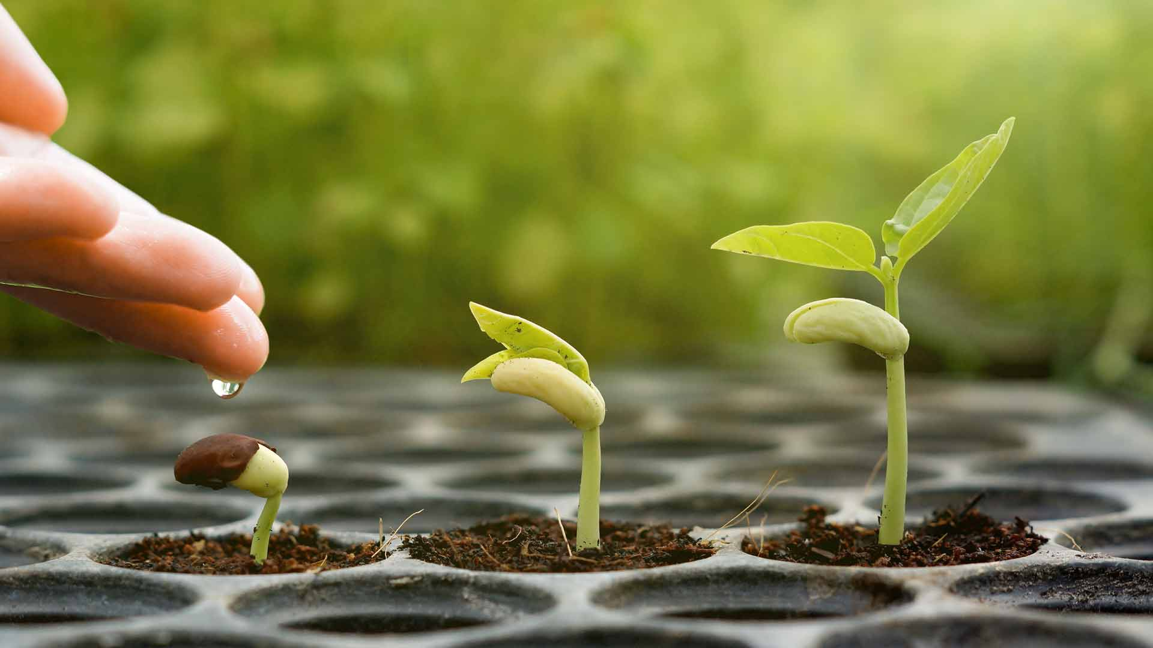
Growing spiritually
Luke 8:14
Richie Thetford www.thetfordcountry.com

Slide 2

It takes time to grow spiritually
“Quantity” and “Quality” time
Time to absorb God’s word
  1 Peter 2:2
Richie Thetford www.thetfordcountry.com

Slide 3

Time must be managed well
Must exercise good stewardship
We might be “prodigal” in regard to time
  Luke 15:11-13
Prodigal = recklessly wasteful, extravagant
Richie Thetford www.thetfordcountry.com

Slide 4

An Over commitment to Activities
Things compete with our devotional lives
Take the time for “maintenance”
Distracted by worry and other things
  Luke 10:41-42
Richie Thetford www.thetfordcountry.com

Slide 5

Jesus is our perfect example
In the matter of perfect devotion to God
  Mark 3:20
  Mark 6:30-32
Jesus arranged for time alone with His Father
  Matthew 14:13-14, 22-25
  Mark 1:35
  Luke 6:12; 5:16
Richie Thetford www.thetfordcountry.com

Slide 6

conclusion
Must meditate on spiritual matters
  1 Timothy 4:15
Ask for God’s help
  Luke 11:1
Richie Thetford www.thetfordcountry.com

