Slide 1
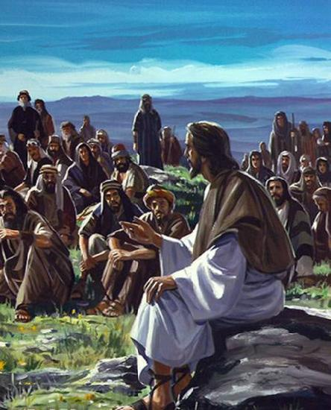
The Great Physician
“The Spirit of the LORD is upon Me, Because He has anointed Me To preach the gospel to the poor; He has sent Me to heal the brokenhearted, To proclaim liberty to the captives And recovery of sight to the blind, To set at liberty those who are oppressed”
Luke 4:18
Richie Thetford www.thetfordcountry.com

Slide 2
What Kind of Physician is Christ?
Knows Our Case
John 2:24-25
Able to Save
Hebrews 7:25; John 11:25
Sympathetic
John 11:32-36; Hebrews 4:15
Richie Thetford www.thetfordcountry.com

Slide 3
What Can Christ Cure?
Our Soul’s Disease
I said, "LORD, be merciful to me; Heal my soul, for I have sinned against You."
Psalm 41:4
Romans 11:26-27
Richie Thetford www.thetfordcountry.com

Slide 4
What Are the Stages of this Disease?
Lust or Evil Desire
James 1:14-15
Practice of Sin
Romans 1:32; Galatians 5:21
Death
James 1:15; Romans 5:12
Richie Thetford www.thetfordcountry.com

Slide 5
What is Christ’s Remedy for Sin?
Word of God
Psalm 107:20; Romans 10:17
Faith
Hebrews 11:6; John 8:24
Repentance
Acts 17:30; Luke 13:5
Richie Thetford www.thetfordcountry.com

Slide 6
What is Christ’s Remedy for Sin?
Baptism
Acts 22:16; Romans 6:3-4
1 John 1:7
Confession and Prayer
Acts 8:22
1 John 1:9
Richie Thetford www.thetfordcountry.com

Slide 7
What Doesn’t Christ Heal All People?
Many Will Not Come
John 5:39-40
Matthew 11:28-30
Many Will Not Obey
Luke 6:46-49
Hebrews 5:8-9
Richie Thetford www.thetfordcountry.com

Slide 8
Who Needs the Great Physician?
ALL DO!
“for all have sinned and fall
short of the glory of God”
Romans 3:23
Romans 6:23
Richie Thetford www.thetfordcountry.com

Slide 9
The Great Physician
“Those who are well have no need of a physician, but those who are sick. I did not come to call the righteous, but sinners, to repentance.”
Mark 2:17
“The Great Physician now is near, the sympathizing Jesus….”
“O hear the voice of Jesus”
Richie Thetford www.thetfordcountry.com

