Slide 1
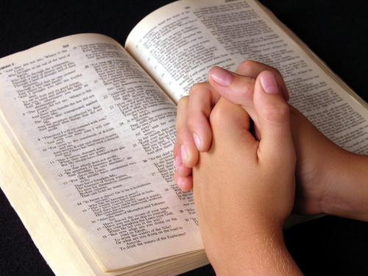
The Great Faith of Noah
Hebrews 11:7

Slide 2
Faith Caused Noah to Accept a Future Reality as a Fact
Most important parts of reality are unseen
2 Corinthians 4:18
Hebrews 11:1
2 Peter 3:1-9

Slide 3
Faith Caused the Future Reality to Have a Practical Impact on Noah’s Life
Faith calls for decisive action
James 2:14-26

Slide 4
Faith Caused Noah to Endure Scoffing
We must obey God and endure scoffing
Matthew 10:25, 28
Hebrews 12:1-4

Slide 5
Faith Caused Noah to Do Exactly What God Instructed, Without Modification
We must do all things “according to the pattern”
Hebrews 8:5
Hebrews 7:11-14

Slide 6
Faith Saved Noah from Destruction
The quality of faith exhibited by Noah is the only kind that saves
1 Peter 3:18-22

Slide 7
Conclusion
Noah’s faith was an obedient trust in God
Does our own faith have the characteristics of the faith that saved Noah?

