Slide 1
The Gospel Helps Us
Philippians 3:8
“Yet indeed I also count all things loss for the excellence of the knowledge of Christ Jesus my Lord, for whom I have suffered the loss of all things, and count them as rubbish, that I may gain Christ”

Slide 2
What Our Problems Are
Problems in the world
Pain in the heart
Sin in behavior
Sin in the heart
Broken relationship with God

Slide 3
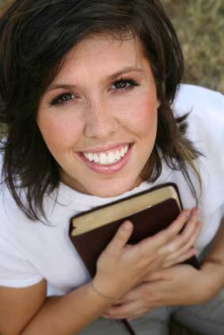
What Our Problems Are
Help in knowing God
Philippians 3:8; John 17:3
Help with our inner heart
Proverbs 4:23; Romans 12:2
Help with our behavior
Colossians 2:6; 3:5-7, 12-14
Help with our feelings
John 16:33
Help with our external circumstances
Matthew 5:13-16

Slide 4
What Our Priorities Ought to Be
Concerned about problems with the gospel’s priorities
Romans 12:2
Matthew 7:5
Philippians 3:8
Ecclesiastes 12:13-14
Matthew 23:23-28
Matthew 22:37-40
Be careful what “appeal we make
Demand “practical” “God centered” preaching

Slide 5
Heaven is Where Perfection is Promised
The gospel promises the hope of heaven
Mark 10:29-31
1 Timothy 4:8
God will destroy this world
2 Peter 3:10-13
John 6:26-27
Gospel allows us to know God
Revelation 22:4; Matthew 5:6-8
Knowing God is what the Bible is all about
Jeremiah 9:23-24; Philippians 3:7-11

Slide 6
Conclusion
What would you say Christianity is?
Being with God in eternity
1 Peter 1:3-12
Ephesians 3:19
John 4:23
Jesus died so that we might have life
John 3:16
Hebrews 11:6

