Slide 1
The “GOLDEN RULE”
Matthew 7:12
https://poweredtemplate.com/14178/0/index.html
Richard Thetford www.thetfordcountry.com

Slide 2
“Golden Rule” vs “Silver Rule”
Many have taught that which is similar
Jesus’ rule was slightly different
Jesus’ rule is truly the “Golden” rule
Jesus requires you to do something favorably to others, while others prohibit you from doing something unfavorably to others!
Richard Thetford www.thetfordcountry.com

Slide 3
A Guideline for Righteous Conduct
In harmony with the Law and the Prophets
Matthew 5:20-48
“Love your neighbor as yourself”
Romans 13:8-10
This ONE “rule” summarizes what the Law and the Prophets were all about.
Richard Thetford www.thetfordcountry.com

Slide 4
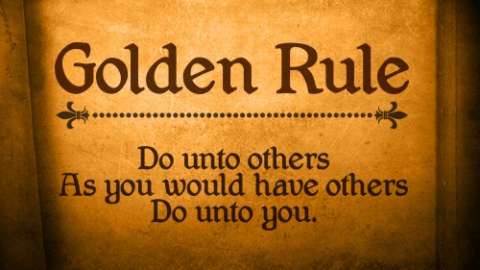
Examples – How to Apply this “Rule”
In teaching the lost
2 Timothy 2:24-26
Ephesians 4:15
In correcting one another
Galatians 6:1-2
In treating our family, neighbors, enemies
Don’t limit the application of the “Golden Rule” to religious matters!
Richard Thetford www.thetfordcountry.com

Slide 5
Conclusion
“The Golden Rule” would reconcile capital and labor, all political contention and uproar, all selfishness and greed.”
--- Joseph Parker (1830-1902)
“We have committed the Golden Rule to memory; let us now commit it to life.”
--- Edwin Markham (1852-1940)
“Therefore, whatever you want men to do to you, do also to them, for this is the Law and the Prophets.”
--- Jesus (Matthew 7:12)
Richard Thetford www.thetfordcountry.com

