Slide 1
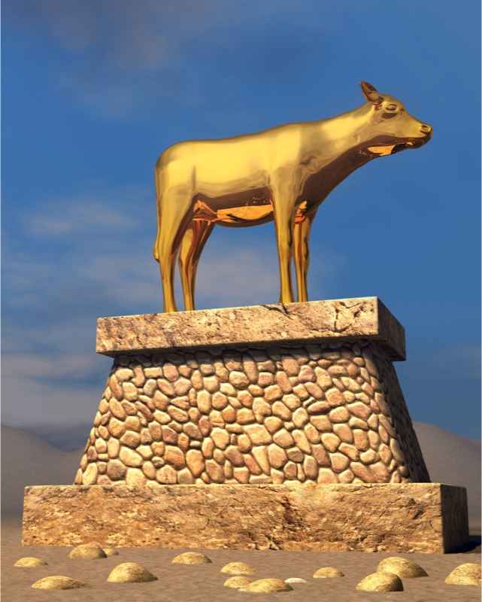
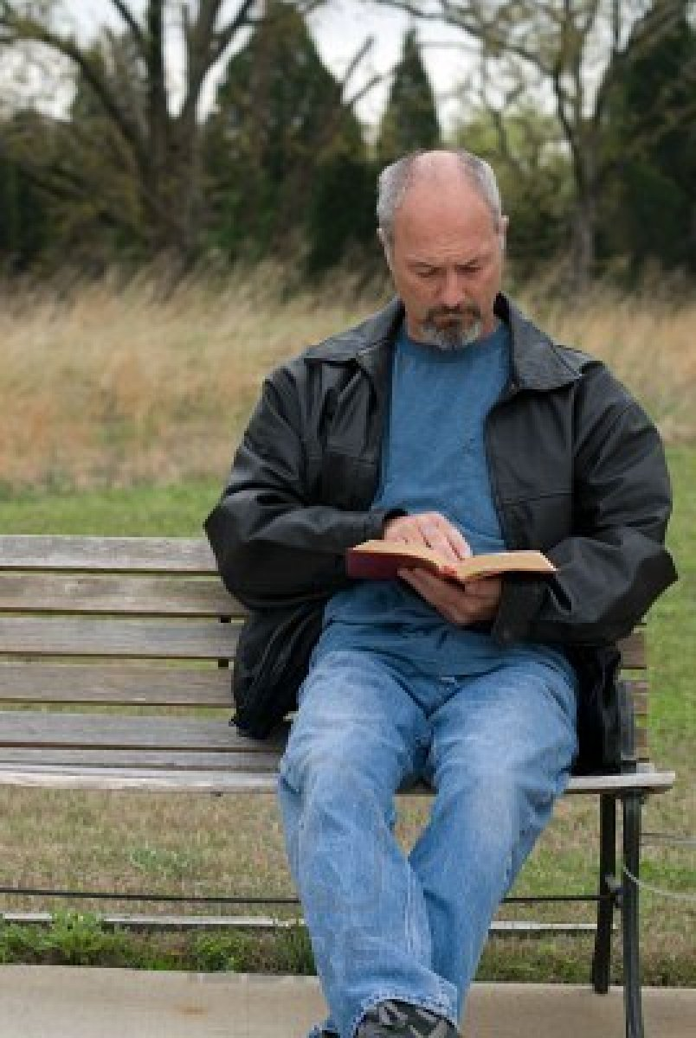
The Golden Calf
Exodus 24:12-18
and the Christian

Slide 2
The Golden Calf
A Golden Calf is constructed
Exodus 32:1-6
Recognize when it comes (v1)
Recognize where it comes from (v1)
Recognize who wants it (Vs2-4)
Recognize what it is (v4)
Recognize how it changes your life (v6)

Slide 3
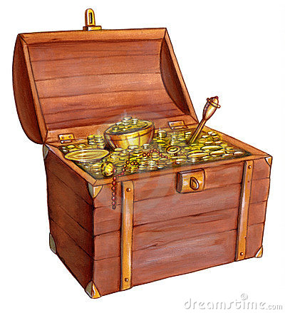
The Financial Treasure Key
Matthew 6:19-21
Do not lay up for yourselves treasures on earth, where moth and rust destroy and where thieves break in and steal; but lay up for yourselves treasures in heaven, where neither moth nor rust destroys and where thieves do not break in and steal. For where your treasure is, there your heart will be also.

Slide 4
The Financial Treasure Key
The treasure of Matthew 6:19-21
Money, wealth, and materialism are cancers
Christians have bought into the philosophy of the need for more
Jesus has another plan for us!
“Too many people spend money they haven’t earned, to buy things they don’t want, to impress people they don’t like.”
---- Will Rogers

Slide 5
Materialism and the Rich Fool
Luke 12:13-21
Our Problem
Wanting more than we already have
A Warning
Fight against greed is a constant struggle
The Truth
Who we are is much more important than what we have!

Slide 6
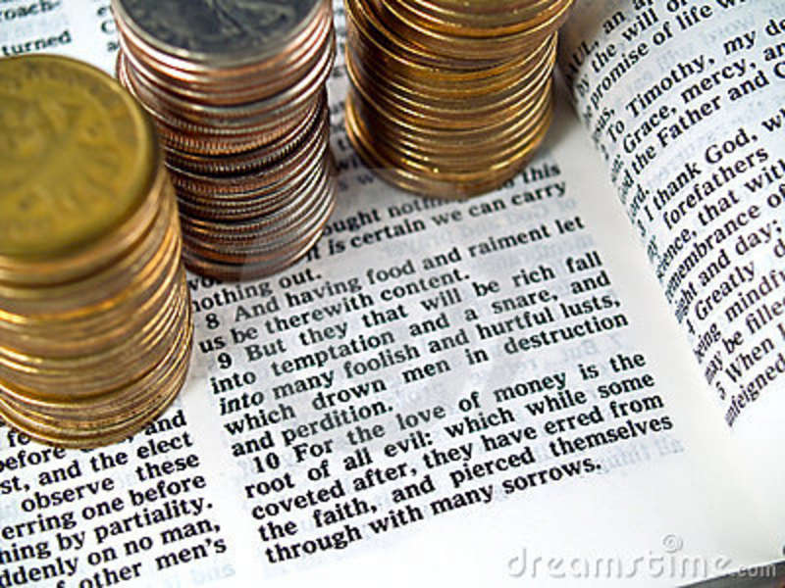
Parable’s Application Lessons
We already have more than we think we do
“the ground of a certain rich man yielded plentifully”
Greed will never allow us to be satisfied
The more we get, the more we want
Once it has a grip, it is difficult to escape

Slide 7
Parable’s Application Lessons
No matter how much we get, we can’t take it with us
Why invest so much passion in getting things?
God has a much better investment plan
God has other priorities for us – Replace:
Selfishness with selflessness
Stuff with people
Our own desires with the kingdom of God

Slide 8
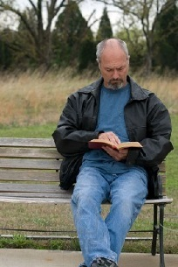
Conclusion
1 Timothy 6:6-12
Now godliness with contentment is great gain. For we brought nothing into this world, and it is certain we can carry nothing out. And having food and clothing, with these we shall be content. (6-8)
When we are CONTENTED Christians, then….
We will grow
Our families will grow
The church will grow

