Slide 1
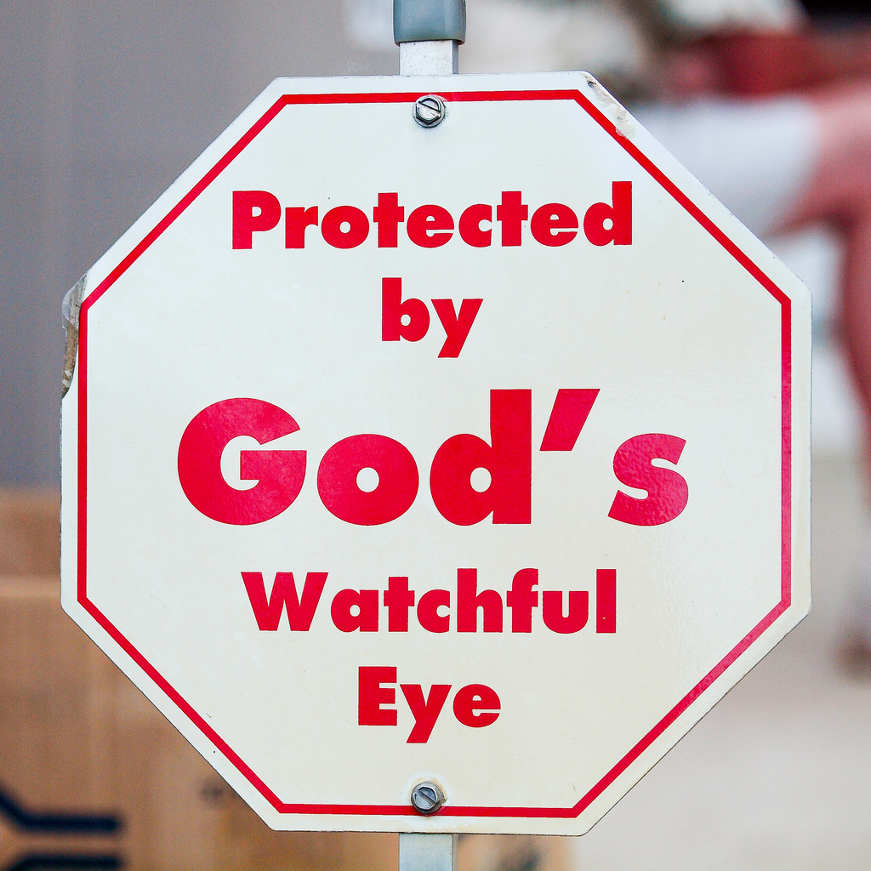
God’s Watchfulness
Daniel 6:1-10
Richie Thetford www.thetfordcountry.com

Slide 2
A Conspiracy Daniel 6:1-10
Darius’ organization
Dissatisfaction of the Governors
Governor’s invention
Daniel’s prostration
Lessons Learned
Proverbs 22:29; Proverbs 11:3
Proverbs 26:28; 1 Thessalonians 5:17; Psalms 55:17
Richie Thetford www.thetfordcountry.com

Slide 3
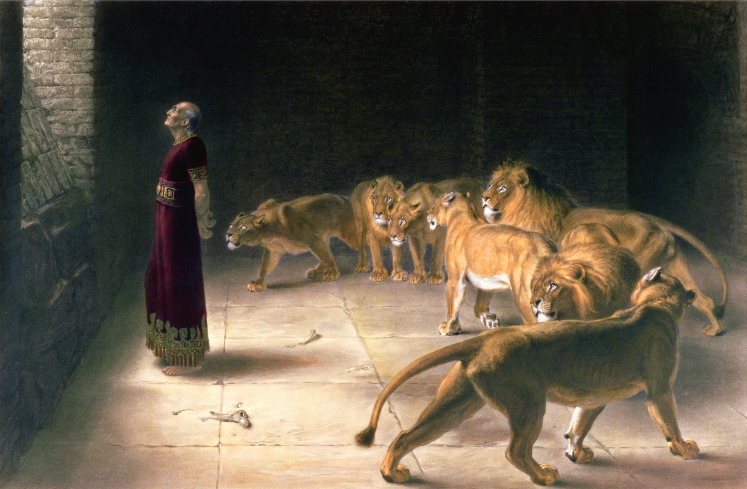
Confrontation and Condemnation Daniel 6:11-17
The plan consummated
Deliverance sought
Daniel condemned
Lessons Learned
Psalms 37:32; Psalms 35:21
Proverbs 16:20; Proverbs 25:2
Psalms 91:2; Proverbs 3:5-6
Richie Thetford www.thetfordcountry.com

Slide 4
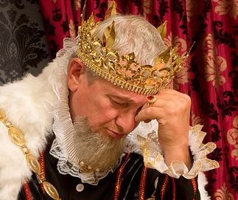
Conservation Daniel 6:18-23
The king’s anticipation
The King’s inspection
The king’s alleviation
Lessons Learned
Proverbs 24:17
Proverbs 13:12
Richie Thetford www.thetfordcountry.com

Slide 5
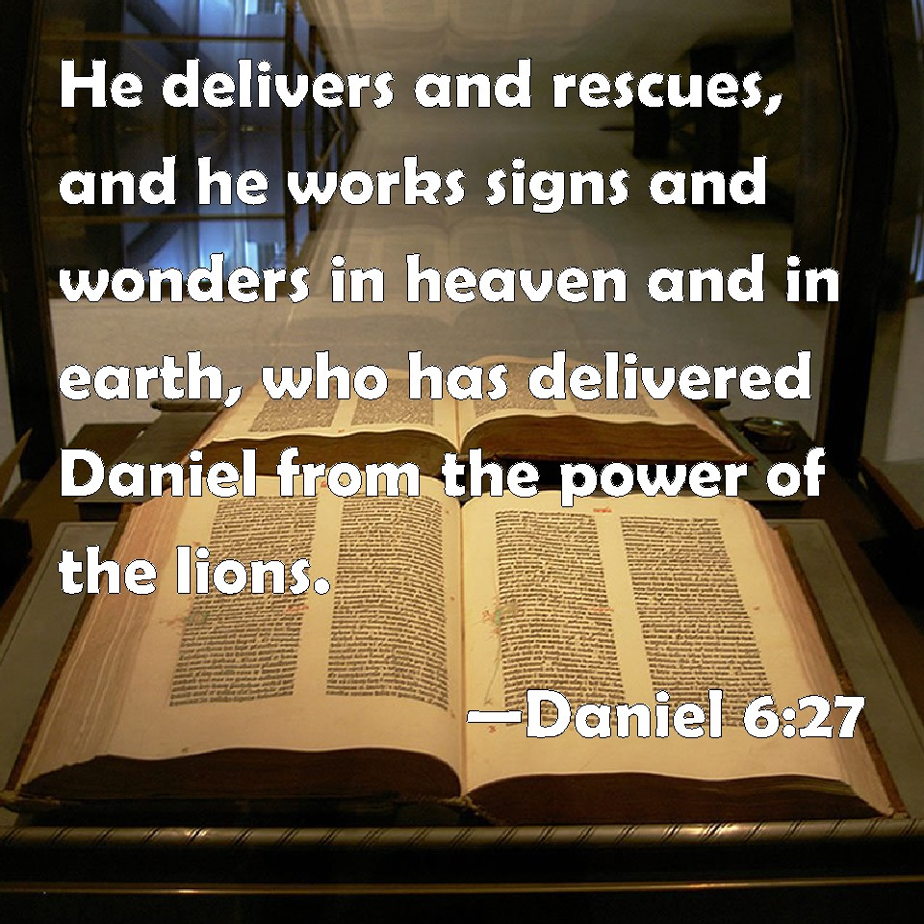
Consternation and Proclamation Daniel 6:24-28
The king’s anger
The King’s proclamation
Lessons Learned
Romans 13:3-4
Romans 1:20
Richie Thetford www.thetfordcountry.com

Slide 6
God’s Watchfulness
A conspiracy
Confrontation and Condemnation
Conservation
Consternation and Proclamation
Never waiver from our faith and steadfastness!
1 Corinthians 15:58
Richie Thetford www.thetfordcountry.com

