Slide 1
GOD’s
Existence
Richie Thetford www.thetfordcountry.com

Slide 2
The Humanist Manifesto
“We find insufficient evidence for belief in the existence of a supernatural; it is either meaningless or irrelevant to the question of the survival and fulfillment of the human race.”
--- Human Manifesto, II, p. 16
Richie Thetford www.thetfordcountry.com

Slide 3

If there is no God
There is no standard
Richie Thetford www.thetfordcountry.com

Slide 4
Creation – Without God’s Existence?
God’s creation a cosmos – not a chaos
  Design points to a supreme designer
  Existence of life – points toward God
Everything produces after its own kind – something can’t come from nothing!
“In the beginning God created the heavens and the earth” (Genesis 1:1)
Richie Thetford www.thetfordcountry.com

Slide 5
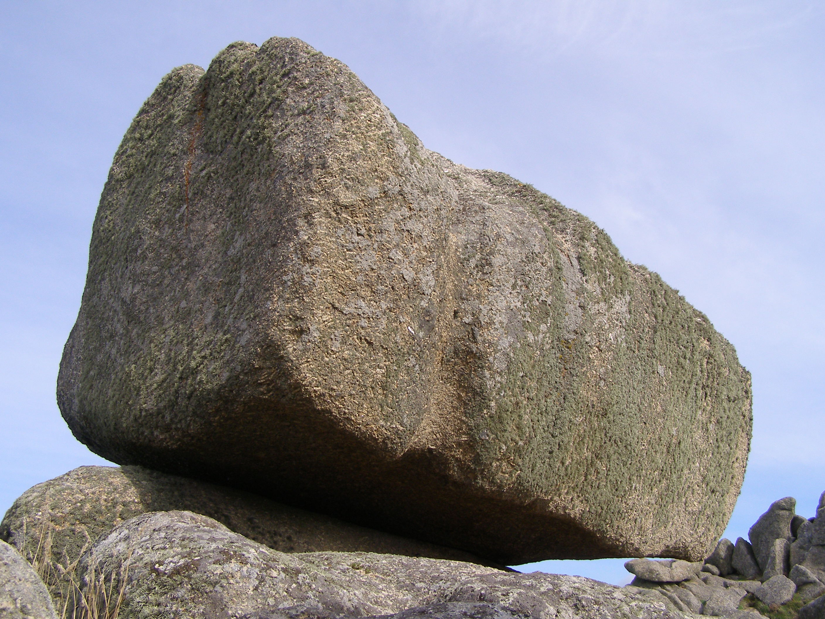
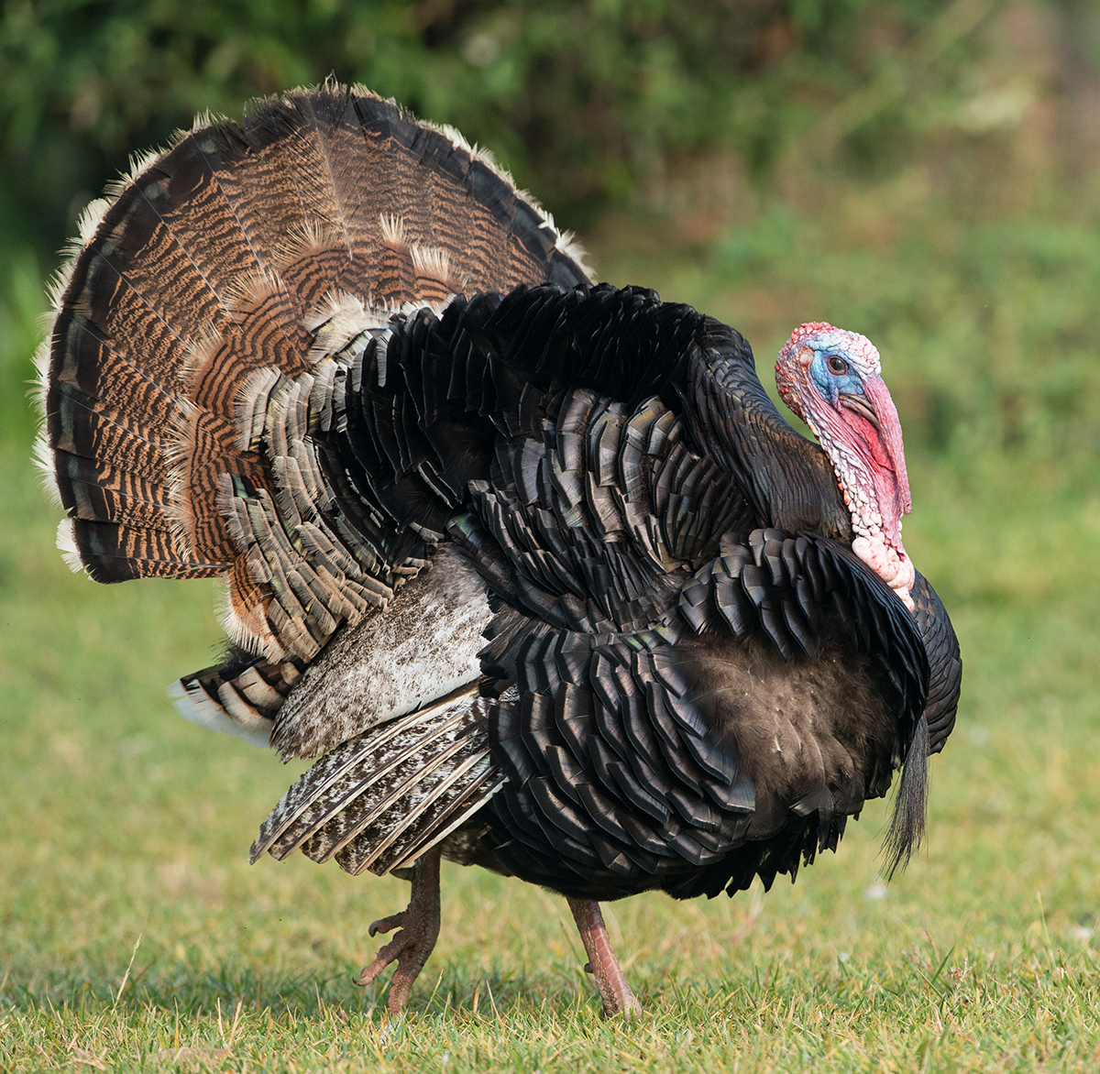
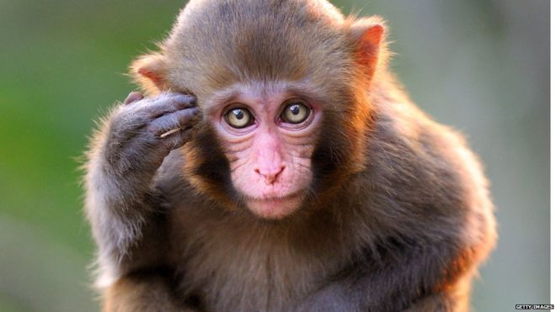
Creation – Without God’s Existence?
Conscience of man points to God
  Where did our conscience come from?
Rock? Turkey? Monkey?
…..it originated from God!
“In the beginning God created the heavens and the earth” (Genesis 1:1)
Richie Thetford www.thetfordcountry.com

Slide 6


Big Bang Watch Theory
Creation points toward God’s existence.
The most logical explanation of the universe
that we live in is the existence of God.
Richie Thetford www.thetfordcountry.com

Slide 7

The Bible Points Toward God’s Existence
No logical person denies the existence of the Holy Bible
  Contains things beyond the capability of unguided men
Written by 40 men over 1,600 years
  Unsurpassed unity
  Points to Jesus
    Genesis 12:1-3
“In the beginning God created the heavens and the earth” (Gen 1:1)
Richie Thetford www.thetfordcountry.com

Slide 8
The Bible Points Toward God’s Existence
New Testament announces the arrival of Jesus
  Closes with a promise (Revelation 2:10)
Contains prophecy
  Isaiah’s prophecy -- 700 years before
    Isaiah 7:14; 9:6; 53:4-6, 8
How did the author KNOW these things?
  Because God revealed them to him!
“In the beginning God created the heavens and the earth” (Genesis 1:1)
Richie Thetford www.thetfordcountry.com

Slide 9

Jesus Points to God’s Existence
No one can deny that Jesus lived
  Too much historical evidence
  New Testament documents
  are eyewitness accounts of
  His contemporaries
    John 20:25-31
Jesus demonstrates the very existence of almighty God!
“In the beginning God created the heavens and the earth” (Genesis 1:1)
Richie Thetford www.thetfordcountry.com

Slide 10
God’s Existence
The fool has said in his heart, “There is no God.” (Psalm 14:1)
Denial of the existence of God is related to an unwillingness to submit to God’s ethical standard
All will come to this realization at the judgment of Christ!
  2 Corinthians 5:10
There is a GOD!
Richie Thetford www.thetfordcountry.com

