Slide 1
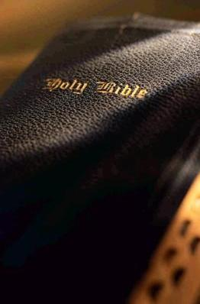
God versus Man – Then and Now
1 Kings 12:25-33

Slide 2
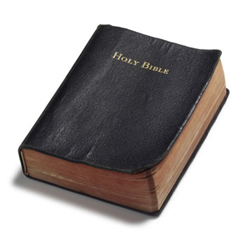
God’s Way versus Jeroboam’s Way
The object of worship
God’s way
Exodus 20:1-6
Jeroboam’s way
1 Kings 12:28-30
The place of worship
God’s way
Deuteronomy 12:10-14; 1 Kings 14:21
Jeroboam’s way
1 Kings 12:29

Slide 3
God’s Way versus Jeroboam’s Way
The feast
God ordained
Leviticus 23:33-38
Jeroboam ordained
1 Kings 12:32-33
The priests
God’s way
Numbers 3:5-13
Jeroboam’s way
1 Kings 12:31

Slide 4
God’s Way versus Jeroboam’s Way
The results
God’s blessing
Deuteronomy 11:26
God’s curse
1 Kings 12:30
1 Kings 13:1-5

Slide 5
Lord’s Church versus Denominations
The builder
Christ
Matthew 16:18
Psalms 127:1
Man
Boniface III, Calvin, Wesley Smyth, Smith, etc.

Slide 6
Lord’s Church versus Denominations
Name of the members
Divine
Acts 11:26
1 Peter 4:16
Human
Catholic, Presbyterian, Methodist, Baptist, etc.

Slide 7
Lord’s Church versus Denominations
The foundation
Sonship of Christ
Matthew 16:13-18
1 Corinthians 3:11
Doctrines of Men
Matthew 7:15-23
Matthew 15:8-9

Slide 8
Lord’s Church versus Denominations
Worship
As God directs
John 4:24
As one’s conscience directs, as long as he is sincere
Judges 17:6

Slide 9
Lord’s Church versus Denominations
Membership
Lord adds to the church
Acts 2:37-41,47
Join the church of your choice
Results
Has the Father and the Son
2 John 9
Has not God
2 John 9

Slide 10
Conclusion
Following the footsteps of Jeroboam or the steps of Christ
One can ONLY be right religiously when we listen to and obey the Word of God NOT THE WORDS OF MEN
“For the wages of sin is death, but the gift of God is eternal life in Christ Jesus our Lord.”
Romans 6:23

