Slide 1


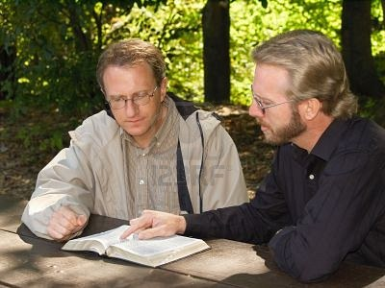
God has
spoken!
Hebrews 1:1-4
Richard Thetford www.thetfordcountry.com

Slide 2
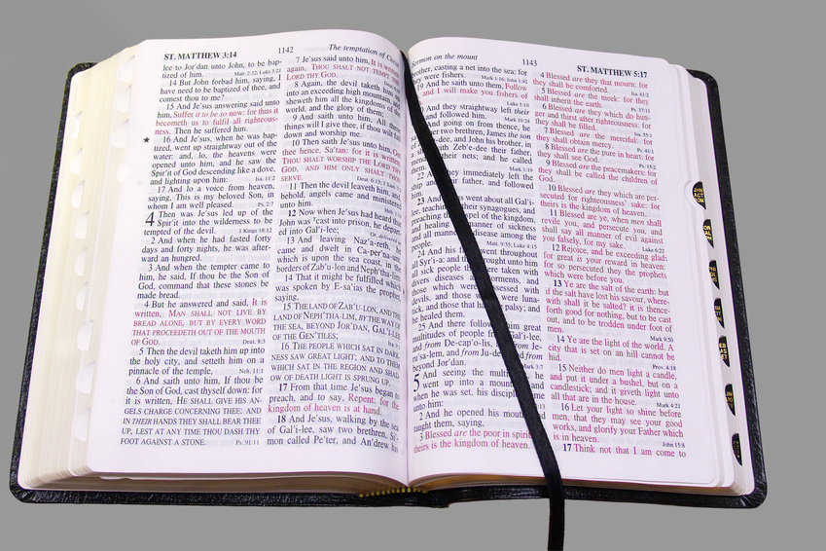
God has
spoken!
What does this really mean?
  Psalms 8:1-9
  Acts 17:24-27
God is the creator of ALL things!
He “has” spoken
  Ephesians 3:1-7; Jude 3
God’s message is complete and final!
  2 Timothy 3:16-17; John 20:30-31
Richard Thetford www.thetfordcountry.com

Slide 3

God's Word is
powerful!
“For the word of God is living and powerful, and sharper than any two-edged sword, piercing even to the division of soul and spirit, and of joints and marrow, and is a discerner of the thoughts and intents of the heart.”
Hebrews 4:12
World came through His spoken word
  Romans 1:16
Richard Thetford www.thetfordcountry.com

Slide 4

God's Word is
final!
Man is not able to change it
  John 12:48
Many standards in the religious world
  Creeds, traditions, opinions
When God speaks – we should listen
  Ecclesiastes 9:12
  Hebrews 5:9
  Matthew 7:21
Richard Thetford www.thetfordcountry.com

Slide 5
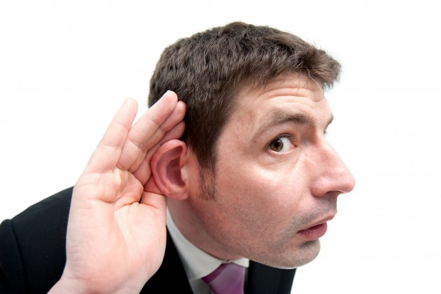
God has
spoken!
Have We Listened?
"And behold, I am coming quickly, and My reward is with Me, to give to every one according to his work.” Revelation 22:12
Richard Thetford www.thetfordcountry.com

