Slide 1
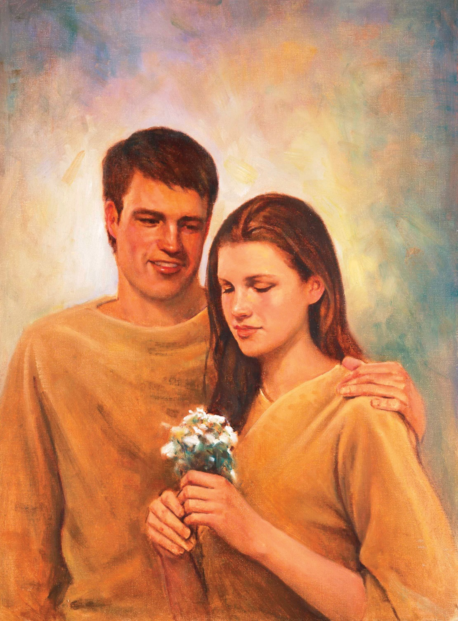
GOD
Demands
Obedience
Genesis 2:16-17
Genesis 3:1-13
Richard Thetford www.thetfordcountry.com

Slide 2
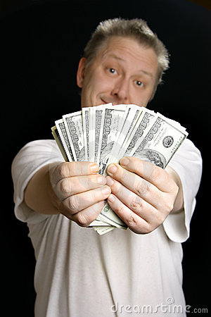
Receive
100,000.00!
Criteria
Come to the Bank
10-11 a.m.
Monday
Bring this Ad
Richard Thetford www.thetfordcountry.com

Slide 3
God Demands Obedience to His Word
Believe and be Baptized
Mark 16:16
Gospel is Saving News
1 Corinthians 15:1-3
Baptism is Essential
1 Peter 3:20-21
Repentance is Necessary
Acts 2:38; 17:30-31
Confession is Essential
Romans 10:9-10
Salvation
John 3:16
1 John 2:2
Ephesians 3:8-11
Colossians 1:23
Richard Thetford www.thetfordcountry.com

Slide 4
God Expects Results from His Letter
“Never Heard the Truth”
2 Thessalonians 1:8
“Didn’t Understand”
Ephesians 3:3-4; 5:17
“Baptism Not Necessary”
Acts 2:38; 22:16; Galatians 3:27
“Married to Faithful Christian”
2 Corinthians 5:10; Romans 14:12
“Judged Christians by Others”
Matthew 4:8-10
“I Can Serve More than One”
Matthew 6:24
From ALL Men
Luke 13:22-30
"BUT...."
HELL
Rom 2:8-9
Richard Thetford www.thetfordcountry.com

Slide 5

Receive
ETERNAL LIFE
Criteria
Come to Me
Matthew 11:28
Be Baptized
Mark 16:16
Do My Will
Matthew 7:21
GOD
Says:
Richard Thetford www.thetfordcountry.com

