Slide 1
“second mile” religion
Matthew 5:41
Matthew 5:39-40
Richie Thetford www.thetfordcountry.com

Slide 2
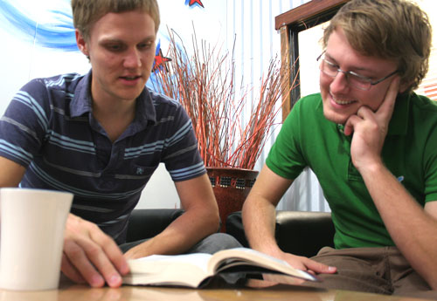
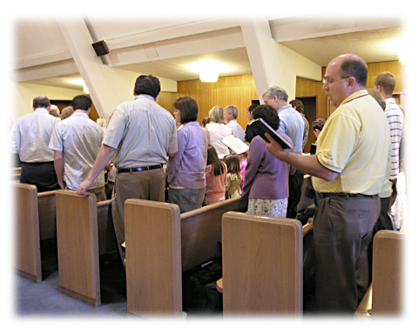
“second mile” religion
Bible Study
  2 Timothy 2:15
  2 Timothy 2:2
  Hebrews 5:12-13
Worship
  Acts 20:7
  Matthew 6:33
  Hebrews 10:25
  James 4:17
Richie Thetford www.thetfordcountry.com

Slide 3



“second mile” religion
Sin
  1 John 1:9
  Romans 6:1-2
Forgiveness
  Luke 17:4
  Matthew 18:21-22
Love
  Matthew 5:43
  Matthew 5:44
Richie Thetford www.thetfordcountry.com

Slide 4


“second mile” religion
Modest Apparel
  1 Timothy 2:9
  Matthew 18:6-7
Evil
  3 John 11
  1 Thessalonians 5:22
Richie Thetford www.thetfordcountry.com

Slide 5
“second mile” religion
HEAVEN – Don’t miss it for the WORLD!
“Whatever your hand finds to do, do it with your might; for there is no work or knowledge or wisdom in the grave where you are going.” Ecclesiastes 9:10
Richie Thetford www.thetfordcountry.com

