Slide 1
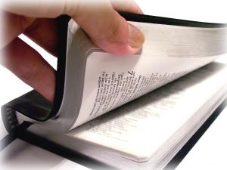
Giving thanks to our god
Romans 1:21
Luke 17:15-19

Slide 2
Giving thanks to our god
King David – a celebration
of thanksgiving
  1 Chronicles 15:26-28
  1 Chronicles 16:4-7
We should give thanks
  Psalms 96
  1 Chronicles 16:23-33

Slide 3
Giving thanks to GOD IN SONG
Expression of our thanks to Him
  Ephesians 5:19-20
  Colossians 3:16

Slide 4
Giving thanks in worship
Thankful for the power of God
  Psalms 96:2-9
Thank Him for salvation
  Psalms 71:15
  Exodus 15:1-2
  Acts 4:12

Slide 5
Giving thanks in worship
He is glorious and we honor Him
  Psalms 96:3
  Psalms 29:2
  Psalms 72:19
Surrounded
us with
beauty
  Psalms 40:5

Slide 6
Giving thanks in worship
Our response to God
  Psalms 96:4-5
Thankful for the dignity of God
  Psalms 96:6-8

Slide 7
Thankful for His judgments
Are righteous
  Romans 2:5
We judge based
on God’s judgment
  John 7:24
  Romans 2:1-4
God’s judgments are
according to truth
  Psalms 96:13

Slide 8
conclusion
Remembering David’s thanksgiving during a moment of great blessing helps us be “thanksgivers” to God
“rooted and built up in Him and established in the faith, as you have been taught, abounding in it with thanksgiving.”
Colossians 2:7

