Slide 1
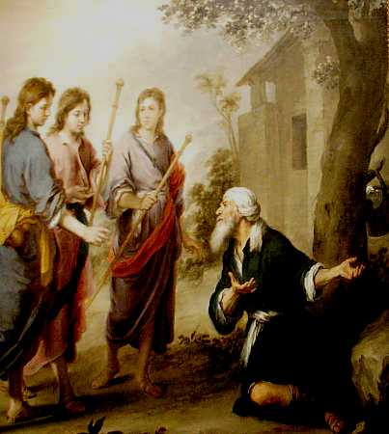
Given To Hospitality
Genesis 18:1-8
Ephesians 4:32
Hospitality: “the act, practice, or quality of being hospitable; solicitous entertainment of guests”

Slide 2
Given to Hospitality
Bible teaches the responsibility for every Christian to be hospitable
“distributing to the needs of the saints, given to hospitality.” Romans 12:13
And above all things have fervent love for one another, for “love will cover a multitude of sins.” Be hospitable to one another without grumbling.
1 Peter 4:8-9

Slide 3
A Duty of the Elders
Cannot lead without knowing the needs of others in the congregation
Titus 1:8-9
1 Timothy 3:2
Flock needs to know the elders also
1 Thessalonians 5:12-14

Slide 4
A Duty of Every Christian
Must know one another to bear one another’s burdens
Galatians 6:2
1 Corinthians 5:11
One who shows hospitality is blessed
“Do not forget to entertain strangers, for by so doing some have unwittingly entertained angels.” Hebrews 13:2

Slide 5
Some Results of Hospitality
Helps in converting the lost
Meet and greet visitors and other members
Helps prevent apostasy
Evil companions corrupt good morals
1 Corinthians 15:33
Luke 22:54-62
Helps prevent division
Can’t ignore others – must have a good attitude
Galatians 5:19-21
2 Corinthians 12:20

Slide 6
Conclusion
Must enjoy being with one another for others to want to associate with us
God’s Word teaches us to be hospitable
be “given to” hospitality

