Slide 1
Give Thanks to God
Psalm 96
Psalm 100
Luke 17:11-19
Romans 1:21
1 Chronicles 15:26-28
Richie Thetford www.thetfordcountry.com

Slide 2
We Give Thanks to God in Song
Ephesians 5:19-20
Colossians 3:16
Richie Thetford www.thetfordcountry.com

Slide 3
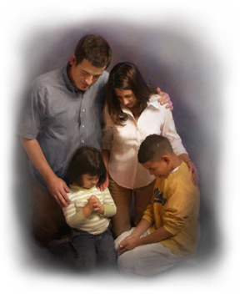
We Give Thanks to God for Blessings
Psalms 71:15
Exodus 15:1-2
Acts 4:12
Psalms 29:2
Psalms 40:5
Richie Thetford www.thetfordcountry.com

Slide 4
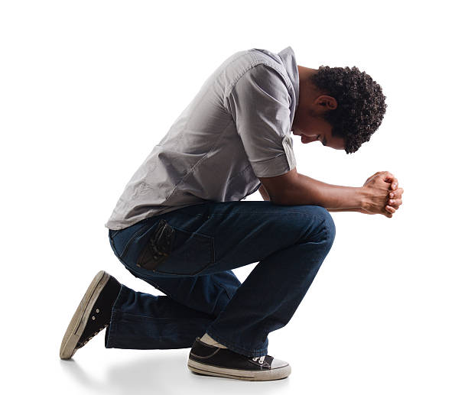
Give Thanks for His Judgments
Romans 2:5
John 7:24
James 2:1-4
Romans 2:2
1 Chronicles 13:7-11; 15:13
Richie Thetford www.thetfordcountry.com

Slide 5
Remember and be THANKFUL
Colossians 2:7
Philippians 4:6
Revelation 7:12
Richie Thetford www.thetfordcountry.com

