Slide 1
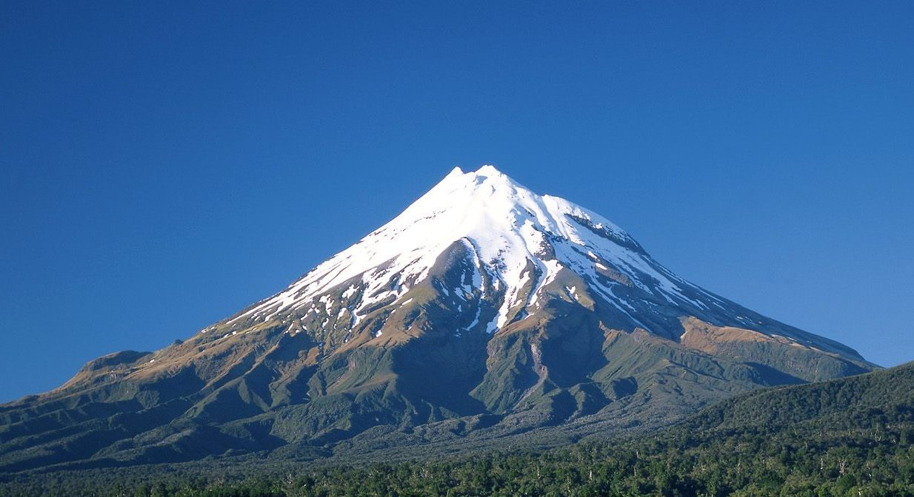
Joshua 14:6-13; 15:13-14
Give Me This Mountain!

Slide 2
The Man The mountain the Message
Give Me This Mountain!
CALEB

Slide 3
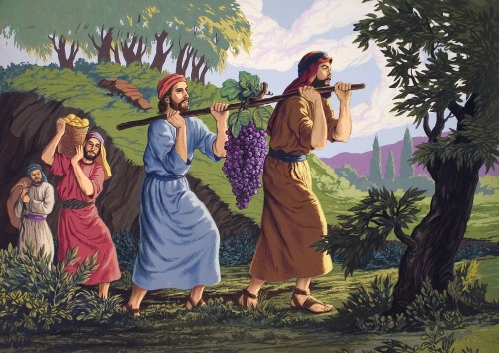
The man
CALEB
A recognized leader
Numbers 13:1-3
A man of courage
Numbers 13:21, 30
Joshua 15:13-14
Dedicated to the cause
Numbers 13:3
Man of faith and trust
Numbers 13:26-30; 14:8-9

Slide 4
The mountain
CALEB
“Now therefore give me this mountain”
Joshua 14:12
Hill country belonged to sons of Anak
Numbers 13:33
Two things in the mountains of Hebron:
A challenge to Caleb’s faith
An opportunity for God to demonstrate His faithfulness to keep His promises

Slide 5
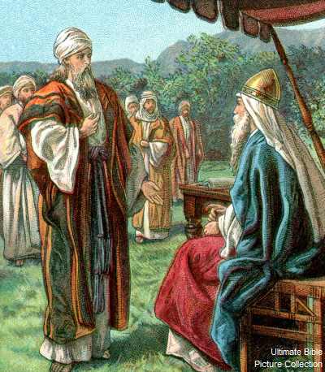
The message
CALEB
A lesson in character
Courage
2 Timothy 1:6-8
2 Timothy 1:12
Faith
Hebrews 11:6
Matthew 6:33
Matthew 7:7-8
Caleb’s key to success is our key to success

Slide 6
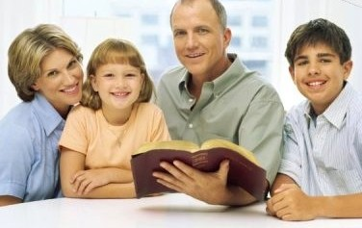
conclusion
CALEB
We don’t have to be afraid to face our mountains in life!
Matthew 17:20
We can’t hold back, doubt or waver!
James 1:6-8
Matthew 7:21

Slide 7
Joshua 14:8,14
Give Me This Mountain!
“Nevertheless my brethren who went up with me made the heart of the people melt, but I wholly followed the LORD my God…….Hebron therefore became the inheritance of Caleb the son of Jephunneh the Kenizzite to this day, because he wholly followed the LORD God of Israel.”

