Slide 1

From Earth to Heaven
“Therefore, since all these things will be dissolved, what manner of persons ought you to be in holy conduct and godliness”
2 Peter 3:11

Slide 2

Live a Christ-Like Life
Christ is our example
  1 Peter 2:21
  Philippians 2:3-5
  Acts 10:38
Jesus’ life and teaching
  Cared enough to die for us
  Loved unconditionally
  Did His Father’s will

Slide 3

Strive to Save Our Family
Noah – A preacher of righteousness
  2 Peter 2:5
  1 Peter 3:20
Joshua
  Joshua 24:15
The world and the church
  Genesis 18:19
  Ephesians 6:4

Slide 4

Be Committed to the church of Christ
Never be ashamed of it
  Acts 20:28
  1 Corinthians 15:25
When Christ returns:
  The church of Christ,
  the church belonging to
  Christ, His church, will
  be delivered to His Father
    1 Corinthians 15:24

Slide 5

Strive for Unity
Make it our aim to
have unity
  Ephesians 4:1-6
Church must function
in unity
  Acts 5:29

Slide 6
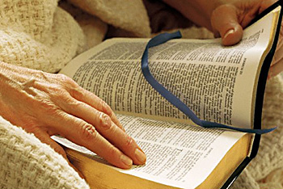
Must Be in the Book of Life
Our journey is being recorded
  Exodus 32:32
  Philippians 4:3
Only the redeemed are included
  Revelation 20:11-15:
The way we live our life from this day forward
will determine where we will spend our eternity!
Revelation 2:10

