Slide 1
4 Fundamental Needs
Need to Know
Need to Grow
Need to Glow
Need to Go
Richie Thetford www.thetfordcountry.com

Slide 2
Need to Know
Need more knowledge of God’s Word
Hosea 4:6
Romans 15:14
1 Corinthians 15:34
Ephesians 4:13
Colossians 1:9-10
John 8:32
Acts 17:11
“Study to shew thyself approved unto God, a workman that needeth not to be ashamed, rightly dividing the word of truth.”
2 Timothy 2:15
Richie Thetford www.thetfordcountry.com

Slide 3
Need to Grow
Physically and Spiritually
1 Peter 2:2
Hebrews 5:12-14
“but grow in the grace and knowledge of our Lord and Savior Jesus Christ. To Him be the glory both now and forever…” 2 Peter 3:18
Richie Thetford www.thetfordcountry.com

Slide 4
Need to Glow
Radiate knowledge and growth in life!
Glow defined:
“to shine with intense or white heat; be animated; light; earnestness; ardor.” (Webster)
Philippians 2:15
1 Thessalonians 5:5
“Let your light so shine before men, that they may see your good works and glorify your Father in heaven.”
Matthew 5:16
Richie Thetford www.thetfordcountry.com

Slide 5
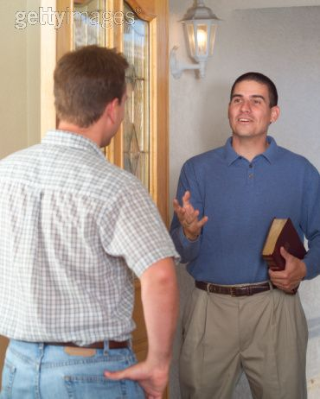
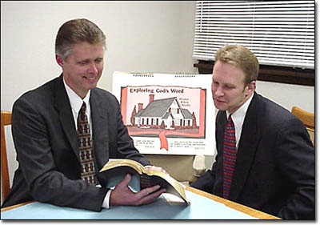
Need to Go
We are saved to save!
First word in the great commission – “Go”
Matthew 28:19-20
Preach the gospel to everyone
Mark 16:15-16
Luke 9:59-62
Before one can be saved – must hear
Romans 10:12-17
Richie Thetford www.thetfordcountry.com

Slide 6
Summary
KNOW
Study and put into practice the Word of God
GROW
Don’t stay on the milk of the Word – Grow in knowledge
GLOW
Be excited about being a Christian – Let others see our light!
GO
The gospel truly is the good news of salvation!
Richie Thetford www.thetfordcountry.com

