Slide 1
Esther 4:13-17
Richie Thetford www.thetfordcountry.com

Slide 2
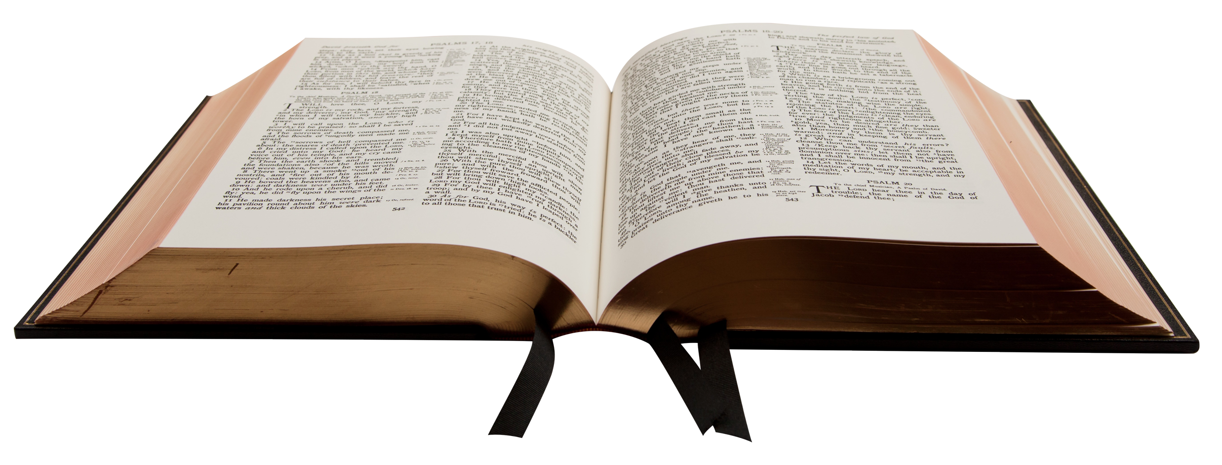
For such a time as this
A time when people had little or no respect for life
Esther 4:11
Esther 3:5-6
Richie Thetford www.thetfordcountry.com

Slide 3
For such a time as this
A time when pleasure was the order of the day
Esther 1:8
Luke 8:14
Matthew 6:33
Richie Thetford www.thetfordcountry.com

Slide 4
For such a time as this
A time for divorce for any cause
Esther 1:17-19
Matthew 5:32
Matthew 19:9
Richie Thetford www.thetfordcountry.com

Slide 5
For such a time as this
A time for strong drink
Esther 1:10-11
Proverbs 20:1
Isaiah 5:11
1 Peter 4:3
Richie Thetford www.thetfordcountry.com

Slide 6
For such a time as this
A time for wickedness
Esther 1:7
Genesis 13:13
Proverbs 11:10
Richie Thetford www.thetfordcountry.com

Slide 7
For such a time as this
A time for gross immodesty
1 Timothy 2:9-10
2 Peter 2:14-15
Matthew 5:28
Richie Thetford www.thetfordcountry.com

Slide 8
For such a time as this
A time of pride
Esther 3:5-6, 14
Proverbs 16:18
Mark 7:21-23
1 Timothy 3:6
Richie Thetford www.thetfordcountry.com

Slide 9
For such a time as this
A time for providence
Esther 6:1
Proverbs 16:18
Mark 7:21-23
1 Timothy 3:6
Richie Thetford www.thetfordcountry.com

Slide 10
God is always in control
Richie Thetford www.thetfordcountry.com

