Slide 1
Fellowship
“sharing things in common with others”
1 John 1:5-10
Defined: “A community of interest, activity, feeling, or experience; the state of being a fellow or associate; a company of equals or friends.”
Richie Thetford www.thetfordcountry.com

Slide 2
Fellowship with God and Christ
Raised our status through the death and resurrection of Jesus
Ephesians 2:4-7
Believers share a relationship with God
1 Peter 1:15
Richie Thetford www.thetfordcountry.com

Slide 3
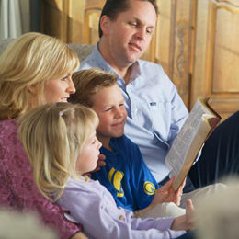
Fellowship with God and Christ
Our fellowship is with Christ as He had with His Father
John 17:21-23
John 15:1-8
Learn to have proper fellowship through the Word of God
1 John 1:3
Ephesians 5:1-2
Romans 8:1
Richie Thetford www.thetfordcountry.com

Slide 4
Fellowship with the Righteous
Must have fellowship with like believers
Psalms 119:63
Philippians 2:1-2
“Can two walk together unless they are agreed?” Amos 3:3
Richie Thetford www.thetfordcountry.com

Slide 5
Fellowship with the Wicked
Believers should not have fellowship with unbelievers
Matthew 28:16-20; 1 Corinthians 9:16-17
Does not mean that believers should have nothing to do with unbelievers
Richie Thetford www.thetfordcountry.com

Slide 6
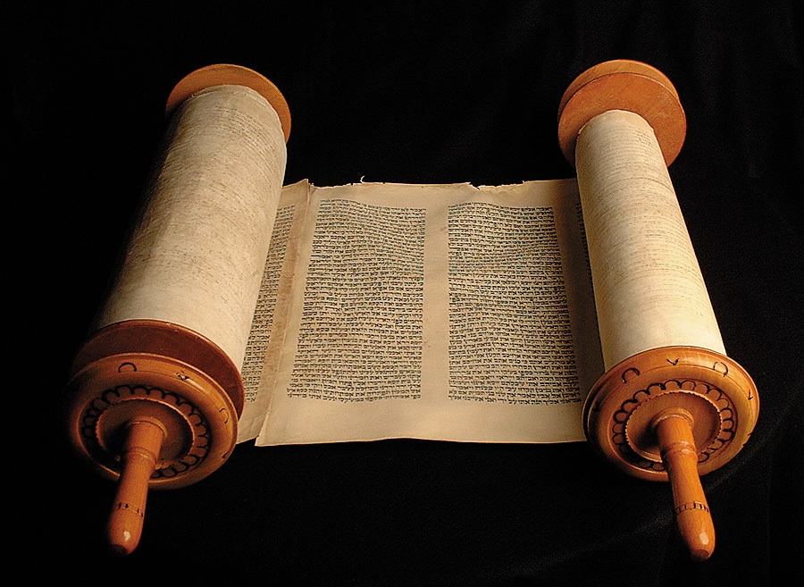
Fellowship with the Wicked
We can learn from the Old Testament:
God taught man that in ALL things we must be pleasing to Him first
If not, then we are not in fellowship with Him
Old Testament Instructions:
Exodus 34:13-16
Richie Thetford www.thetfordcountry.com

Slide 7
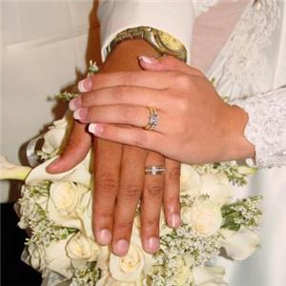
Fellowship with the Wicked
We can be led away through marriage relationships
Deuteronomy 7:2-4
Joshua 23:12-13
2 Corinthians 6:14-18
Ephesians 5:6-11
1 Corinthians 15:33
2 Peter 3:17
Am I doing what is best for my soul?
Richie Thetford www.thetfordcountry.com

