Slide 1

The Fear of the Lord
Richie Thetford www.thetfordcountry.com

Slide 2
The Fear of the Lord
The early church:
The church at Philippi:
Then the churches throughout all Judea, Galilee, and Samaria had peace and were edified. And walking in the fear of the Lord and in the comfort of the Holy Spirit, they were multiplied. (Acts 9:31)
Therefore, my beloved, as you have always obeyed, not as in my presence only, but now much more in my absence, work out your own salvation with fear and trembling (Philippians 2:12)
Richie Thetford www.thetfordcountry.com

Slide 3
The Fear of the Lord
Job’s discourse:
What do you think about when you hear the words “fear of the Lord” or “fear and trembling?”
And to man He said, “Behold, the fear of the Lord, that is wisdom, And to depart from evil is understanding.” (Job 28:28)
And do not fear those who kill the body but cannot kill the soul. But rather fear Him who is able to destroy both soul and body in hell. (Matthew 10:28)
Richie Thetford www.thetfordcountry.com

Slide 4

The Fear of the Lord
Three points:
Define the “fear of the Lord”
Why the “fear of the Lord” is important to the Christian
How we can develop a healthy “fear of the Lord”
Richie Thetford www.thetfordcountry.com

Slide 5
Defining the “Fear of the Lord”
“Fear”
Hebrew: “YIRAH”
Fear, terror, awesome or terrifying thing (object causing fear)
Greek: “PHOBOS”
Fear, dread, terror, that which strikes terror
“Fear of the Lord” defined as “Reverence or Awe”
Also should include a place for “trembling!”
Greek for “trembling”: “TROMOS”
“a trembling or quaking with fear”
Richie Thetford www.thetfordcountry.com

Slide 6
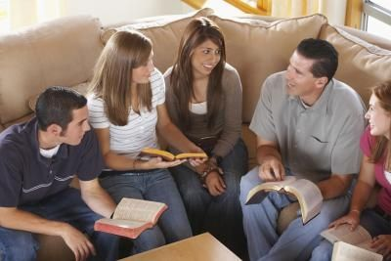
Defining the “Fear of the Lord”
A proper “Fear of the Lord” would include:
A reverence and awe
Being afraid to offend God
A trembling if one knew that they offended God and have not obtained His forgiveness
Hebrews 10:26-27
Hebrews 10:30-31
Hebrews 12:28-29
Richie Thetford www.thetfordcountry.com

Slide 7
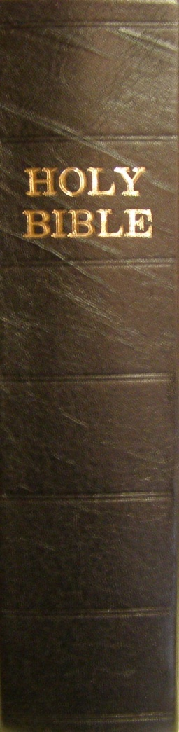
Importance of the “Fear of the Lord”
From the book of Proverbs the “fear of the Lord”:
Is the beginning of knowledge (1:7)
Will cause one to hate evil (8:13)
Will prolong life (10:27)
Provides strong confidence (14:26-27)
Prompts one to depart from evil (16:6)
Leads to a satisfying life (19:23)
Is the way to riches, honor, life (22:4)
Richie Thetford www.thetfordcountry.com

Slide 8
Importance of the “Fear of the Lord”
Without the “fear of the Lord”:
We close ourselves of God’s wisdom
We flirt with evil and be corrupted by it
Our lives may be shortened
We will never come to know the love of God
We will not be motivated to repent of sin
We will not be motivated to “work out our own salvation”
Richie Thetford www.thetfordcountry.com

Slide 9
Importance of the “Fear of the Lord”
Without the “fear of the Lord”:
We cannot please God
Isaiah 66:1-2
Only the one who “trembles” at God’s word has God’s promise to receive His mercy
But the mercy of the Lord is from everlasting to everlasting On those who fear Him, And His righteousness to children's children, To such as keep His covenant, And to those who remember His commandments to do them. (Psalms 103:17-18)
Richie Thetford www.thetfordcountry.com

Slide 10
Developing the “Fear of the Lord”
The “fear of the Lord” comes through the word of God
The purpose: to “fear the Lord”
Deuteronomy 31:10-13
As one reads the word of God, one gains a “fear of the Lord”
Romans 2:4-11
2 Peter 3:7-14
The word of God, properly used, will maintain a proper balance
Richie Thetford www.thetfordcountry.com

Slide 11
Conclusion
God is greatly to be feared in the assembly of the saints, And to be held in reverence by all those around Him. (Psalms 89:7)
Why do we need to “fear the Lord?”
To work out our own salvation with “fear and trembling”
Hebrews 4:1-2, 11
Therefore, having these promises, beloved, let us cleanse ourselves from all filthiness of the flesh and spirit, perfecting holiness in the fear of God. (2 Corinthians 7:1)
Richie Thetford www.thetfordcountry.com

